Slide 1
Smoke Alarm Installation Program
NC Office of State Fire Marshal
Injury Prevention Division

Slide 2
Everyone Installing Alarms Should Review This Presentation.
To ensure there are working smoke alarms in every home in your community and all occupants have and practice an escape plan.
To be able to correctly install and explain alarm specifications to occupant
To understand and be able to explain symptoms of CO poisoning and CO safety tips.
When ready use right arrow button below to advance to the next slide.

Slide 3
Neighborhood Canvassing Tips
Alert residence in advance that you will be installing alarms with door hangers, flyers, public service announcements, etc.
Go into homes in pairs and not alone
Have occupant go with you to each room where installing alarms
Educate residence on fire prevention and CO safety
Watch video for “how to” canvassing tips http://www.ncdoi.com/OSFM/RPD/PT/Videos_Prevention.aspx?video=ymYMxjtcMSo&Name=Smoke Alarm Canvassing Program

Slide 4
About the Alarms
The alarms being provided are 10 year Lithium Battery Tamper Proof Smoke Alarm.
Made to last ten-years, and then replace the alarm.
A sealed unit prevents removal of the lithium battery.
Once activated the batteries will supply power to the alarm for the life of the alarm (10 years).
Caution residents that these alarms and batteries are sealed. The cover is not removable!

Slide 5
Placement of Alarms
  Alarms are to be installed and not handed to occupant
  Install an alarm in these locations:
  Outside each separate sleeping area.
  Inside each bedroom
  Each level of the home
  Include the basement.
Maximum 6 alarms per home with this grant

Slide 6
Avoid these areas
Garages- Products of combustion are present
Kitchens -Normal cooking may cause nuisance alarms. Avoid 3’ of door to kitchen
Bathrooms -Moisture/steam can cause nuisance alarms- Avoid installing 3’ of the bathroom door with tub and shower
Most attics, unless used as sleeping area
Air supply ducts for heating or cooling
Fluorescent lights may cause nuisance alarms

Slide 7
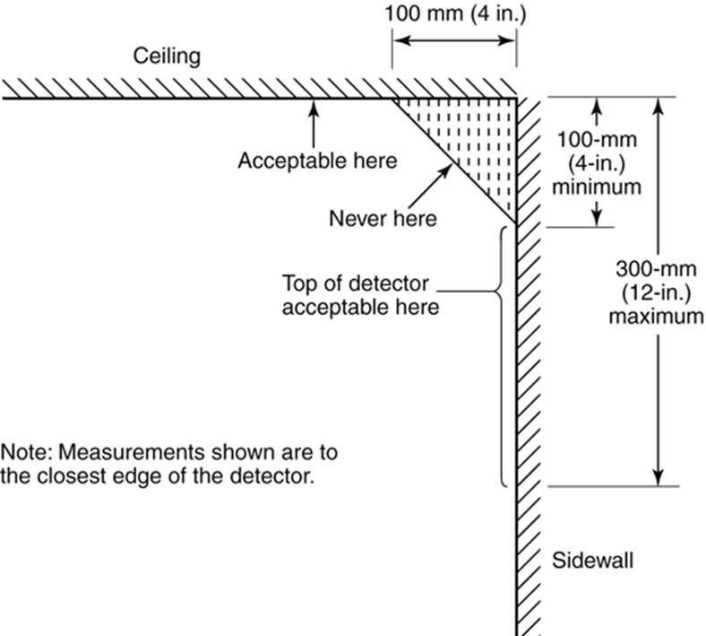
Where to place alarms
Mounting the alarm on the ceiling in the center of the room places it closest to all points in the room.

Slide 8
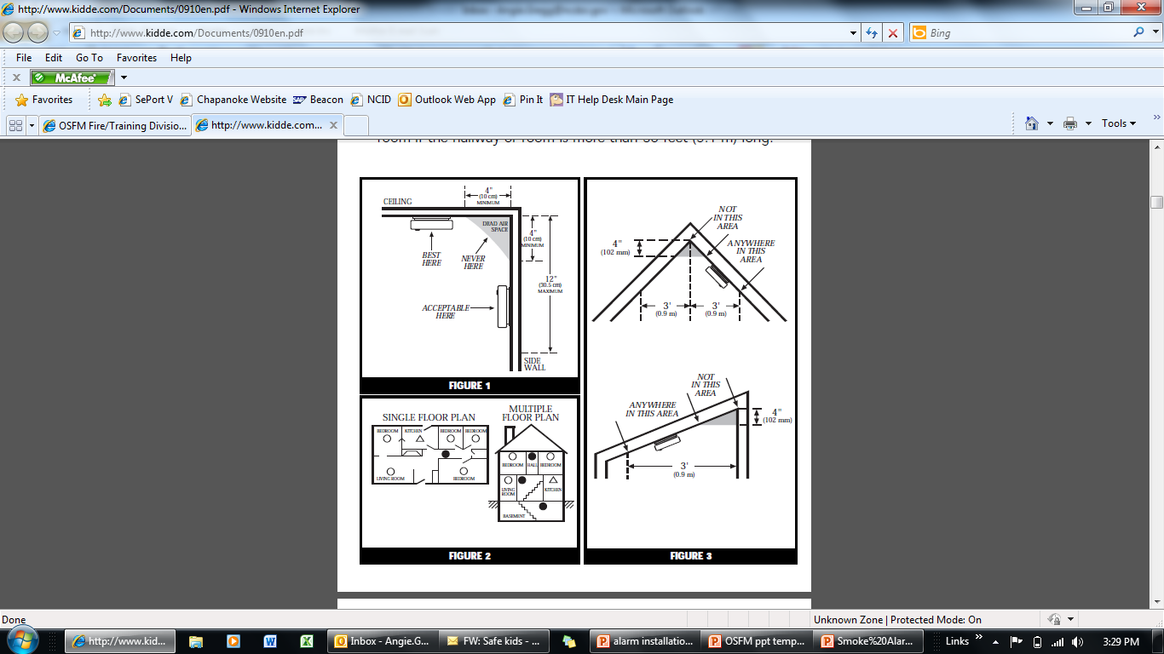
Where to place alarms

Slide 9
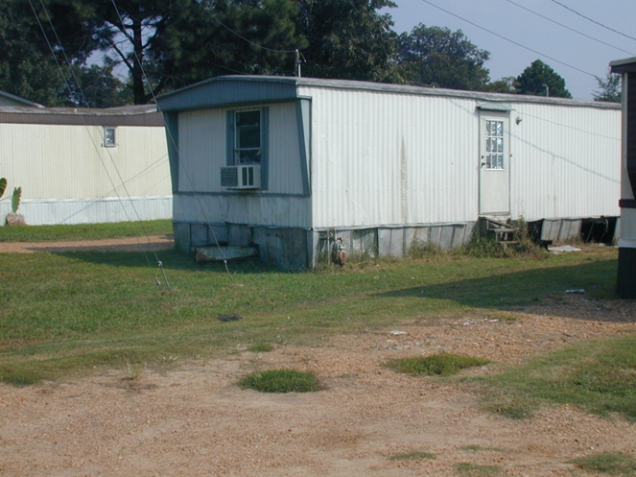
Mobile Homes
Many older mobile homes built before 1978 have little or no insulation compared to present standards. If there is little insulation or if you are unsure about insulation, install the alarms on the walls. Extreme heat or cold can be transferred from the outside to the inside through poorly insulated walls and roof. This may create a thermal barrier which can prevent the smoke from reaching an alarm mounted on the ceiling. In such units install the smoke alarm on an inside wall.

Slide 10
Equipment Needed
Smoke Alarms
Step Ladder
  Power Drill
    3/16 drill bit
Hammer, Screwdriver
Clipboard/portfolio
Waiver Forms
Survey Forms
Educational material

Slide 11
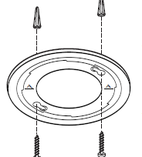
Securing Alarm
Select location
Attach mounting bracket
  Place bracket on wall
  3/16” drill for anchor
  Anchor, screws to mount
Be sure bracket is mounted correctly before installing alarm
Write installation date on alarm

Slide 12
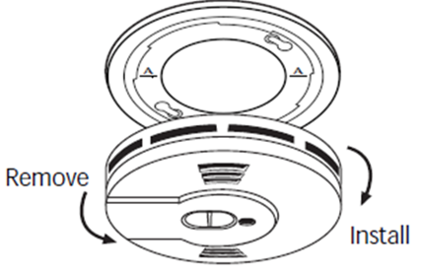
Activate Alarm
Install alarm on the mounting bracket
Rotate alarm clockwise and alarm ratchets into place
The alarm is now activated
Model equipped with feature that automatically activates the alarm when mounted in bracket first time
Test alarm by holding down test button for 5 sec or until alarm sounds

Slide 13
Nuisance Alarms
These smoke alarms are designed to minimize nuisance alarm.
SMART HUSH will silence alarm for approximately 8 minutes
Tell resident to use only when source of smoke is identified, such as smoke from cooking
Dense smoke will override the SMART HUSH
Explain to occupant that if the alarm sounds check for fire first. If fire is discovered, get out and call the fire department.

Slide 14
Testing and Maintenance
Show resident how to test the alarms
Instruct the resident to test monthly by pushing test button and holding minimum of 5 seconds or until alarms sounds
Give cleaning instructions
  At least once a year, Vacuum, Clean cloth
Leave smoke alarm instructions with resident.

Slide 15
Testing and Maintenance of Existing Alarms
Check date on existing alarm
Replace all battery operated alarms 10 years old (Hardwired alarms over 10 years old also need to be replaced by electrician)
Test the alarms
Immediately replace smoke alarm that does not respond properly when tested.
  If no alarm sounds, the unit has defective batteries or other failure.
Change battery if over a year old

Slide 16
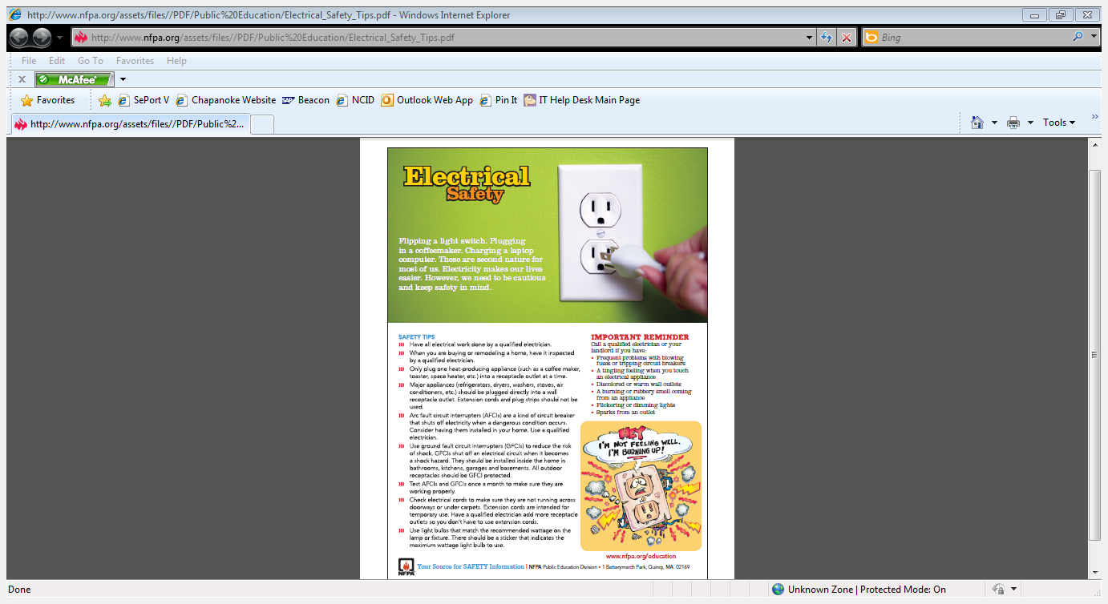
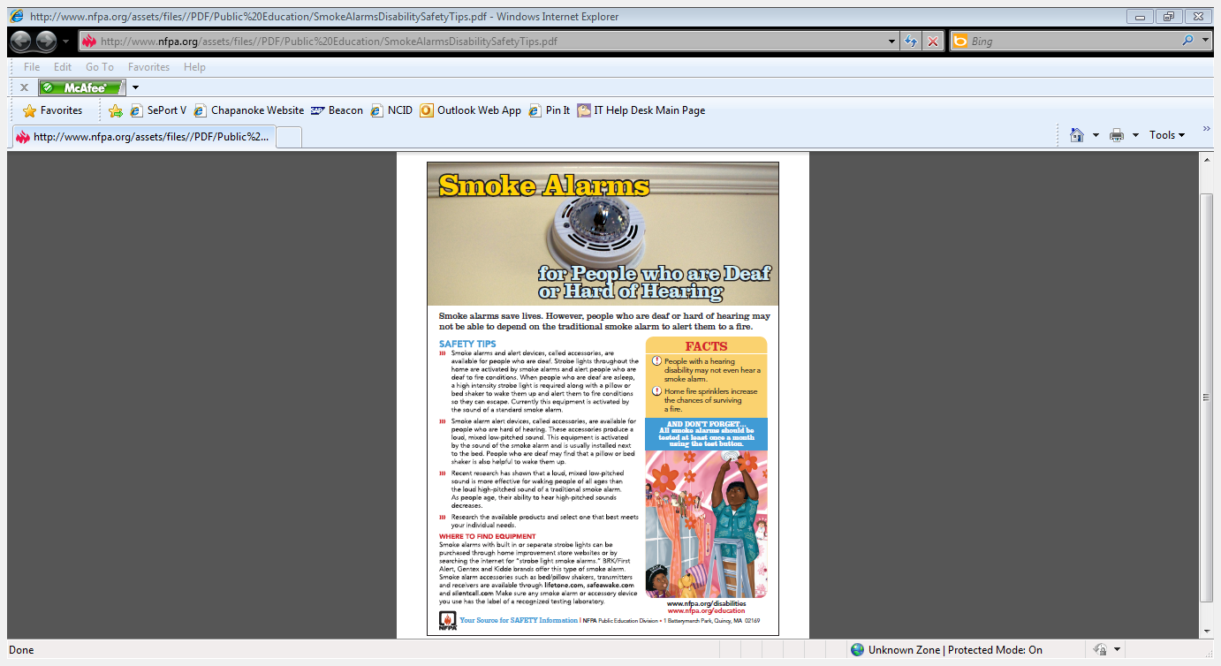
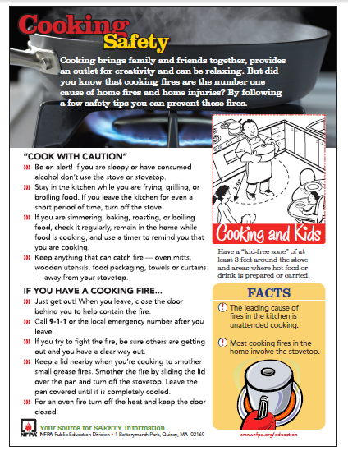
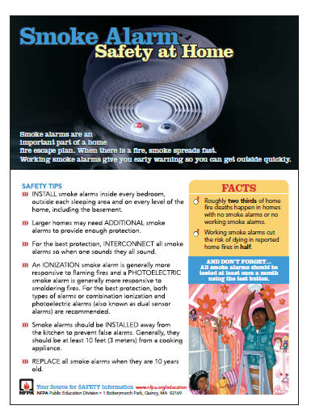
Fire Safety Materials
You can download, print and leave these safety sheets with occupant from www.nfpa.org

Slide 17
Plan of Escape
Discuss having a family meeting and develop an escape plan.
Explain importance of having at least 2 ways out of each room.
Help resident determine a meeting place outside the home where all can meet if fire occurs.

Slide 18
Survey and Waiver
In order to track where alarms are being installed and to be able to report to our funding sources you must complete online Survey form.
Submit Survey Forms online within 30 days of installation
Have resident fill out and sign waiver form
Maintain the Survey Form and Waiver form in your records.

Slide 19
Defective Alarm
If you have an Alarm that will not test properly
  Hold test button for at least 5 seconds for alarm to sound
Contact your Regional Injury Prevention Specialist
Alarms will be returned to Kidde for additional testing

Slide 20
Carbon Monoxide (CO)
Safety Tips
Visit www.cpsc.gov for additional CO safety tips, videos, resources, posters, flyers, etc.
Have your home heating systems inspected and serviced annually
Never use portable generators inside homes or garages.
Never bring a charcoal grill into the house for heating or cooking. Do not barbeque in the garage.

Slide 21
Carbon Monoxide (CO) Safety Tips
Never use a gas range or oven for heating.
Open the fireplace damper before lighting a fire and keep it open until the ashes are cool.
Install CO alarms in your home outside separate sleeping areas.
Know the symptoms of carbon monoxide poisoning.

Slide 22
SAVES
Let us know if one of the Smoke Alarms you installed alerted the resident to a fire.
Alarm Alerted Residence to Fire
  Kitchen fire
  Stove fire
  Home fire
  ANY fire
ANY activation that alerted occupant of a fire please report to your Regional Injury Prevention Specialist.

Slide 23
Alarms
Additional alarms can be requested when Survey Forms are submitted.
The Guidelines for Installation of Home Smoke Alarms are available in PDF format on the attachments tab in the upper right hand corner.
For more information please contact your Regional Injury Prevention Specialist regarding this Smoke Alarm Canvassing Grant.
THANK YOU!!!

