Slide 1

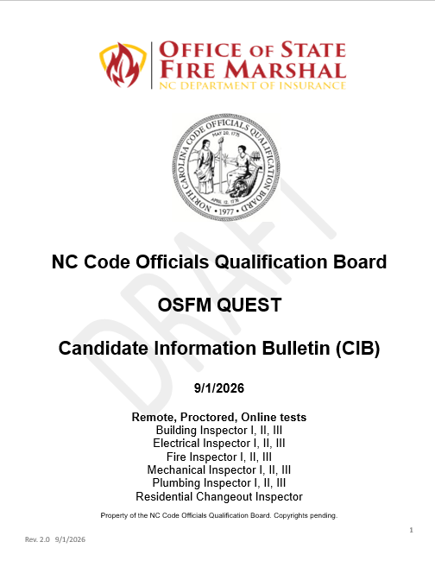


COQB CANDIDATE INFORMATION BULLETIN
WARNING!
Candidates are responsible for all content within the CIB. Failure to comply with the CIB may result in test failure, forfeiture of test fees, up to and including civil penalties and possible criminal charges. Be prepared by reading the Candidate Information Bulletin!

Slide 2
COQB CANDIDATE INFORMATION BULLETIN
READ ME FIRST
The Candidate Information Bulletin (CIB) has been prepared to provide test-takers with the information and resources necessary to prepare for and take an OSFM QUEST test. The CIB contains step-by-step procedures for navigating through the testing process. The checklist presented on the next few pages has been provided to assist you in the process. Please use it.
The CIB is divided into seven (7) Parts so that you don’t have to read it all at once. Each part covers a different phase of the QUEST testing process. Please read each section as you progress through the testing process.
PART 1 - GENERAL INFORMATION
PART 2 - PURCHASING & SCHEDULING A TEST
PART 3 - REFERENCES & CONTENT OUTLINES
PART 4 - TESTING REQUIREMENTS
PART 5 - RULES OF CONDUCT
PART 6 - TEST DAY AND AFTER THE TEST
PART 7 - APPENDICES

Slide 3

SUPPORT
Applications and Eligibilities
Terri Tart, terri.tart@ncdoi.gov
Sarah Shannon, sarah.shannon@ncdoi.gov
Renita Denton, renita.denton@ncdoi.gov
Board & CE Courses
Jennifer Hollyfield, jennifer.hollyfield@ncdoi.gov
Code Book Sales
Ronae Bennett. ronae.bennett@ncdoi.gov
Who To Email
osfmexamsupport@questionmark.com
Charged or paid twice
Purchasing
Scheduling
Rescheduling Tests
Technical Issues
osfm.quest@ncdoi.gov
Test Accommodation(s)
Refunds
Unresolved testing issues

Slide 4

COQB CANDIDATE INFORMATION BULLETIN
WARNING! You MUST “Test Your Equipment” prior to your test. If you do not download and test the Guardian Browser prior to the test, you may not be able to take the test at your scheduled time. If using a business computer (state, AHJ), work with your IT department if necessary to overcome any security issues. If you cannot use a business computer, you will need to use a personal computer. See Section XII, TEST EQUIPMENT REQUIREMENTS.

Slide 5
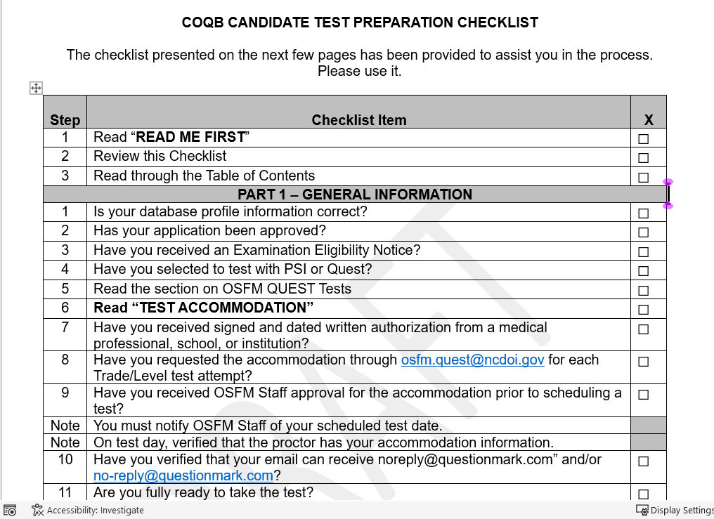
COQB CIB CHECKLIST
A checklist has been provided to assist you in the process.
Please use it.

Slide 6

LEGAL WARNING
All examination materials, including test questions and test items, are the sole property of the North Carolina Code Officials Qualification Board and are confidential. No test items or examination content may be copied, reproduced, retained, disclosed, transmitted, or shared during or after the examination. Any examinee who is found or suspected to have harvested, copied, shared, disclosed, or otherwise misappropriated examination content; released confidential examination materials; or engaged in fraudulent or improper testing practices may be reported to the Board for investigation. Such conduct may result in disciplinary action, including denial of an application, suspension or revocation of a license, civil penalties as authorized by law, and referral to appropriate authorities for criminal investigation or prosecution.

Slide 7
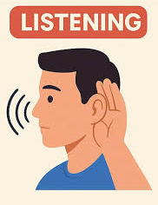
PART 1 – GENERAL INFORMATION
I hate waterlemons.
You that read wrong.
You read that wrong too.
This is how your test attempt may fail and cost you additional fees.
Read along carefully in the CIB while listening to this PowerPoint.
This is an overview of the OSFM QUEST Test.
Other information in this section includes:
Database requirements
Testing with PSI or QUEST
Question blocks within the test
Test accommodations
Read while Listening

Slide 8
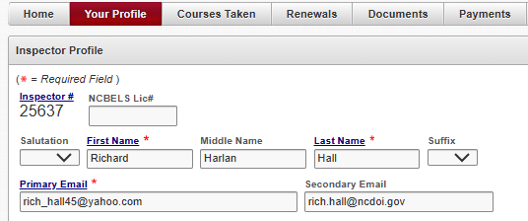
PART 1 – GENERAL INFORMATION
I. COQB DATABASE REQUIREMENTS
Candidate information in the COQB database profile MUST be kept up to date.
QUEST requires two unique identifiers: 1) CEOID and 2) Primary email.
If for any reason your email changes (e.g., changing jurisdictions) you MUST update the COQB database.
12345
IMPORTANT COQB INSTRUCTORS: Your INSPECTOR PROFILE primary email address cannot match your INSTRUCTOR PROFILE primary email address. If it does, you will continually
receive error messages and you will not receive purchase or scheduling emails.
You must use separate email addresses for each.

Slide 9
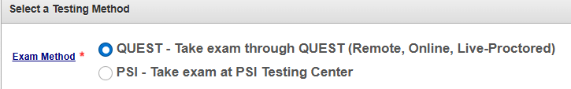
II. TEST WITH PSI OR QUEST
Candidates who have already taken their first COQB test attempt through PSI must take their second attempt through PSI as well. Candidates who are on their first attempt, and until 6/15/2027, can choose their testing method (PSI or QUEST). Candidates may select to test through PSI until 4/30/2027. However, you MUST take any retests through PSI prior to 6/15/2027. The information below can be found on the “This is a Pre-Qualification Application” page.
IMPORTANT: Once you choose a testing method and your application is submitted, you will NOT be able to change methods (PSI or QUEST).

Slide 10

III. OSFM QUEST TESTS
The NC Code Officials Qualification Board contracted with Questionmark to manage the OSFM QUEST testing process.
Remote
Secure internet connection
Undisturbed room
Your home
On-line
Desktop or Laptop Computer
Meet the requirements in Part 4 of the CIB
Live – Proctored
Room check
ID check
Observed throughout the exam
Excludes
Tablets, iPads, Chromebooks, Phones

Slide 11
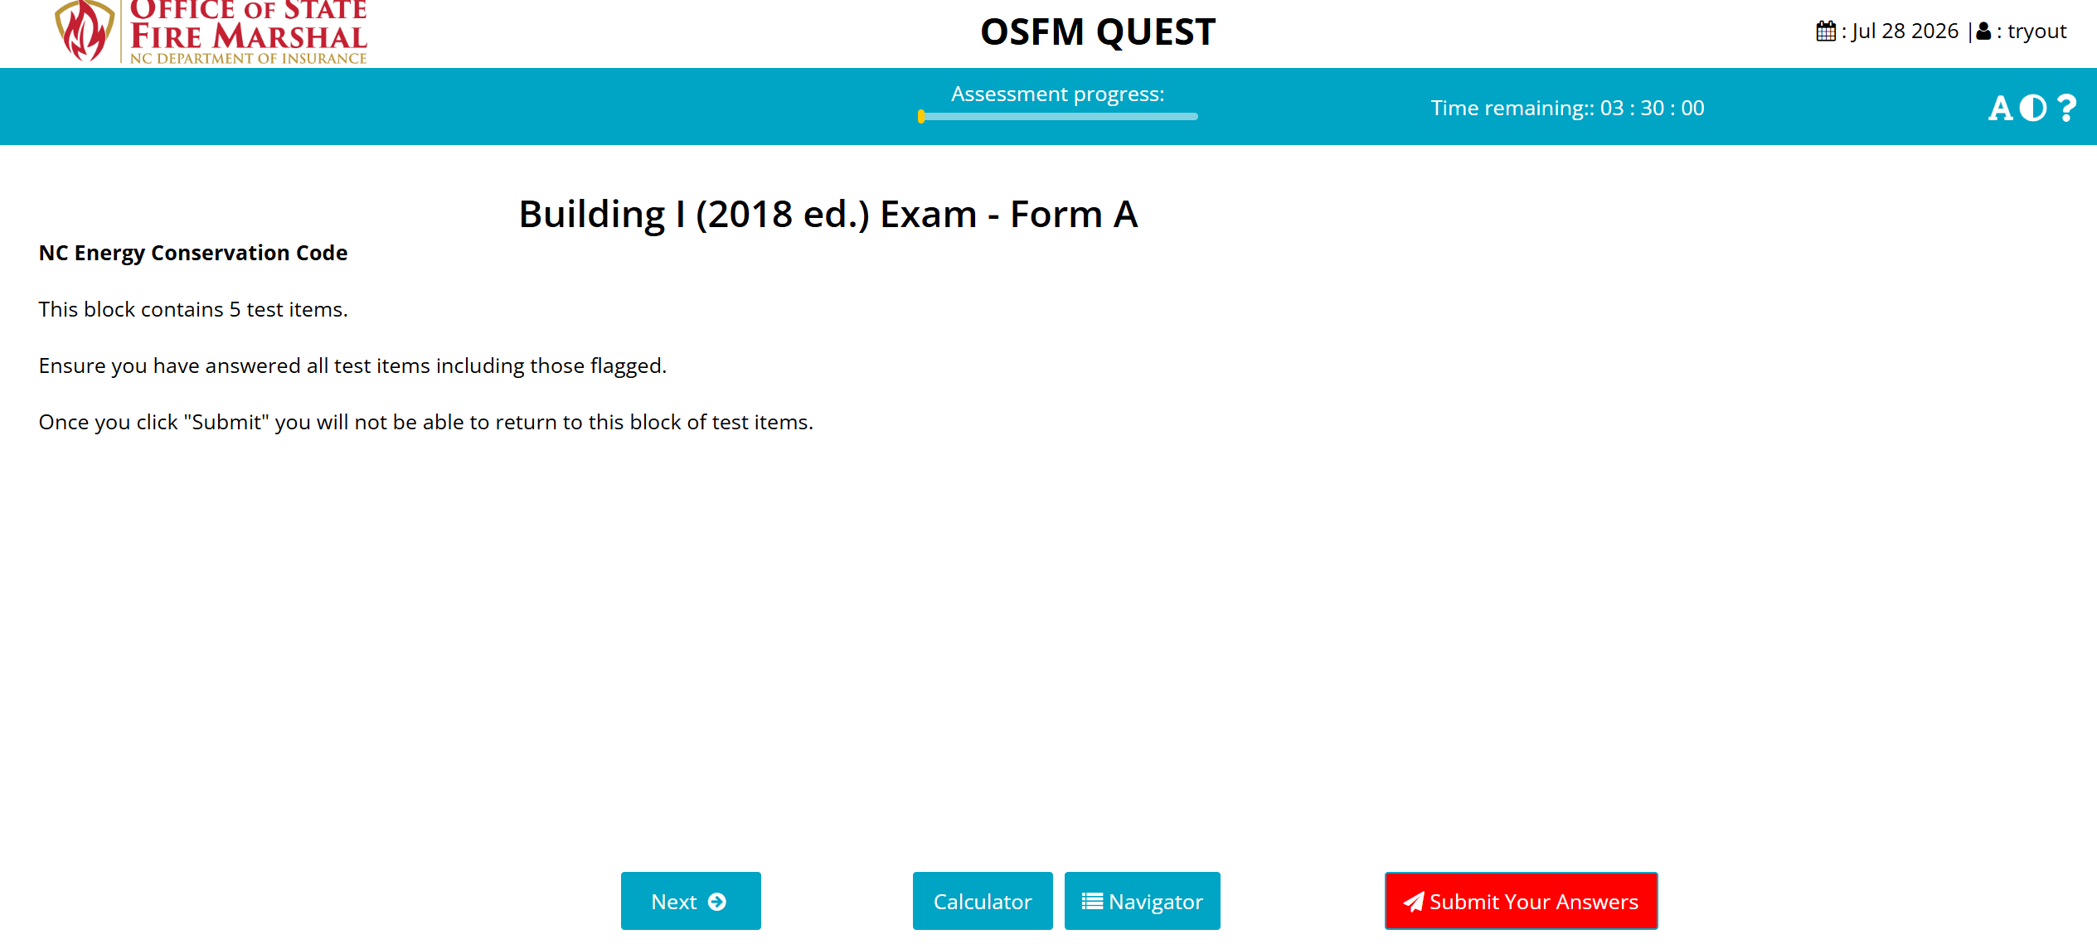
TEST BLOCKS
The COQB test is divided into blocks. The first few blocks provide general information about the test. The remaining blocks contain test questions (test items). You can navigate within a block of questions, change answers, flag a question, etc. To move to the next block, you must click on the “Submit Your Answer” button at the bottom right corner of the screen. If you do not answer all test questions within a block, you will not be allowed to proceed to the next block.
IMPORTANT: Clicking “Submit Your Answer” means you are finished with a block of questions. Once you click on the submit button you cannot go back to that block. Do not submit a block of questions unless you have finished reviewing and making final changes. NOTE: For screenshots of how the test will appear, see Appendix A, TEST SCREENSHOTS
.

Slide 12
IV. TEST ACCOMMODATION
Test accommodation is provided in accordance the Americans with Disabilities Act (ADA) and the candidate's needs. You must provide signed and dated written authorization from a medical professional, school, or institution.
Accommodations requiring prior approval include, but are not limited to, magnifying glasses, hearing aids, diagnoses necessitating extended time, etc.
IMPORTANT: Reading test items aloud during the test is not permitted unless you have accommodation.
A candidate with a disability or a candidate who would otherwise have difficulty taking the test may qualify for an accommodation. If you have a previously approved accommodation from another testing organization, you may use that paperwork (signed and dated by provider). The accommodation process and required forms can be found on the COQB website. Please submit all documentation to osfm.quest@ncdoi.gov for review and approval.

Slide 13
IV. TEST ACCOMMODATION (cont.)
IMPORTANT: You MUST request the accommodation through osfm.quest@ncdoi.gov for each Trade/Level test attempt. You do NOT need to resend paperwork.
IMPORTANT: Make sure you have received OSFM Staff approval for the accommodation prior to scheduling a test.
IMPORTANT: On test day, verify that the proctor has your accommodation information. If they cannot verify and allow you the accommodation, let them know you want to reschedule the test and send an email explaining the issue to osfm.quest@ncdoi.gov.
WARNING: Once you are scheduled for a test attempt, you must notify osfm.quest@ncdoi.gov so staff can add the accommodation. If you do not, the accommodation will not be available, and you must reschedule and pay another test fee.

Slide 14
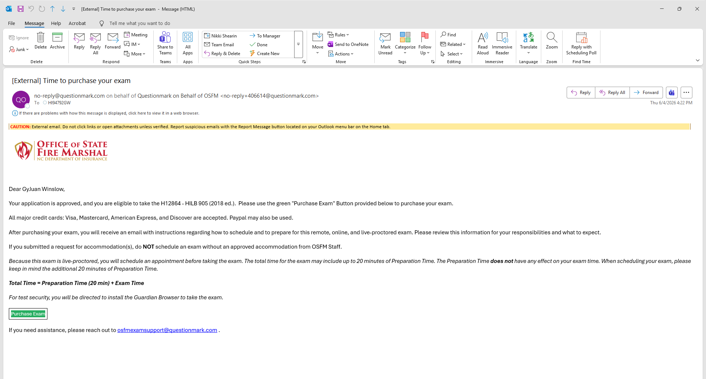
PART 2 - PURCHASING & SCHEDULING A TEST
IMPORTANT: Candidates are responsible for purchasing and scheduling their test. We recommend that you not pay and schedule your test until you are fully ready to take the test. This will preclude you from potentially missing a test date and having to repay and/or continually having to reschedule after you pay if you decide you are not fully prepared.
IMPORTANT: You will be sent emails from “noreply@questionmark.com” and/or “no-reply@questionmark.com”. Verify with your agency’s cybersecurity department and/or email settings so that you can receive these emails. Otherwise, you will not receive the emails necessary to purchase and schedule your test. Check your spam and junk folders for these emails.
noreply@questionmark.com
You must receive emails from both sender addresses.

Slide 15

V. BEFORE SCHEDULING A TEST
Make sure that you have reviewed ALL the following information.
  You must be authorized by the NC Code Officials Qualification Board (the Board) to take a test.
  To apply for accommodation, please refer to Section IV. TEST ACCOMMODATION.
  Upon approval from the Board, you will receive an Examination Eligibility Notice, along with instructions for paying, and scheduling the test.
  IMPORTANT: Eligibilities are valid for 5 years; however, at the time you test, you will test on the NC Code in effect at that time, not the code that was in effect at the time of your eligibility.
  Each eligibility is valid for two (2) attempts. If you fail both test attempts, you must resubmit your standard application to the Board.

Slide 16

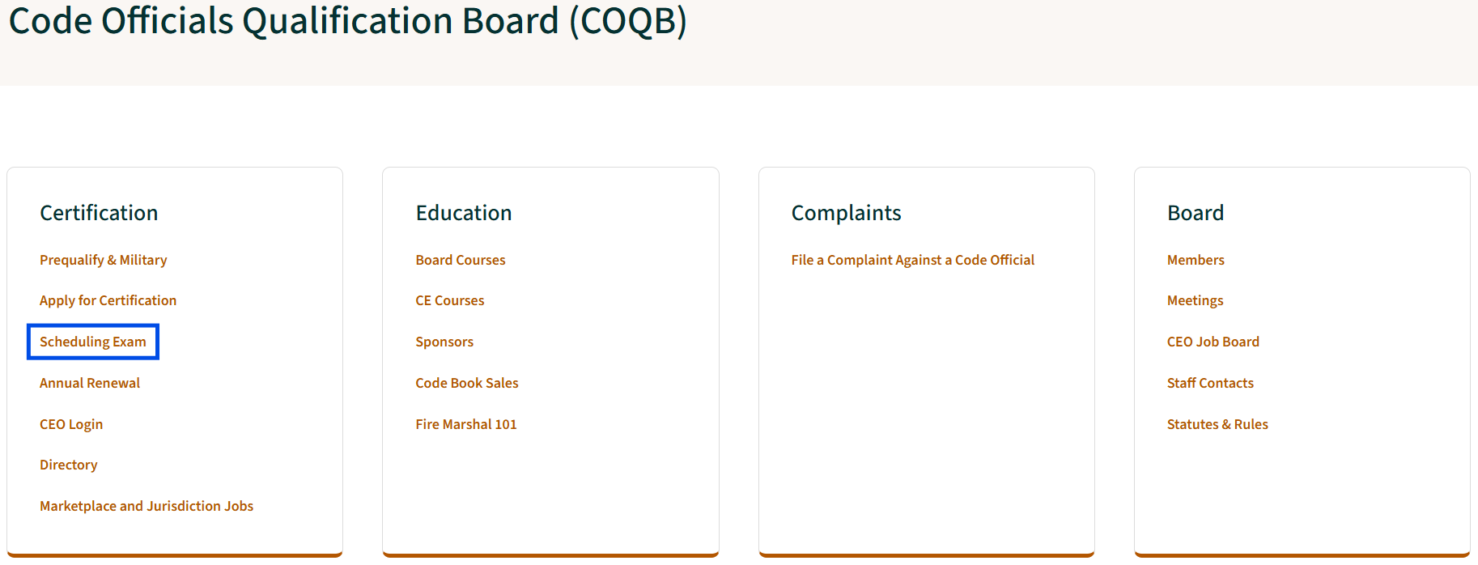
WEBSITE
NCOSFM.gov
NCOSFM.gov/licensing-certification
Notes:
These are screenshots from the COQB webpage.
On the Code Officials Qualification Board Webpage, you may review scheduling an exam with Questionmark or PSI.

Slide 17

VI. TEST PURCHASING AND SCHEDULING
Read through and follow the instructions outlined in Section VI of the CIB.

Slide 18
VII. CANCELED OR MISSED APPOINTMENTS AND REFUNDS
Canceling A Test Appointment
Candidates can reschedule their test 24 hours prior to their test start time. If they do not show up to the test within 60 minutes of the appointment time, the session will be marked as “No Show”.
Missed Appointment
IMPORTANT: If you miss your appointment, you will not be able to take the test as scheduled and you will forfeit your test fee, if you:
do not cancel your appointment.
do not log on within (1) one hour after your scheduled test start time.
do not present proper identification when you log on for the test.
Refunds
Refunds for general circumstances (e.g., illness, change in life circumstances, or no longer needing the license, etc.,) must be requested through OSFM.quest@ncdoi.gov. OSFM Staff will review the claim. If approved, OSFM Staff will direct QuestionMark to process the refund.
Questionmark can process a refund for an accidental charge or paying twice. Contact osfmexamsupport@questionmark.com.

Slide 19

FORGOT YOUR TEST DATE AND TIME?
VIII. What do I do if I forgot my test date and time?
Follow the instructions in Section VIII of the CIB.

Slide 20
PART III – REFERENCES & CONTENT OUTLINES
IX. REFERENCE MATERIALS
Approved references are allowed for COQB tests. Each test is formatted in order by Code (e.g., (NCRC, NCBC, NCECC). Content Areas are based on the arrangement and formats outlined in the applicable code(s). The test is divided into blocks containing test items from specified chapters. All test items within each block are shuffled. You cannot jump between blocks. Once the answers to a block have been submitted, you may not return to the block.
Standard Board Tests available through QUEST.
Building I, II, III | 130 MC items | 3.5 hours | Remote, proctored, online test
Electrical I, II, III | 130 MC items | 3.5 hours | Remote, proctored, online test
Fire I, II, III | 130 MC items | 3.5 hours | Remote, proctored, online test
Mechanical I, II, III | 130 MC items | 3.5 hours | Remote, proctored, online test
Plumbing I, II, III | 130 MC items | 3.5 hours | Remote, proctored, online test
Residential Changeout Inspector | 130 MC items | 3.5 hours | Remote, proctored, online test
NOTE: For screenshots of how the test will appear, see APPENDIX A.

Slide 21
PART 3 – REFERENCES & CONTENT OUTLINES
IX. REFERENCE MATERIALS (cont.)
Tests are OPEN BOOK unless otherwise designated. The references listed in the tables found in section X. TEST CONTENT OUTLINES are the ONLY references allowed during the test. Candidates are responsible for having their own references.
Reference materials may be highlighted, underlined, and/or annotated prior to the test session. Notes on the pages of the reference materials are allowed. However, if written in pencil, they MUST be highlighted; if written in pen, they DO NOT need to be highlighted. No partial references will be allowed as acceptable reference materials for tests.
You may NOT write any notes in the references during the test session. Furthermore, candidates are not permitted to have any additional papers (loose or attached) within their approved references. All additional materials must be removed from the references prior to the test session.
WARNING! DO NOT use copies of or remove the codebook index or table of contents. All pages must be contained inside the binder.

Slide 22
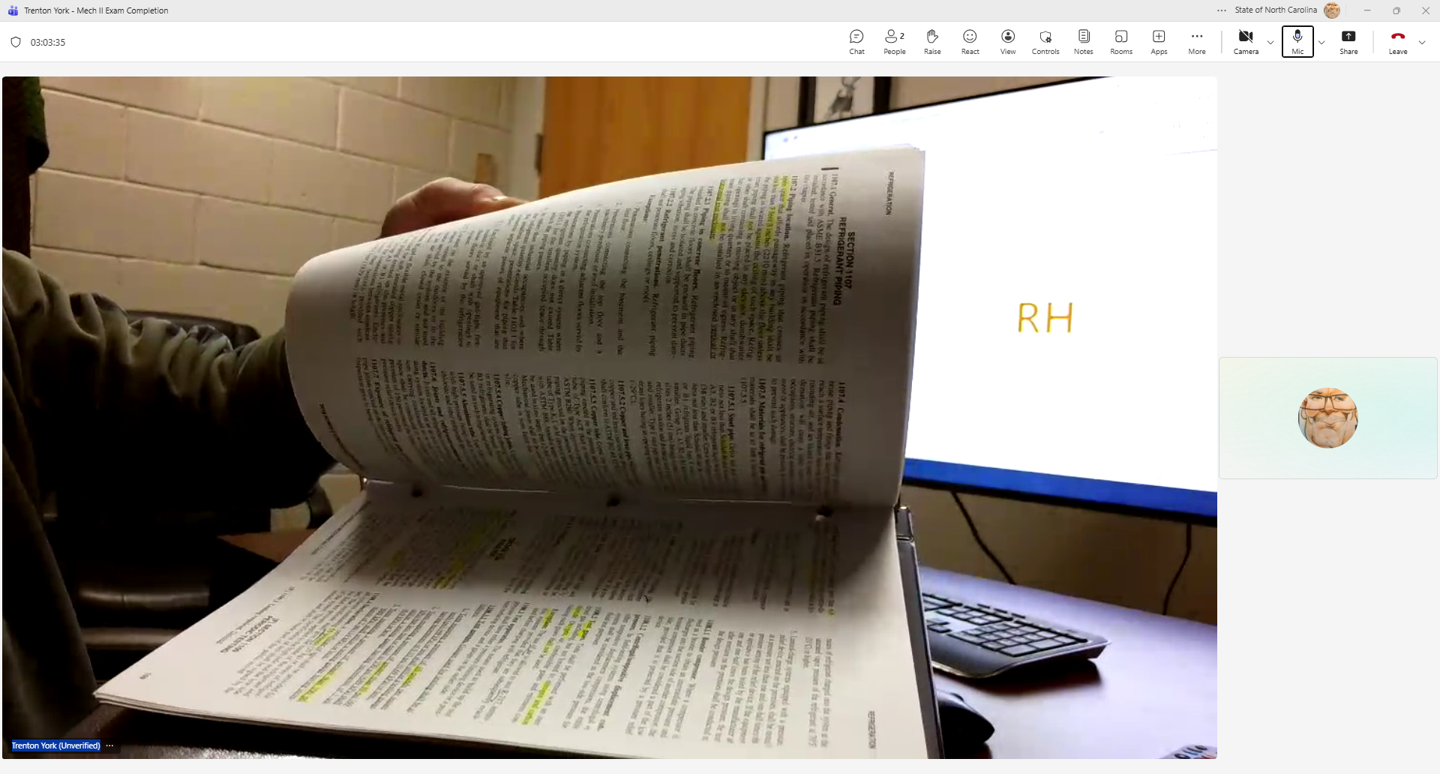
REFERENCES & CONTENT OUTLINES
Tabbing Your Code Book
IMPORTANT: ALL TABS MUST BE PERMANENT AND NON-REMOVABLE
Temporary tabs, such as Post-it Notes or stapled tabs, are not allowed and must be removed from the reference before the test session. Divider tabs are also not allowed. See Section XI. TABBING THE CODE BOOK for more information.
Reference materials must be properly bound and accessible. Candidates are not permitted to have any additional papers (loose or attached) within their approved references. Any additional materials MUST be removed from the references.
WARNING: On test day you will be required to present reference materials during the room scan. You must show them to the proctor before the test begins. You will be required to SLOWLY flip through the pages of your reference materials to allow the proctor to determine consistency throughout the text. Using unauthorized materials is a serious violation that can lead to the forfeiture of your eligibility.
WARNING! All pages must be contained inside the binder.

Slide 23

TEST SECURITY
WARNING! All tests and test items are the sole property of NC Code Officials Qualification Board. No test items shall be copied, saved, or shared during or following the test. Any candidate caught or suspected of harvesting, sharing test items or test content, releasing confidential test materials, or participating in fraudulent test-taking practices will be reported to the Board and disciplinary actions taken, up to and including permanent revocation of your license, civil penalties, and criminal charges.
WARNING! The following violations or variations thereof will cause your test to be terminated immediately and will be reported to the Board.
  Candidate writing in the references during the test.
  Candidate who tries to use unapproved additional papers (loose or attached) within their approved references. This includes but is not limited to partial references, notes pages, indexes, code reference sheets, class handouts, scratch paper, sticky (Post-IT) notes, stapled tabs, divider tabs, etc.
  Candidate who copies, saves, or shares test items during or following the test.
  Candidate caught or suspected of harvesting or sharing test items or test content.

Slide 24
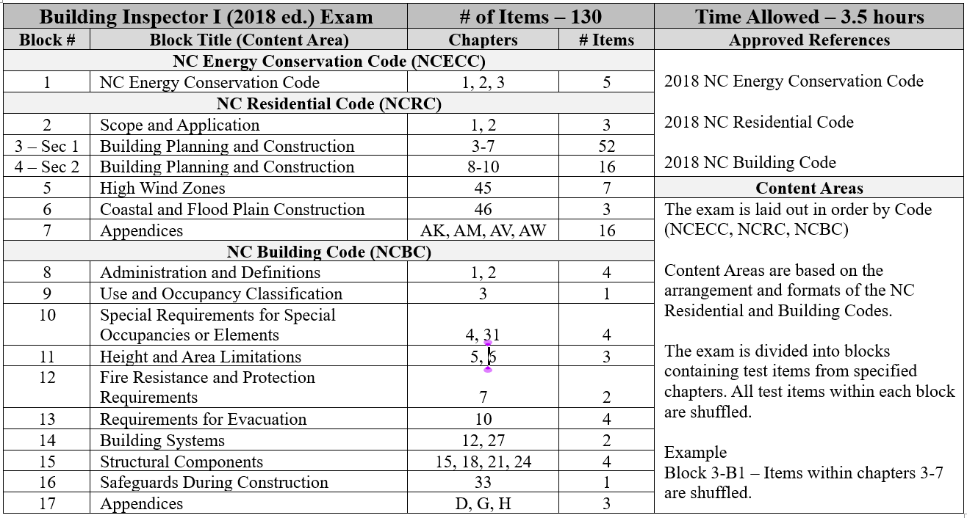
X. TEST CONTENT OUTLINES
Each test is laid out in order by Code (e.g., NCECC, NCRC, NCBC). Content Areas are based on the arrangement and formats outlined in the applicable code(s). The test is divided into blocks containing test items from specified chapters. All test items within each block are shuffled. Candidate cannot jump between any previous block of items.
See Section X. TEST CONTENT OUTLINE for detailed Content Outlines for each Exam.
SAMPLE

Slide 25
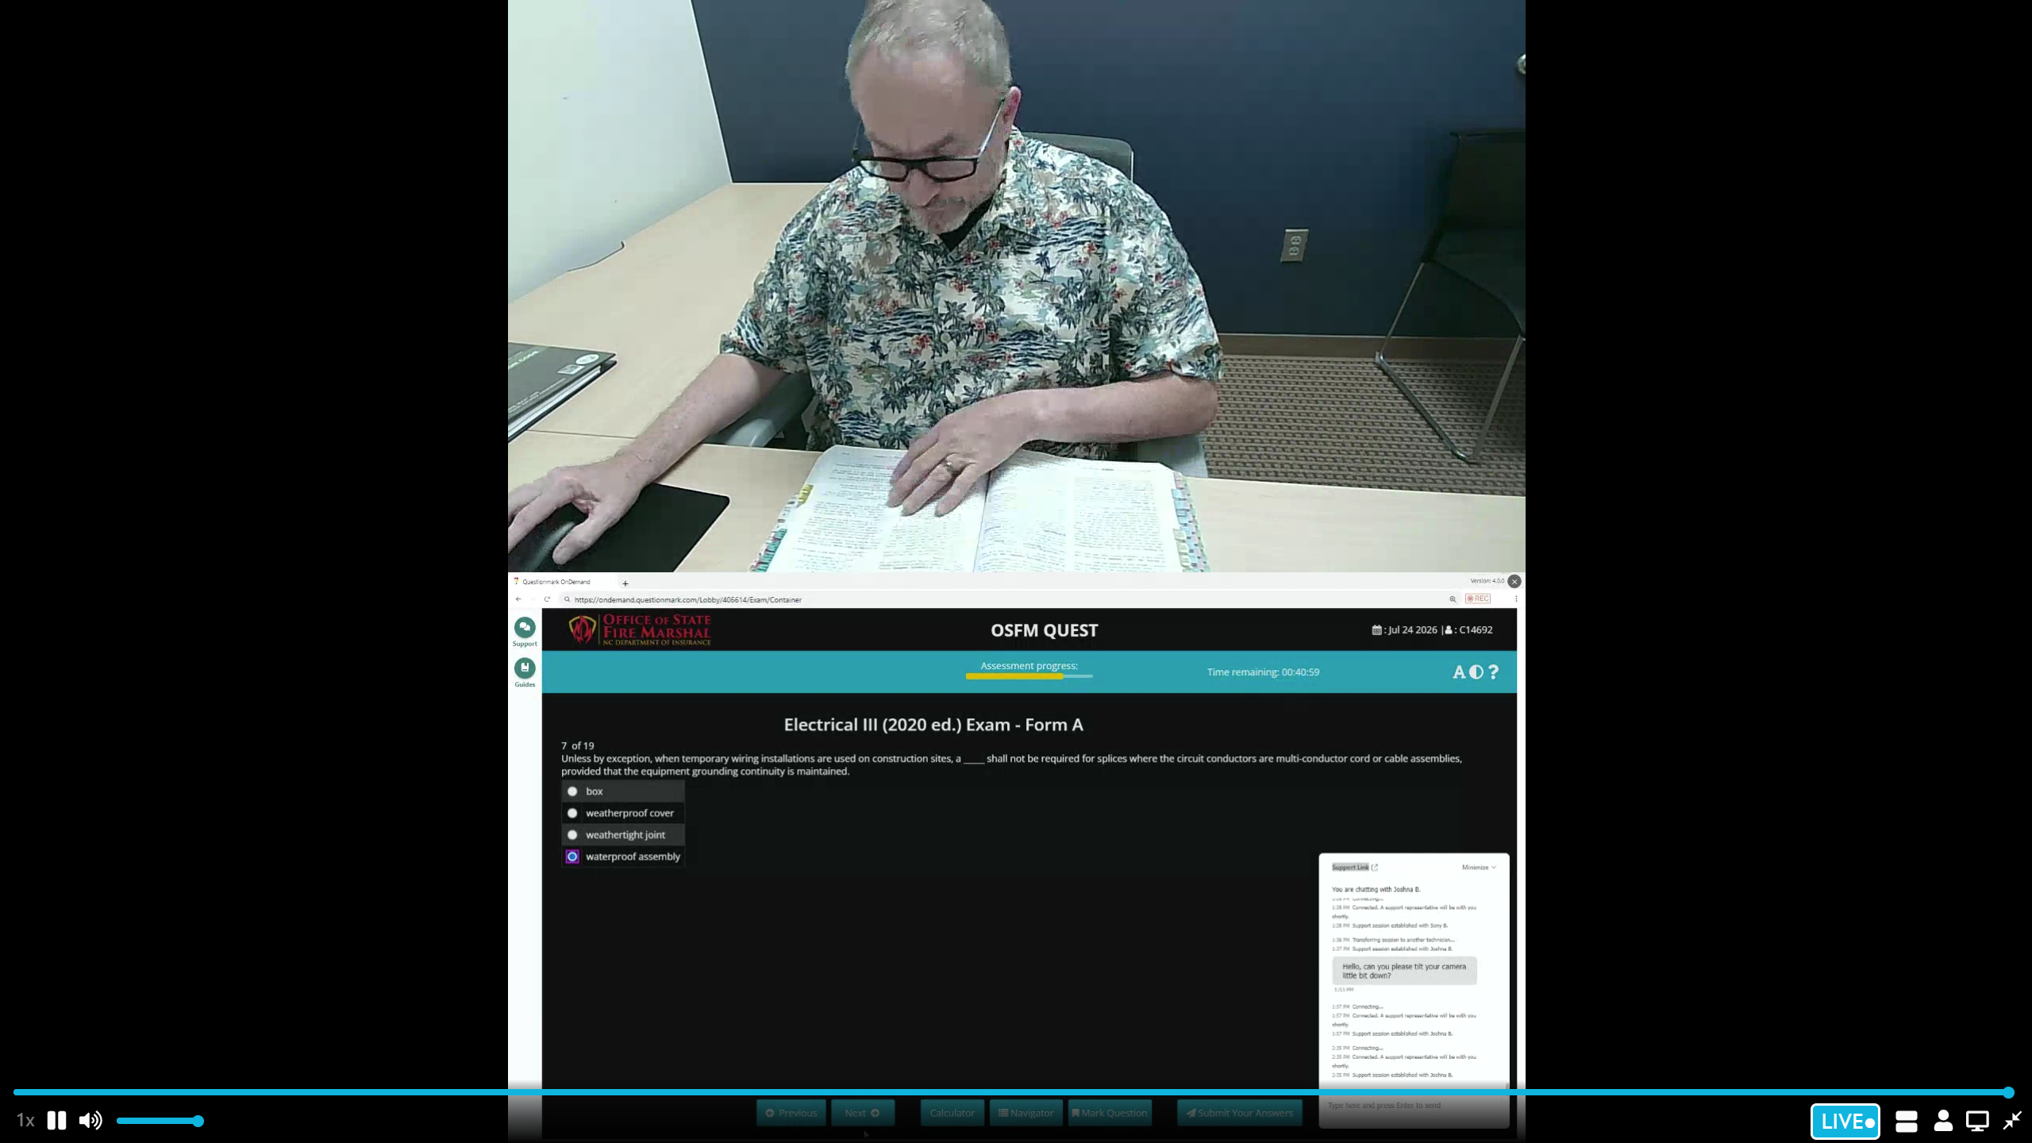
XI. TABBING THE CODE BOOK
Tabbing your codebook properly is necessary for successful testing. On test day, you will be required to present your codebook to the proctor. If the proctor misses an issue with your codebook (e.g., unapproved tabs, Post-It notes, sticky notes, etc.) and upon OSFM review of the check-in process, irregularities are identified, your results may be cancelled, eligibility forfeited, and additional fees applied. You may also be denied future testing.
WARNING! All unauthorized tabs must be removed prior to your appointment.
Be sure to follow the tabbing instructions in section XI of the CIB.
IMPORTANT: If your codebook is bound and tabbed in accordance with the CIB and the proctor insists you need to remove the tabs, you can refuse the exam and reschedule, no loss of eligibility and no additional fees.

Slide 26

WARNING – BUYER BEWARE
Test preparation is your responsibility.
You may not use any training class or Pass-the-Exam class as a reason for NOT passing the test, nor does it exempt you from additional test fees.
Information contained in the test is not provided to any COQB Instructor.
Notes:
Buyer Beware
Test preparation is your responsibility.
Any training class or Pass-the-Exam class cannot be used as a reason for not passing the test, nor does it exempt you from additional test fees.
Information contained in the test is not provided to any COQB Sponsor.

Slide 27

PART 4 – TESTING REQUIREMENTS
XII. TEST EQUIPMENT REQUIREMENTS
Neither OSFM, nor the testing service can provide a computer, set up, recommend specific testing sites/locations, or locate reliable internet service for you. Computer access for taking a test is solely the candidate’s responsibility. The computer must be connected to a stable power source and reliable internet connection.
You MUST TEST YOUR COMPUTER BEFORE TEST DAY in an environment that is identical to or close to the location where you plan to take your test. DO NOT wait until you log in to take your test to find out your computer does not meet the necessary equipment requirements.
Screenshot and Remote Access applications that allow a candidate to capture, edit, share regions, windows, or full screens on the computer are prohibited.
If you do not download and test the Guardian Browser prior to the test, you may not be able to take the test at your scheduled time. A personal computer is recommended. However, if a business computer (e.g., state, AHJ), must be used, please work with your IT Department to overcome any issues.

Slide 28
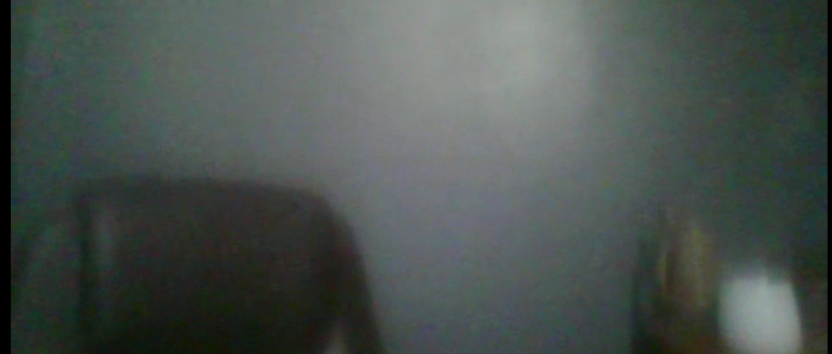
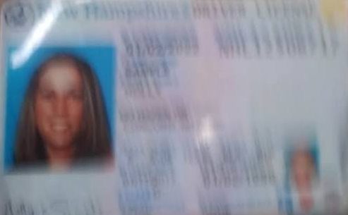
XII. TEST EQUIPMENT REQUIREMENTS (cont.)
You must have a working internal or external webcam, microphone, and speaker.
Test your camera prior to test day. The proctor must be able to clearly see you and the test environment. If your camera is out of focus or dirty, the proctor may not be able to properly verify your ID and your testing area. If this situation occurs, you will need to reschedule your exam and pay additional fees.

Slide 29
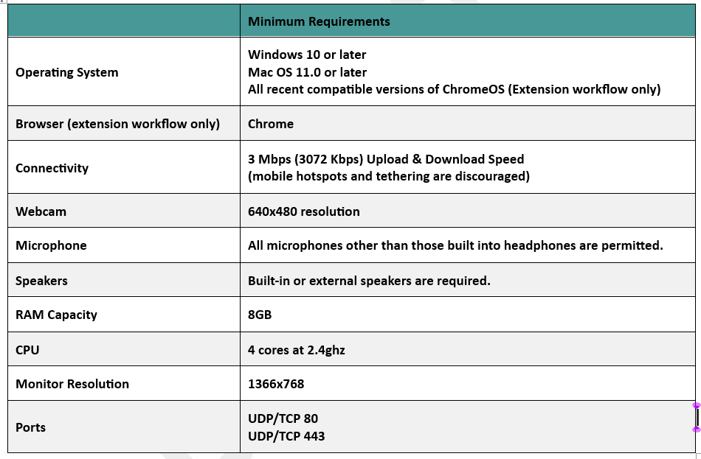

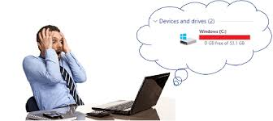
COMPUTER REQUIREMENTS
WARNING! You MUST TEST YOUR COMPUTER BEFORE TEST DAY in an area that is identical to or close to your testing location.
If the computer does not meet the minimum requirements, you will forfeit your test fee. Check ahead of time. DO NOT wait until you log in to take your test to find out your computer is not acceptable.
When taking a COQB test, you will need a computer that fulfills the following system requirements.
TEST DAY
or

Slide 30
XIII. PROHIBITED COMPUTER APPLICATIONS
(3rd party applications)
Screenshot and Remote Access Applications that allow a candidate to capture, edit, share regions, windows, or full screens on the computer are prohibited. If these are found prior to the test, candidates will be asked to uninstall them. The time to uninstall prohibited applications may result in extended wait times prior to the test. You may need to reschedule and repay for another test. If a prohibited application is discovered during the test, it will be considered cheating and presented to the Board for disciplinary action. We recommend that you do not use a computer set up for gaming. These computers often have prohibited applications.

Slide 31
PROHIBITED COMPUTER APPLICATIONS
(3rd party applications)
AnyDesk | Loom
BeyondTrust (Bomgar) | Microsoft Quick Assist
Chrome Remote Desktop | OBS Studio
ConnectWise | Pulseway
Dameware | RealVNC
Dameware Remote Everywhere | RemotePC
Dualmon | RustDesk
Flameshot | ScreenConnect
Game Assist (Edge of Game Bar) | ShareX
Getscreen.me | Snagit
GoToMyPC | Splashtop
Greenshot | Supremo Remote Desktop
Gyazo | TeamViewer
Iperius Remote | TVNServer
Kaseya VSA | Zoho Assist
Lightshot
LogMeIn
Any other application that allows a candidate to capture, edit, share regions, windows, or full screens on the computer are prohibited.

Slide 32
XIII. PROHIBITED COMPUTER APPLICATIONS
(3rd party applications)
WARNING: DO NOT WAIT UNTIL TEST DAY. YOU MAY NOT BE AWARE IT IS ON YOUR COMPUTER.
If you are not sure if you have any of the listed or similar applications that allow remote control of your computer, please check with your IT department or a computer specialist. If a prohibited application is found on your computer on test day and it cannot be removed at that time, you will be required to reschedule and pay additional test fee.
The “Test-it-Out” application DOES NOT check for prohibited applications.
Virtual Machines: You will not be permitted to take your test from within a virtual machine. A virtual machine is a software-based emulation of a physical computer that runs on a host machine (a physical server, desktop, or laptop). It functions as a "computer within a computer," featuring its own virtual CPU, memory, storage, and operating system (OS), which are isolated from the host system. Virtual machines are used to run multiple independent operating systems on a single physical machine, optimizing hardware utilization, improving security, and enabling flexible software testing. Virtual machines can be detected through the pre-test system check and are not permitted.
How can I check what apps are on my computer?
NOTE: Due to various computer models and/or software versions, the procedures below may be different. If so, contact IT or a computer specialist. See Section XIII of the CIB.

Slide 33
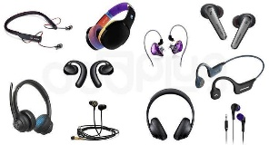
OTHER CONSIDERATIONS
  Mobile devices, tablets, iPads, Chromebooks, cell phones, etc. may not be used.
  Headphones, earphones, earbuds, etc., are not permitted unless required by ADA accommodation.
  Only a single monitor may be used. All other monitors must be disconnected.
  Unlicensed/inactive versions of Windows and Test Builds/Modes are not permitted.

Slide 34
OTHER CONSIDERATIONS
Browser tabs, copy text and image, and window size.
Browser tabs are restricted to prevent test takers from accessing additional tabs during their test.
Text and image copying is disabled to prevent test takers from copying text and images during the test.
Test window size - The test taker’s browser tab will remain fullscreen during the test. Test takers may not change their browser size.

Slide 35
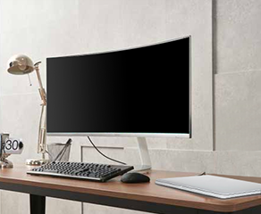
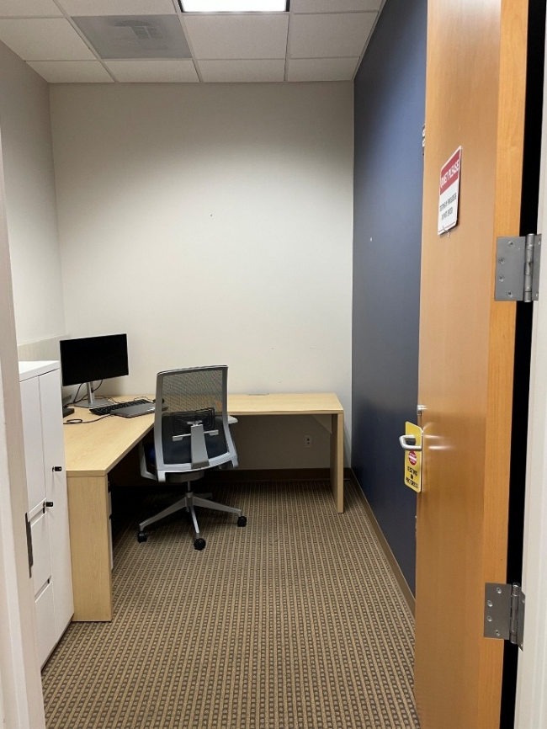
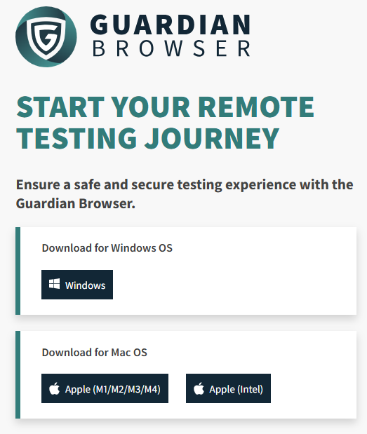
AGENCY DEDICATED ROOM AND COMPUTER
COQB tests require the ProctorU Guardian Browser.
Through beta-testing of remote proctoring, some agencies have determined it is easier and more practical to set up a dedicated computer within testing room with only the Guardian Browser software loaded on it, rather than loading the browser on individual employee computers.

Slide 36
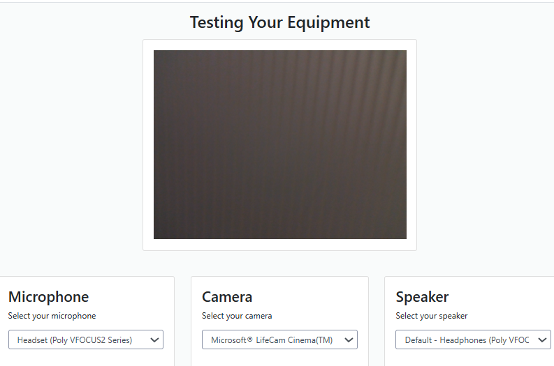
GUARDIAN BROWSER AND TESTING YOUR COMPUTER
WARNING! If you do not test your equipment and your computer disconnects during the test, you will forfeit that attempt and test fees. We highly recommend you test your equipment again on test day and take a screenshot of the results.

Slide 37

GUARDIAN BROWSER AND TESTING YOUR COMPUTER
COQB tests require the ProctorU Guardian Browser.
IMPORTANT: Notice to County and Local Jurisdiction IT Teams,
This communication is to provide clarification regarding the use of the Guardian Browser for State-approved online assessments.
The State has reviewed and approved the Guardian Browser for use in conjunction with the state’s online testing platform. Based on this review, the application is considered safe for installation and use solely for the purpose of administering authorized assessments.
Please note the following important points:
The State’s approval applies only to the use of the Guardian Browser as required for assessment delivery.
The State does not assume responsibility for any technical, operational, or system-related issues that may arise from the installation or use of the Guardian Browser.
All technical support, troubleshooting, and functionality-related questions should be directed to the testing provider at osfmexamsupport@questionmark.com.
Installation and deployment decisions remain at the discretion of each county or local jurisdiction, in accordance with their internal IT policies and procedures.
This notice is intended to provide reassurance that the Guardian Browser has been reviewed and approved at the state level for its intended assessment-related use, while clearly defining support and responsibility boundaries. If you have any additional security related questions, please email osfm.quest@ncdoi.gov.

Slide 38
XV. TEST AREA
The online testing area should mimic “in-class” testing and MUST conform to the following:
Room, preferably a private room with a door and restricted access.
Windows tinted or shaded to prevent onlookers. This restriction only applies if someone walking by a window can see the candidate’s monitor screen.
Wall-mounted dry-erase boards must be fully erased. Flip charts are prohibited.
No other person is permitted to enter the room during testing.
No pets or children are allowed in the room or where they may be a distraction. If anyone enters the testing area, your results may be cancelled.
No communication with others, by any means, during the test.
Room lighting bright enough to be considered “daylight” quality.
The computer is connected to a stable power source and internet connection.

Slide 39
TEST AREA (cont.)
Workstation, desk, or table must be cleared of all materials.
No lap-desk, chair, bed, couch, etc. is acceptable.
Kitchen and dining room tables are allowed.
The removal of all books, papers, notebooks, phones, headphones, tablets, etc. is required.
Adjustable height (elevating) desks are authorized; however, the candidate must be within full view of the proctor while adjusting the height. The camera MUST travel with the desk. Candidate must inform the proctor prior to adjusting the desk.
No writing on the desk or walls.
No dual monitors.
Screenshots of test information are prohibited.
Your face, chin to forehead, must always be in the camera view.

Slide 40
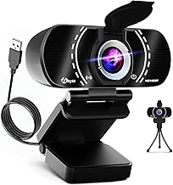
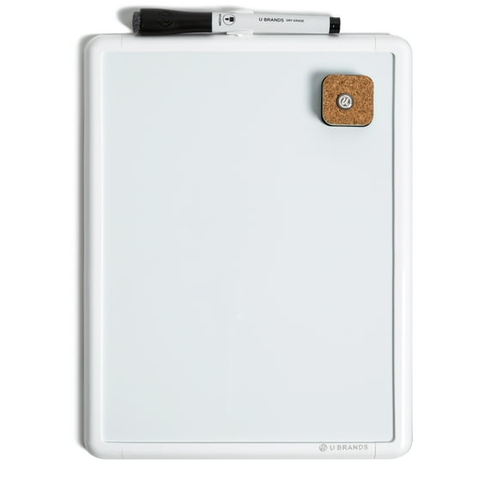
TEST AREA (cont.)
External Cameras
Candidates can use an external camera if they don’t want to use their internal device camera. External cameras can be chosen when testing equipment prior to a test or on test day.
Sample Only
The maximum size allowed is 8.5x11 inches.
Must remain on the desk or table throughout the entire test.
Candidate should be able to write on and erase the board without significantly turning away from the camera, which can be flagged as a potential issue.
The proctor will perform a room scan and require a clear view of the dry-erase board, potentially asking the candidate to adjust the position during the check-in process.
You will be required to show the erased blank whiteboard prior to the test as well as no writing on the back of the whiteboard. Near the end of the test, you will be required to show the proctor your erased whiteboard (front and back) again.
Dry-erase Whiteboard

Slide 41
TEST AREA (cont.)
Clamshell Set-up. (Closed Laptop and Single Monitor)
An external monitor connected to a closed laptop must be set to mirror display and connected directly to the computer. A docking station is not allowed.

Slide 42
XVI. PHYSICAL AREA CHECK
To ensure that these requirements are met, candidates/proctors will take the following actions before unlocking the test:
Six-point camera pans will be standard; four walls, desk, and view of under the desk (standing up away from the desk).
Camera pans will include a view of the entire wall (floor to ceiling). PLEASE PAN SLOWLY AND SMOOTHLY.
Candidates will be asked to remove everything from their desk that is not permanently affixed or approved for the test.
Monitor checks will be conducted using a reflective surface (mirror or cellphone selfie camera view) or with an external webcam to ensure the physical computer is secure. No cables except the mouse, keyboard, ethernet, and power cables may be present.
Testing from a hard surface will be required: no beds, couches or testing from the floor.

Slide 43
PHYSICAL AREA CHECK (cont.)
Candidates will be asked to place their back to the door, if possible.
Candidates will NOT be allowed to test in a room where a clear glass wall would allow someone to view the computer screen.
Cell phones must be viewed by the proctor, and their location must be visually verified to be out of reach of the candidate.
If a disconnection occurs an additional camera pan will be performed.
Proctors will note each time a camera pan is performed.
Webcam, speakers, and microphone must remain on throughout the test
Testing from a bathroom or restroom is not permitted.

Slide 44
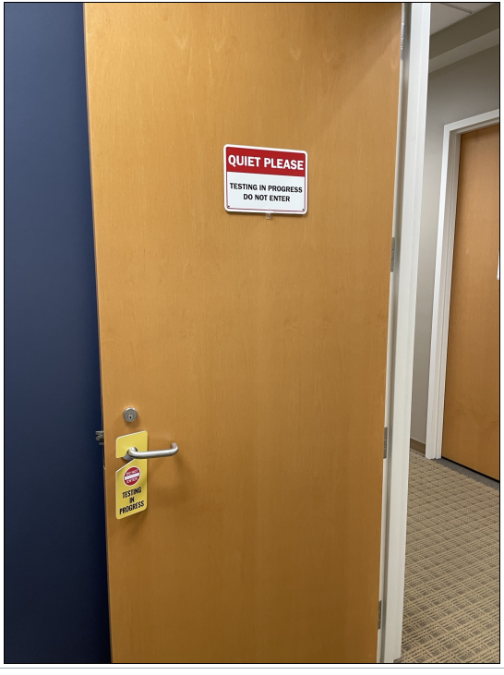
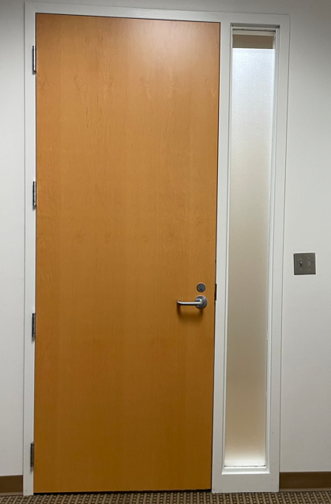
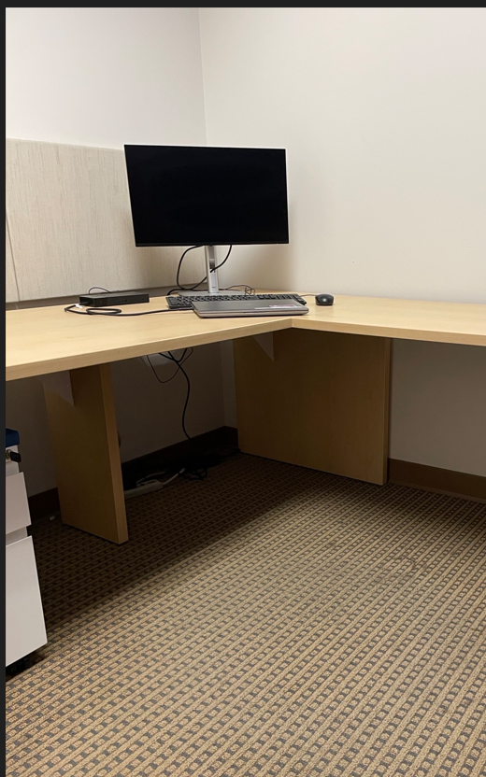
PHYSICAL LAYOUT OF TESTING AREA
OSFM, QuestionMark, and Meazure Learning do NOT approve testing rooms prior to a test. The closer your testing area looks like the one below, the better your chances of having no issues when your test appointment begins. Anything in the room that could possibly lead to test security, or cheating issues must be covered or removed (e.g., bookshelves, posters relating to inspector topics, wall-mounted dry-erase boards with writing, flipcharts, etc.). The proctor will grant final approval at the time of the test.

Slide 45
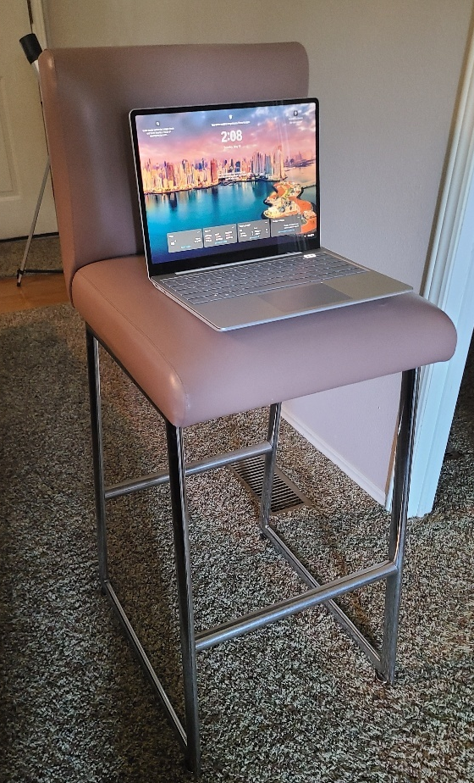
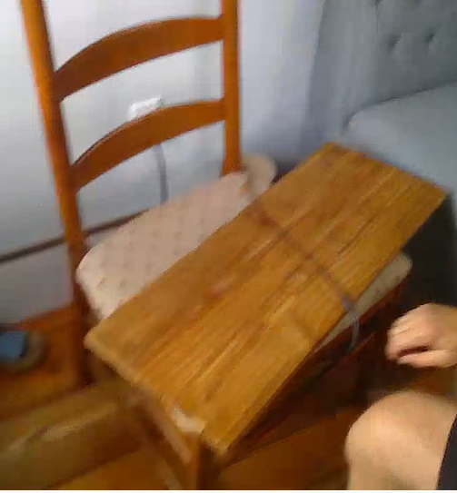
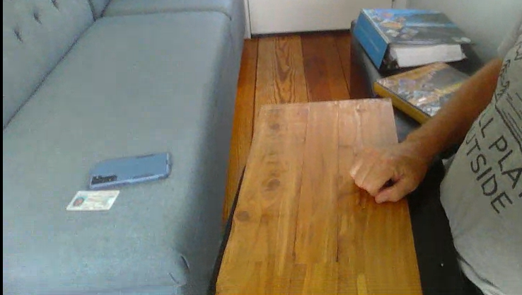
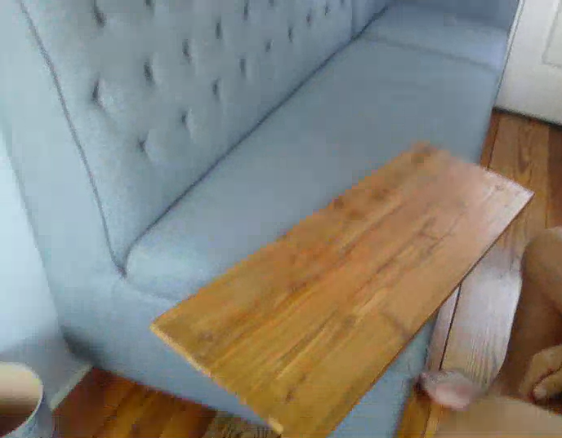

UNACCEPTABLE SET-UPS
These set-ups are NOT Acceptable!

Slide 46

DAY BEFORE TEST
Desk area - meets requirements.
Prepare any “Do Not Disturb” signs to be posted on test day.
IMPORTANT: Anyone entering the test area may result in score cancellation
and additional test fee.
Check your camera set-up – Make sure your head, chin to forehead is visible from your camera.
IMPORTANT: If you are not ready to test, reschedule to avoid paying another exam fee.
Review the Candidate Information Bulletin including the ID policy. You will be required to agree to the terms outlined in this document to take your test; read them carefully.
For screenshots of how the test will appear, see APPENDIX A.
IMPORTANT: If you have an accommodation, it must be approved by OSFM Staff, and you must have shared your appointment information with OSFM Staff. If you do not, you will not be provided the accommodation and may need to reschedule and pay an additional test fee.

Slide 47
DAY BEFORE TEST (cont.)
WARNING: If you are not sure if you have any prohibited applications, please check with your IT department or a computer specialist. If a prohibited application is found on your computer on test day and it cannot be removed at that time, you must reschedule and pay an additional test fee.
WARNING: The “Test-it-Out” DOES NOT check for prohibited applications.

Slide 48
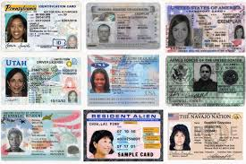
IDENTIFICATION REQUIREMENTS
WARNING: If the candidate fails to present proper identification or the names do not match, the candidate will not be allowed to test. The test fee will not be refunded.
Candidate must provide one (1) form of original, valid (non-expired), signature-bearing government-issued identification with photo. Candidate must register for the test with their LEGAL first and last name as it appears on their government-issued identification. All required identification below must match the first and last name under which the candidate is registered.
Primary Identification (With photo and signature)
State issued driver’s license
State issued identification card
US Government Issued Passport
US Government Issued Military Identification Card
US Government Issued Alien Registration Card
Canadian Government Issued ID
IDs explicitly not accepted:
Social Security Card
Birth Certificate
Debit/credit cards/checks
Any IDs containing sensitive Personally Identifiable Information (PII) that are not listed above

Slide 49

PART 5 – RULES OF CONDUCT
This section describes the rules of conduct adhered to and enforced by the proctoring service.
WARNING!
Candidates are responsible for all content within the COQB CIB. Failure to comply may result in test failure, eligibility forfeiture, and additional test fee.

Slide 50

XIX. WHAT IS ALLOWED?
Restroom Breaks During the Test
With proctor approval, candidates may take a restroom break.
For this exam you are allowed no more than two (2) restroom breaks.
IMPORTANT: Before taking a break, you must have completed and "Submitted" the current block of test items and not have opened the next block of items.
You will not be able to return to any block already submitted.
Breaks may not exceed 15 minutes.
The test time clock never stops.
When a candidate returns from a break, the physical environment will be resecured.
Another room scan must be performed with the proctor.
Other Considerations
Drinks are permitted and must be shown during the room scan. There are no rules on drink containers (e.g., water bottles, thermoses, tumblers, travel mugs, etc.).
Candidate is required to be clothed and not dressed in only undergarments.
Jewelry is acceptable.

Slide 51
WHAT IS NOT ALLOWED?
During breaks, candidates may not disrupt the virtual environment (e.g., browse the internet, check email, etc.).
No communication with anyone.
Candidates are expected to always remain professional and treat the proctors with respect. Aggressive behavior will not be tolerated including but not limited to verbal harassment, abusive or foul language, threats, failure to respond to proctor instructions. Incidents may result in test termination, additional fee and/or referral to the Board for disciplinary action.
Food is not permitted during testing without an accommodation.
Smoking/vaping/dipping/chewing or any form of tobacco may not be used during testing.
No writing instruments or writing paper.
Personal items (purses, wallets, sunglasses, watches, bracelets, arm bands, wrist bands, etc.) must be removed and out of sight.
Non-religious head coverings that obstruct the eyes must be adjusted or removed.
Religious Head Coverings – Candidate must attest that they do not have any recording or listening devices under the head covering.
No headphones, earbuds, or earplugs are permitted. Ears will be inspected by the proctor. Use of hearing aids must be an approved accommodation.
No calculators.
No copying, recording, photo devices, or other similar devices.
No radio, television, or sound device may be operating in the background.
Remain seated unless approved by your proctor.

Slide 52



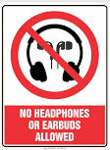
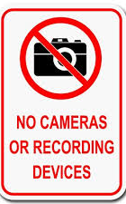







WHAT IS NOT ALLOWED?

Slide 53

PROCTOR INTERVENTION
Proctor Intervention
The proctor may intervene to actions or behaviors that are not allowed. Actions and behaviors that will be flagged during a test:
Talking out loud: Unless you have accommodation, talking or whispering aloud during the test is not permitted.
Being out of camera view: Your face, chin to forehead, must always be in the camera view.
Anyone entering your testing area: You may not have anyone else in your testing location with you.
Anyone talking to you while you are in your testing area: Additional noises, including other people talking to you, while you are taking your test are not allowed.
Looking off-screen: Your eyes must stay within the parameters outlined in this CIB.
Using materials that are not allowed: No unauthorized materials are allowed for this test. Phones and recording devices are prohibited.

Slide 54
PROCTOR INTERVENTION (cont.)
Taking pictures or screenshots of the test: Taking pictures, including screenshots, is not permitted. If you are using a Mac, your proctor will disable the ability to use your keyboard screenshot hotkeys.
Copying and/or pasting any elements of the test: The system will not allow you to copy and paste any content from your test. Regardless of whether you can or cannot perform this function, the system will capture all events of copy and paste that occur.
Using a virtual machine: Virtual machines can be detected through the pre-test system check and are not permitted.
Using a secondary monitor: You may only use one monitor connected to one computer during your test.
Leaving your seat: You must have prior approval from the proctor.
Using tobacco: Smoking/vaping/dipping/chewing or any form of tobacco is not permitted.
WARNING! REMINDER: All tests and test items are the sole property of NC Code Officials Qualification Board. No test items shall be copied, saved, or shared during or following the test. Any candidate caught or suspected of harvesting, sharing test items or test content, releasing confidential test materials, or participating in fraudulent test-taking practices will be reported to the Board and disciplinary actions taken, up to and including permanent revocation of your application, license, civil penalties, and criminal charges.

Slide 55
PART 6 – TEST DAY AND AFTER THE TEST
XX. WHAT TO EXPECT ON TEST DAY
IMPORTANT:
If your codebook is bound and tabbed in accordance with the CIB and the proctor insists you need to remove the tabs, you can refuse the exam and reschedule, no loss of eligibility and no additional fees.
To reduce stress from extended check-in time, have your testing area as clear as possible. See sections on TEST AREA and PHYSICAL AREA CHECK.
The proctor will state the accommodation(s) on file. If they cannot verify and allow the accommodation(s), let them know you want to reschedule the test. Immediately, send an email explaining the issue to osfm.quest@ncdoi.gov.

Slide 56
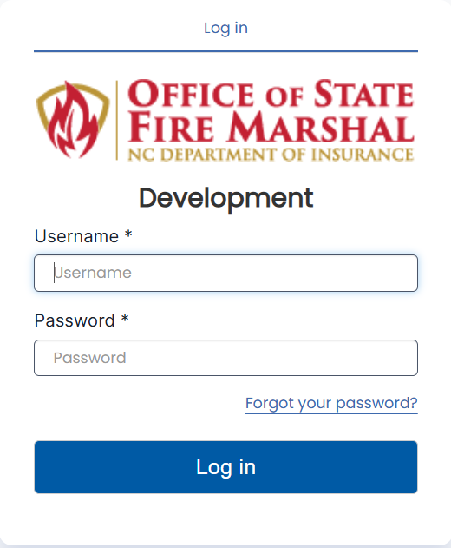
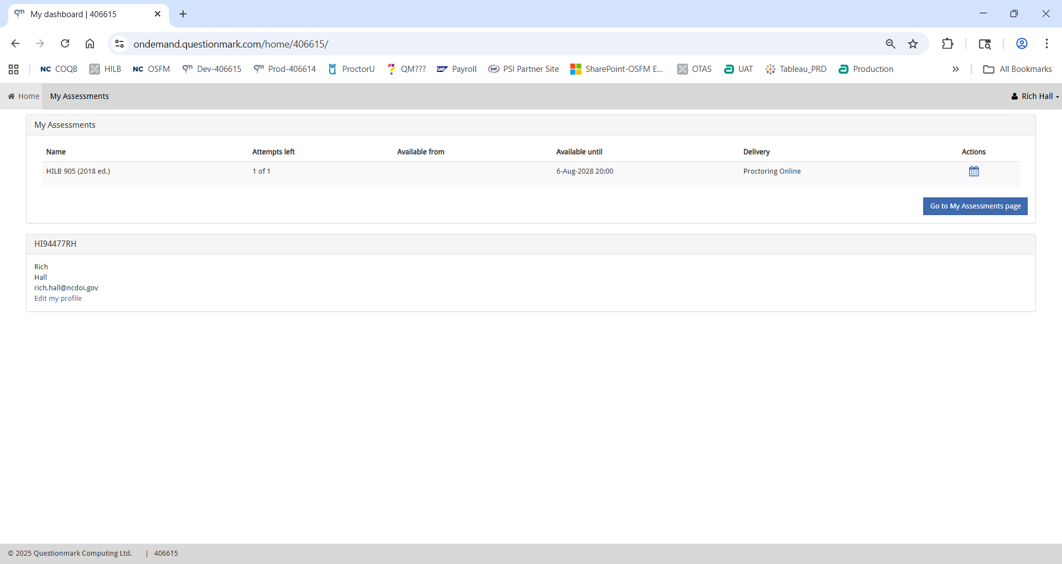
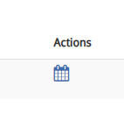
LOGGING INTO THE TEST
Step 1 Step 2 Step 3
.
The “Actions Calendar” button will change to a blue "Play" button for the assessment approximately five minutes before the scheduled start time. Until this time, the button appears as a calendar. Once you are within five minutes of the assessment time, it will transform into the "Start" button.
NOTE: If the Play Button does not appear 5 minutes prior to the test start time, do not panic. Sometimes it doesn’t appear until test time. This delay will not impact your test time.
Step 4. Click the Play button to enter the test process

Slide 57
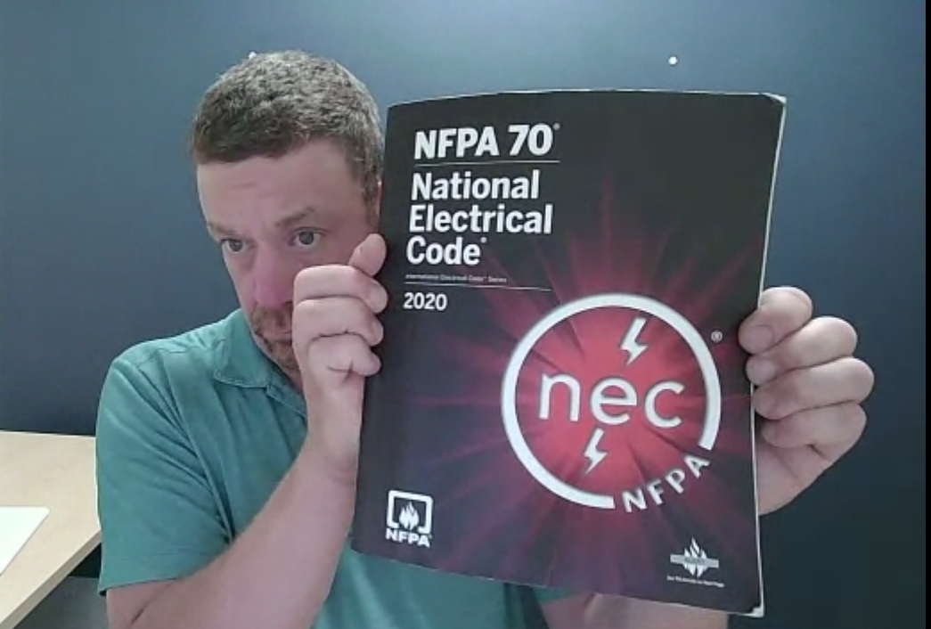
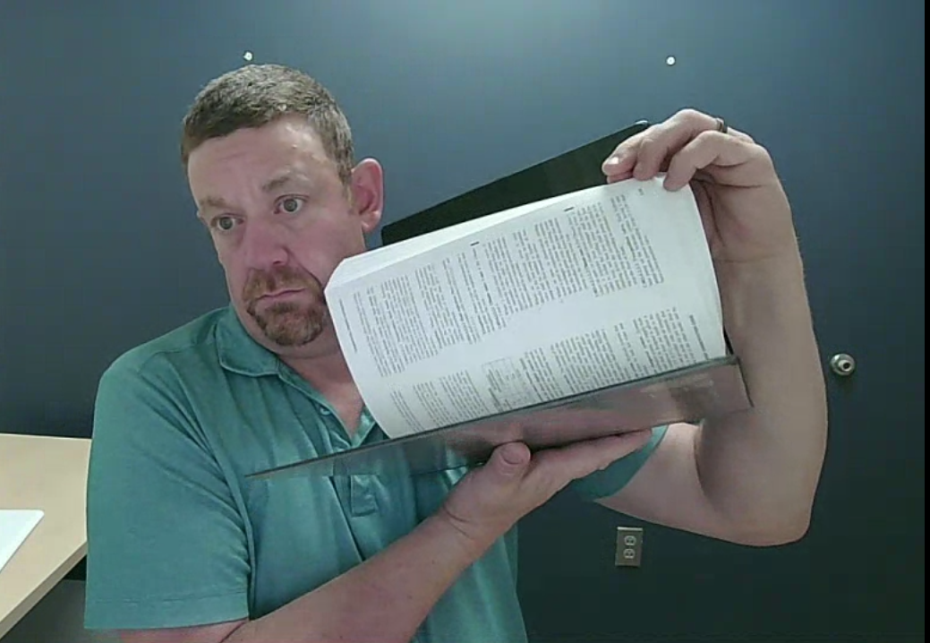
Presenting Reference Materials
WARNING: On test day you will be required to present reference materials during the room scan. You must show them to the proctor before the test begins. You will be required to SLOWLY flip through the pages of your reference materials to allow the proctor to determine consistency throughout the text. Using unauthorized materials is a serious violation that can lead to a canceled score and the loss of an eligibility.

Slide 58
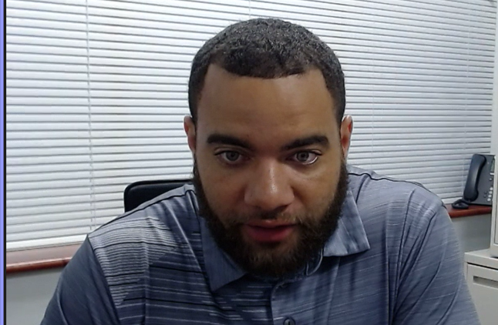
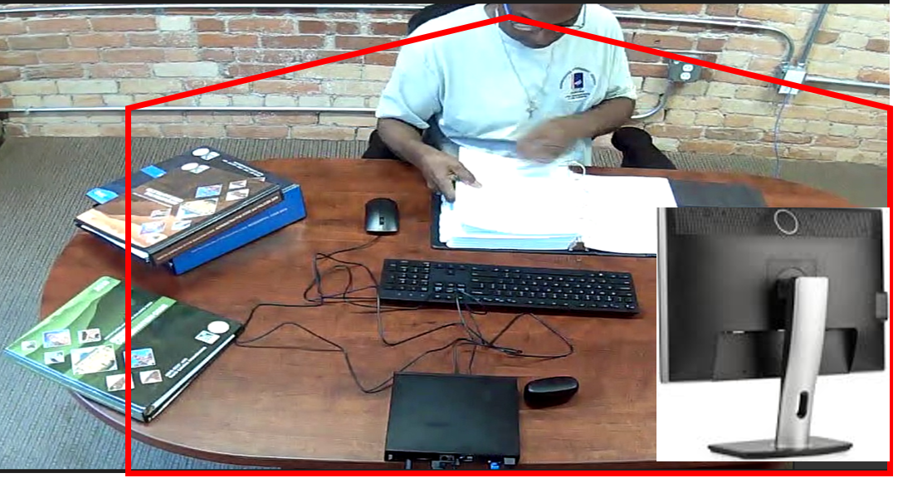
EYE/HEAD MOVEMENT PARAMETERS DURING THE TEST
This image is a representation of the view the proctor will have during the test.
Your face, chin to forehead, must always be in the camera view.
The red line in the following images indicate the allowable eye/head movement parameters

Slide 59
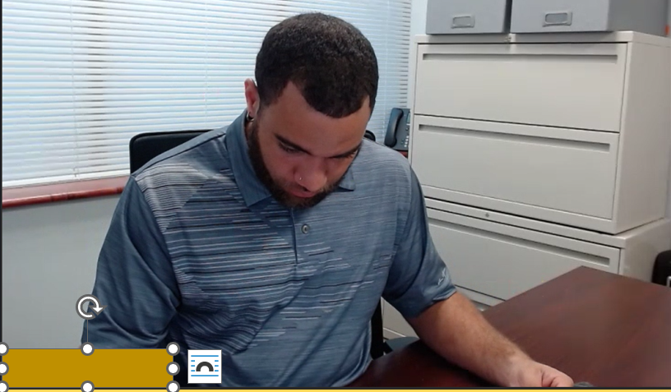
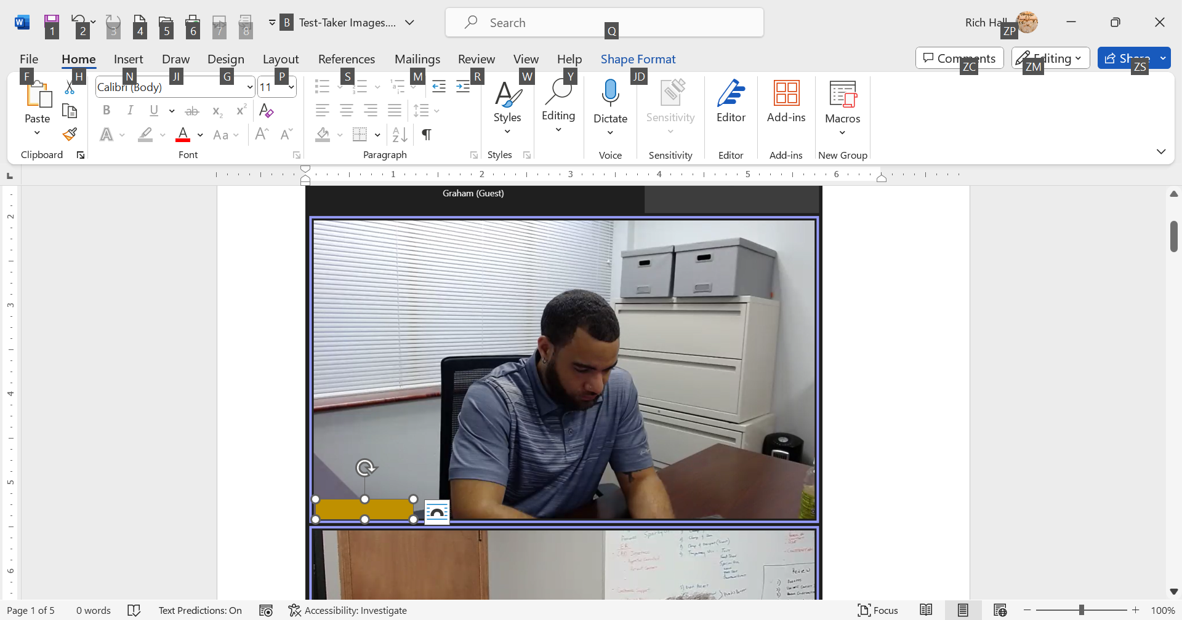
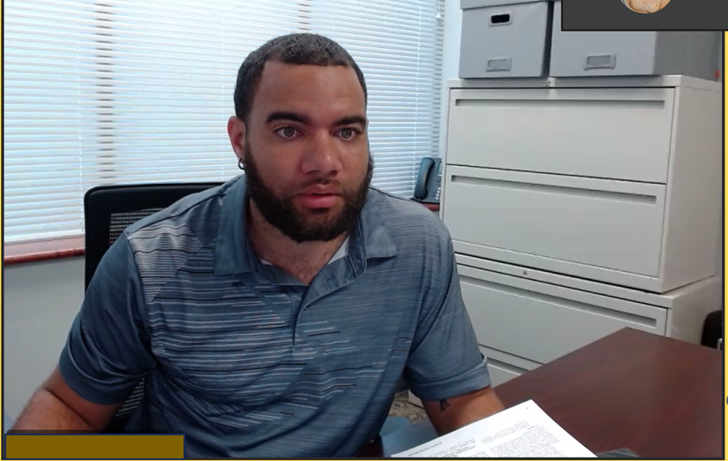
EYE/HEAD MOVEMENT (cont.)
Any other movement will be flagged.
If continuous, the proctor may stop the test.
If this occurs you will forfeit this attempt and may not be able to retest.

Slide 60
APPROPRIATE SET-UP

Slide 61
RESTROOM BREAKS DURING THE TEST
With proctor approval, candidates may take a restroom break.
For this exam you are allowed no more than two (2) restroom breaks.
IMPORTANT: Before taking a break, you must "Submit Your Answers” for the current block of test items and not have opened the next block of test items.
You will not be able to return to any submitted blocks.
Breaks may not exceed 15 minutes.
The test time clock never stops.
During breaks, candidates are not allowed to disrupt the virtual environment (browse the internet, check email, chat, etc.).
When a candidate returns from a break, the physical environment will be resecured.
Another room scan will be performed with the proctor.
Do not communicate with anyone.

Slide 62
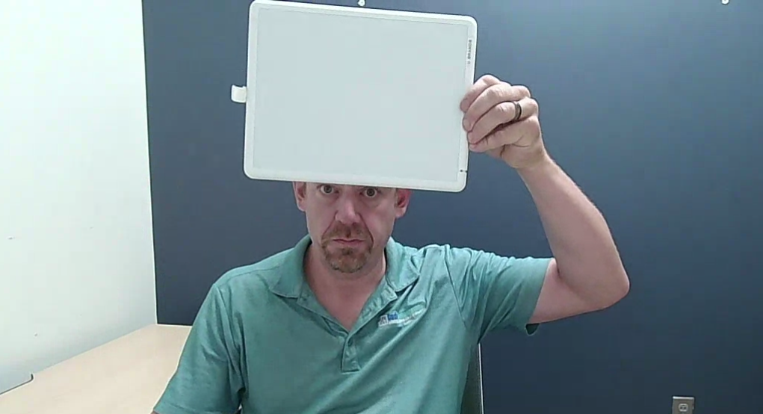
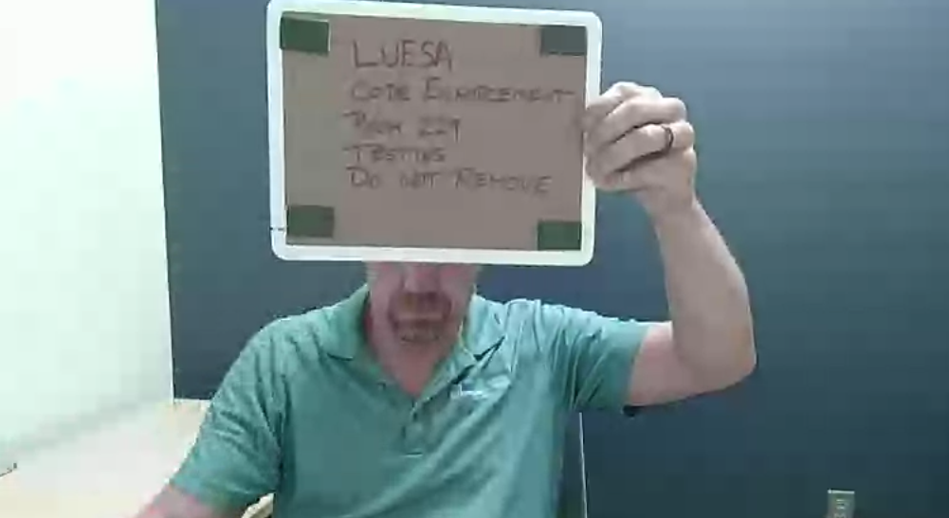
DRY-ERASE WHITEBOARDS
Dry-erase whiteboards are authorized for COQB tests. You will be required to show the erased blank whiteboard prior to the test as well as no writing on the back of the whiteboard. Near the end of the test, you will be required to show the proctor your erased whiteboard (front and back) again. Do not proceed to the next block until your proctor has verified the blank whiteboard.

Slide 63

TECHNICAL ISSUES DURING THE TEST
Known computer issues must be resolved before test day.
Important:
Waiting for a technician:
If there are technical issues, there will be a waiting period for the proctor to connect to a technician.
Be patient and do not panic!
If the issue cannot be resolved, OSFM staff will be notified.
After a review, you will be notified regarding next steps.

Slide 64
TECHNICAL ISSUES DURING THE TEST
The proctor will perform basic troubleshooting for five minutes then transfer to technician if technical issues continue.
Technicians will troubleshoot for up to an additional 20 minutes and if no resolution is achieved, the candidate will need to reschedule.
If repeated technical issues occur during the test, technicians will ask the candidate to reschedule the test.
The technician will be the one to inform the candidate that no more troubleshooting can be performed.
If there is a system failure such as a power outage, loss of network connectivity, software failure, or a candidate closed their browser window, follow the “RESUME PROTOCOL”

Slide 65
RESUMING A TEST
The testing software provides support for disconnections by allowing both candidates and proctors to resume a test.
If you lose your connection or if a proctor requests it, you can resume your test for a limited time.
Log back into Questionmark and click the "Resume" button (see screenshot below).
The “Resume Button” relaunches the Guardian browser. You will be checked in and the room secured before you continue the assessment.
If this does not work, the candidate will need to reschedule the test.

Slide 66
TECHNICAL ISSUES DURING THE TEST
  If the technical issue is on the QUEST side, a fee will not be charged for rescheduling.
  If the technical issue is on the candidate’s side, a new test fee may be required.
  As stated in the “Reservation Confirmation” and “Reservation Reminder” emails”, test your system prior to test day.
  If unable to reconnect to the test. Send a detailed email to osfmexamsupport@questionmark.com.

Slide 67
AFTER THE TEST
Candidates who pass the test:
  will receive notification of the passing status.
  no score information will be available.
  results will be transmitted to the COQB Database.
Candidates who fail the test:
  will receive their score and a coaching report.
  results will be transmitted to the COQB Database.
  each eligibility is valid for two (2) attempts.
  you must wait 30 days between each attempt.
  shortly after failing the test, you will receive an email stating that “Your application is approved, and you are eligible to take the test. Please use the green "Purchase Exam" Button provided below to purchase your test.”
  when you schedule your test, the available dates will be 30+ days from your previous attempt. This process will allow you time to plan what works best for you. Save this email.

Slide 68
CANCELATION OF TEST RESULTS
Candidate test results will be cancelled for suspected irregularities such as:
  giving or receiving assistance with answers during a test,
  harvesting or sharing test items or test content,
  using unauthorized materials,
  failing to abide by the rules presented or directions from the proctor,
  or inappropriate behavior.
  Note: These irregularities may be presented to the Board for disciplinary action.

Slide 69
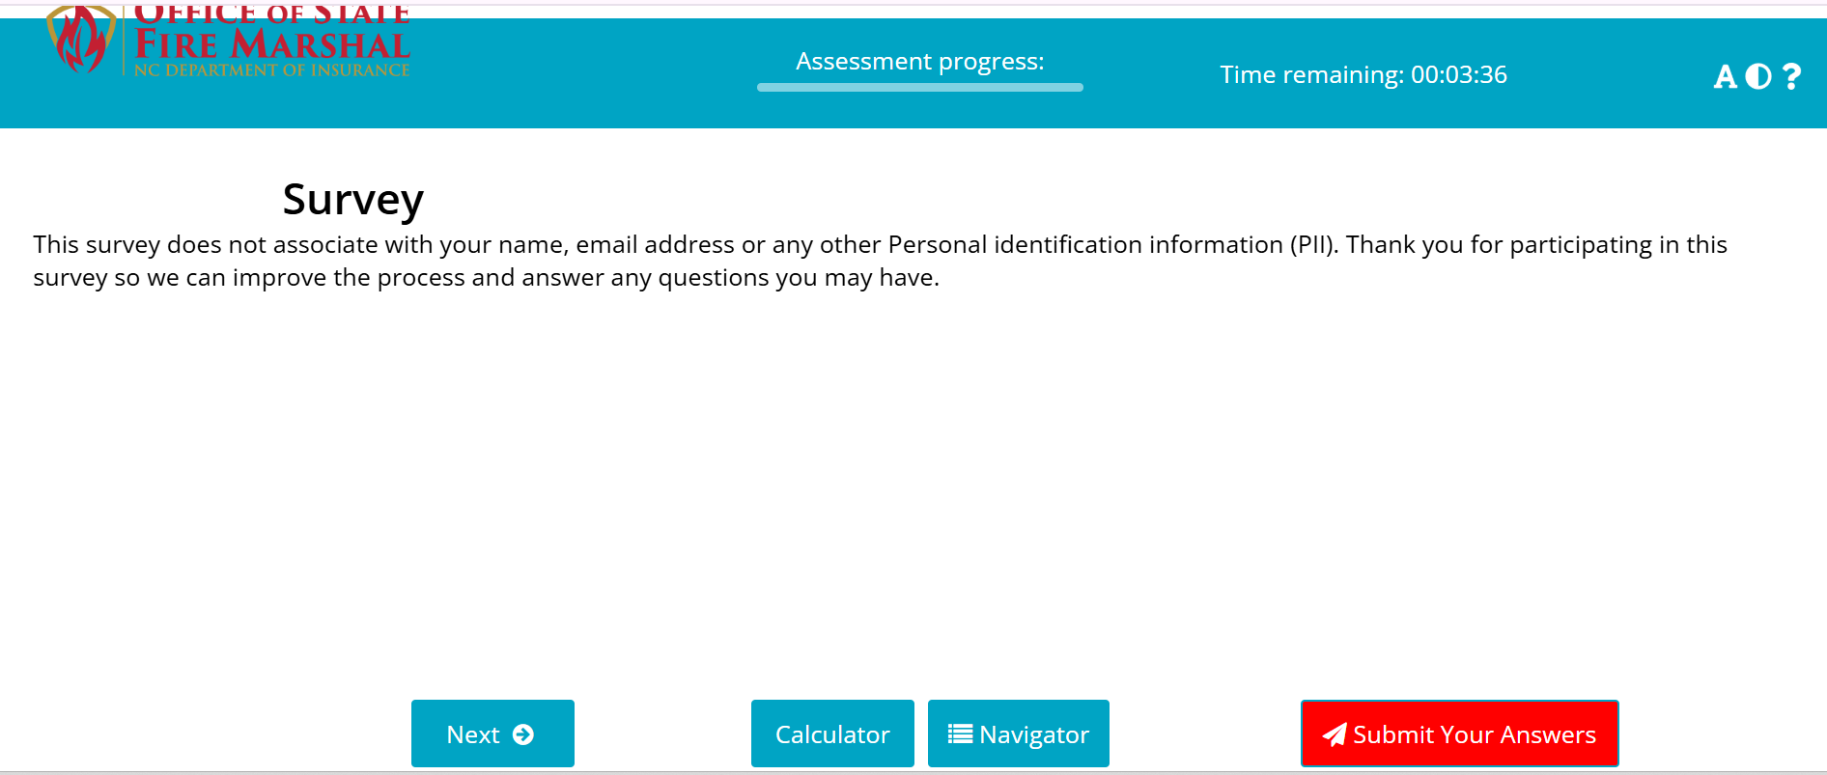
OSFM SURVEY
At the end of the exam, the proctoring service will ask you to complete a survey. The survey is optional.
In your PASS/FAIL email from OSFM, you will receive a link to the 2-minute OSFM survey. Please complete the survey. Your responses will help us improve our services.

Slide 70
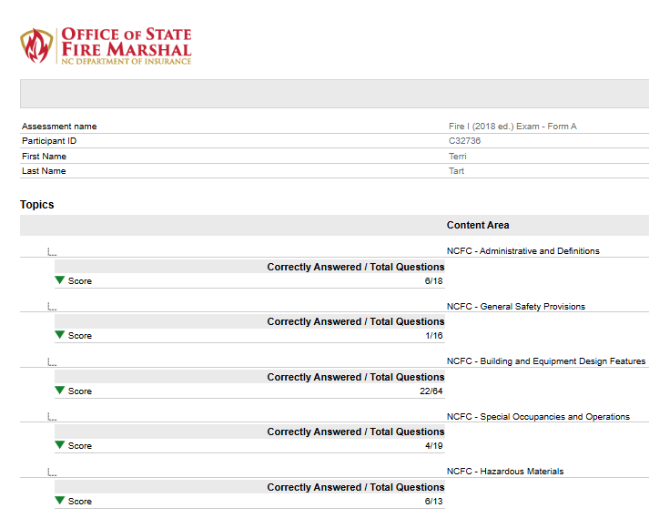
COACHING REPORT
SAMPLE COACHING REPORT
Be sure to check your SPAM or JUNK email.
There are no test review/item challenges for this test. A Coaching Report link will be included in the email. Information in the report is provided to identify areas where you need further study. The Coaching Report shows the total number of questions per content area.
Example: This candidate correctly answered 6 of 18 test items in the NCFC – Administrative and Definitions block of the test.

Slide 71
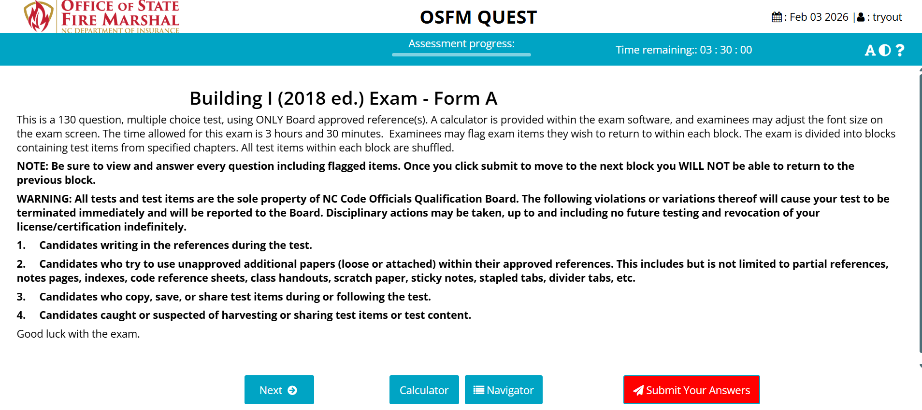
SEE “APPENDIX A” FOR TEST SCREENSHOTS

Slide 72
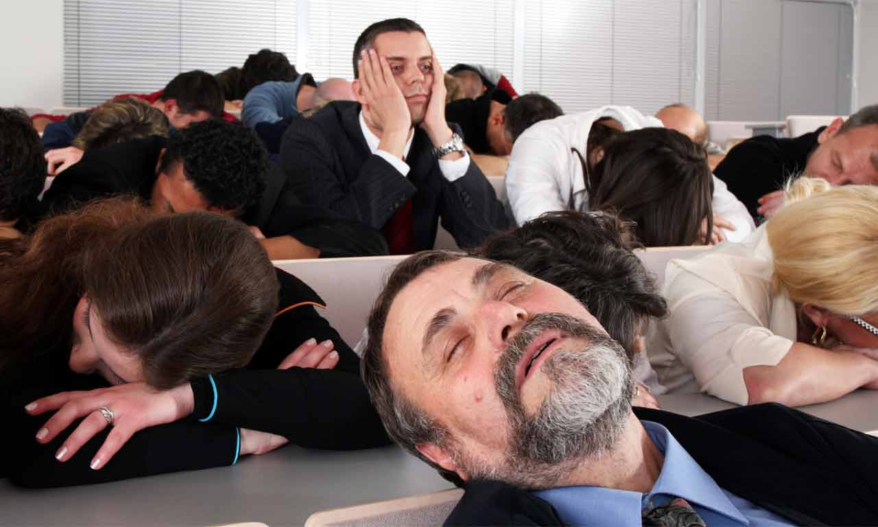
THANK YOU FOR YOUR ATTENTION

