Slide 1
School Director Class version 7 3-2021
Notes:
Basic preliminary information: bathroom location, breaks will be given, lunch time, questions taken throughout presentation.
Introduce yourself

Slide 2
OBJECTIVES
To be able to explain the functions and purpose of the Fire Rescue Commission and Certification Board
To understand the role of the Office of State Fire Marshal and the resources associated with them
To establish a working knowledge of the requirements and responsibilities of the School Director
To be capable of entering certification courses into OSFM 24
To be able to explain the process of becoming a qualified instructor in North Carolina
To understand the differences between the instructor and proctor roles

Slide 3
Section 1
Fire Rescue Commission
Certification Board
Office of State Fire Marshal

Slide 4
NC FIRE RESCUE COMMISSION
General Statutes
  GS 58-78-1 creates the Fire Rescue Commission
  GS 58-78-5 explains their powers & duties
  GS 58-78-5 (a)(1) requires a State Fire Education and Training Plan to be formally adopted
  GS 58-78-5 (a)(14b) establishes voluntary minimum professional qualifications for all levels of fire / rescue service personnel
  GS 58-78-10(c) requires all quarterly meetings shall be open to the public
  GS 58-78-15 creates staff to the Commission; OSFM
Notes:
Fire Rescue Commission is established by General Statutes (State law). Here are the ones that apply.
Created by:
Duties of the commission:
Who will serve as staff to the commission:
Staff falls to DOI

Slide 5
FIRE RESCUE COMMISSION
Represent the following agencies (15 total):
  State Firefighter’s Association (2)
  Society of Fire Rescue Instructors
  Association of Rescue and EMS (2)
  Fire Marshal’s Association
  Association of Fire Chiefs
  League of Municipalities
  Public at Large
  Speaker of the House Appointee
  President of the Senate Appointee
  Governor’s Appointee
  Professional Firefighters of NC
  NC International Association of Arson Investigators
  NC Association of County Commissioners Nominee
Notes:
We are constantly asked how to get on a board. You have to be nominated by one of these organizations.

Slide 6
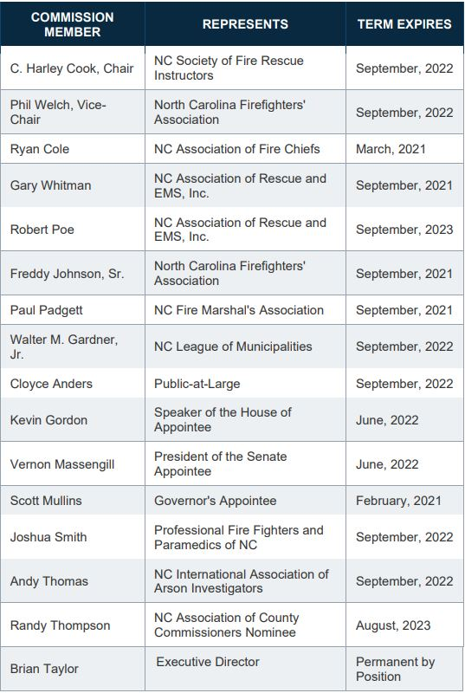
FIRE RESCUE COMMISSION
Notes:
We are constantly asked how to get on a board. You have to be nominated by one of these organizations.

Slide 7

FIRE RESCUE COMMISSION
Quarterly meetings – open to the public
  10am, Tue, April 13, 2021
    Location TBD
  10am, Tue, July 13, 2021
    Location TBD
  10am, Tue, October 12, 2021
    Location TBD
Notes:
There are three boards:
Workers Comp: handled workers comp rates and dealings with the fire/rescue service
Arson Review Board – Handles CFI
Cert Board – Handles all NC Certifications other than previously mentioned

Slide 8
FIRE RESCUE COMMISSION
Accomplishes their mission through three boards
  Worker’s Compensation Board
    Cloyce Anders, Chair
  Arson Review / CFI Board
    Freddy Johnson, Chair
  Certification Board
    Kevin Gordon, Chair
Notes:
There are three boards:
Workers Comp: handled workers comp rates and dealings with the fire/rescue service
Arson Review Board – Handles CFI
Cert Board – Handles all NC Certifications other than previously mentioned

Slide 9
CERTIFICATION BOARD
Board of peers
Represent the following agencies (13 total):
  State Firefighter’s Association (2)
  Society of Fire Rescue Instructors
  Association of Rescue and EMS (4)
  Fire Marshal’s Association
  Fire & Rescue Commission Chair Appointee
  Fire & Rescue Commission Vice-Chair Appointee
  Fire Rescue Commission
  Community College Fire Rescue Advisory Board
  Professional Firefighters and Paramedics
Notes:
Cert board is made up of a group of your peers.
We are constantly asked how to get on a board. You have to be nominated by one of these organizations.

Slide 10
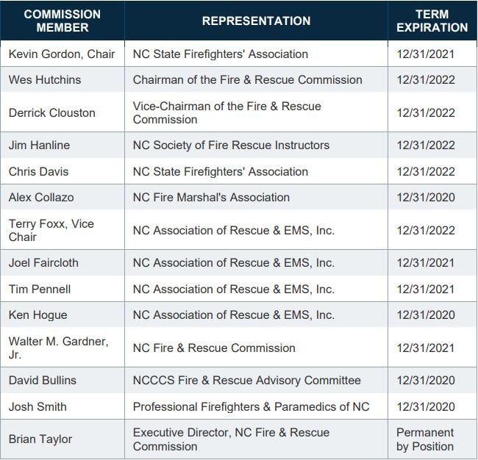
CERTIFICATION BOARD
Notes:
Cert board is made up of a group of your peers.
We are constantly asked how to get on a board. You have to be nominated by one of these organizations.

Slide 11
CERTIFICATION BOARD
Accomplishes the following tasks:
  Decides what will be a NC certification
  Determines the qualifying process for instructors
  Sets rules and enforces requirements for certification
  Develops / approves / evaluates lesson plans and tests
  Approves delivery agencies
  Oversees delivery agency / instructor conduct
All actions must be approved by the Fire Rescue Commission
Notes:
Cert board decides the following:
NC certifications – will talk more about that later
Set rules – examples would be the 3 year and 5 year rules for Instructor 1&2 – also approve delivery agencies
Develop lesson plans – approve materials and content
Oversee Instructor conduct – Investigations into instructors and delivery agencies

Slide 12

CERTIFICATION BOARD
Quarterly meetings – open to the public
  10am, Tue, March 9, 2021
    Kernersville – Canceled
  10am, Tue, June 8, 2021
    Location TBD
  10am, Tue, September 14, 2021
    Location TBD
  10am, Tue, December 14, 2021
    Location TBD
Notes:
There are three boards:
Workers Comp: handled workers comp rates and dealings with the fire/rescue service
Arson Review Board – Handles CFI
Cert Board – Handles all NC Certifications other than previously mentioned

Slide 13
OFFICE OF STATE FIRE MARSAL
Department of Insurance
Reports to the Commissioner of Insurance
  Commissioner of Insurance also serves as State Fire Marshal
There shall be an executive director nominated by the Commission with direct responsibilities to the Commission, who shall be appointed by the Commissioner
  Brian Taylor – Executive Director to the NCFRC
    Executive Director serves on all boards by virtue of position
    Term does not expire on any boards
Notes:
OSFM is the paid department previously mentioned by General Statute
Answer to an elected official
Senior Deputy is on all boards
Here’s the website and phone number

Slide 14
NC DOI / OSFM SENIOR STAFF
Mike Causey - Commissioner of Insurance, State Fire Marshal
Brian Taylor - Chief State Fire Marshal, Assistant Commissioner
Rob Roegner - Senior Deputy Commissioner of Engineering Services
Mike Williams - Senior Deputy Commissioner of Fire & Rescue Services
Notes:
OSFM is the paid department previously mentioned by General Statute
Answer to an elected official
Senior Deputy is on all boards
Here’s the website and phone number

Slide 15
OSFM ORGANIZATION
Two Divisions:
  Engineering
  Fire & Rescue
Divided into seven subdivisions:
  Engineering and Codes (Q Board / Inspector Classes)
  Manufactured Building
  Risk Management
  Injury Prevention
  Fire Investigations
  Training, Inspections and Grants
  Fire Rescue Commission
Notes:
Engineering: Engineering and Codes, Manufactured Building, Risk Management
Fire/Rescue: Prevention and Grants, Training and Inspections, Fire Rescue Commission Staff

Slide 16

OSFM ENGINEERING
Code Classes
  Fire Code classes and all building trades classes are set up and managed by the Code Officials Qualification Board (COQB)
Points of Contact
  Beth Ann Williams
  beth.williams@ncdoi.gov
  919-647-0019
Mike Hejduk
mike.hejduk@ncdoi.gov
919-647-0024

Slide 17
OSFM PREVENTION
Injury Prevention
  Juvenile Fire setter
  Remembering When
  Safe Kids
  Child Passenger Safety
  Smoke Alarm Installation
  Home Fire Sprinkler
  Operation Medicine Drop
  FLSE Association
Notes:
IP – handles the following
Also the Fire and Life Safety Educators Association and Conference
Grants – handles relief funds and state grants

Slide 18
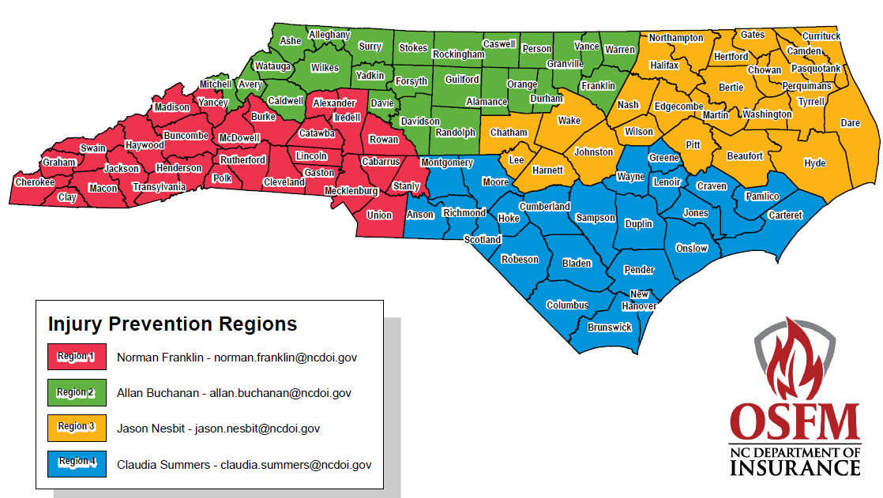
OSFM PREVENTION
Shannon Bullock – Deputy Director, Injury Prevention & Safe Kids NC
  Norman Franklin – Region 1
  Allan Buchanan – Region 2
  Jason Nesbit – Region 3
  Claudia Summers – Region 4

Slide 19
FIRE RESCUE TRAINING, RATINGS, & GRANTS
Brian Wade – Deputy Director, Fire & Rescue Grants, Inspections, Training
Training
  Tony Robinson
  Devin Cockrell
  Bruce Hodges
  Tyler Moore
  Anthony Killough
  Jason Edwards
  Lance Foulk
  Mark Rutherford
Inspections
  Davie Summey
  Vernon Ward
  Tony Bailey
  Terry Young
  Brian Cox
  Deral Raynor
  Lee Kennedy
  Jeremy Hunt
  Jamie Fore
Grants
  Kim Robertson
  Shirley Lofton
  Sharon Dailey
  Michael White

Slide 20
FIRE RESCUE TRAINING, RATINGS, & GRANTS
Training
  Direct training for FDs
    NFA Classes
    Special Training
  Subject Matter Experts
  Instructor Qualification and Upgrades
  Special Schools
Inspections
  9S Ratings
  ISO Ratings
  ISO Education Classes
Grants
  Volunteer Fire Department Grant
  Volunteer Rescue / EMS Grant
  Firefighters’ Relief Fund
  Rescue Squad Workers’ Relief Fund
Notes:
Training – serve as subject matter experts
Inspections – deal with ratings, during checks work with grants to maintain equipment

Slide 21








FIRE RESCUE TRAINING
Qualification Schools
  January 5-6, Fayetteville Fire Department
  February 9, Cape Fear Community College
  March 16, A-B Tech Community College
  April 20-21, Greensboro Fire Department
  May 18, Johnston Community College
  June 15, Martin Community College
  July 20-21, Gaston Community College
  November 16-17, Charlotte Fire Department
Upgrades & Requalifications
  As needed / required

Slide 22
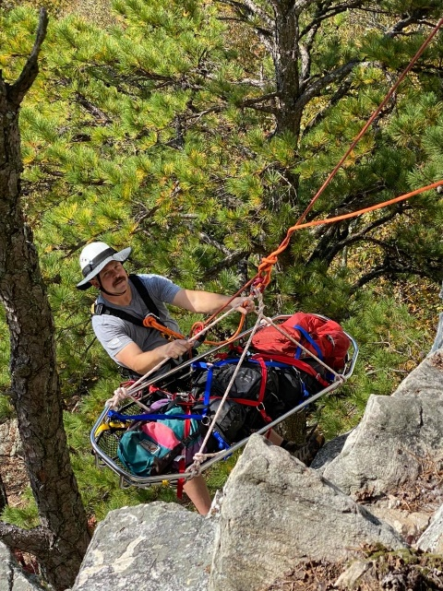
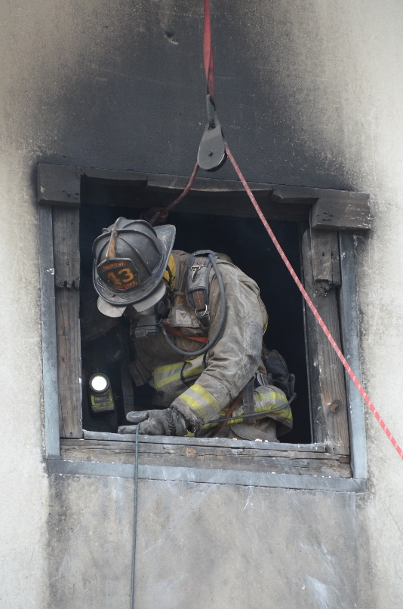

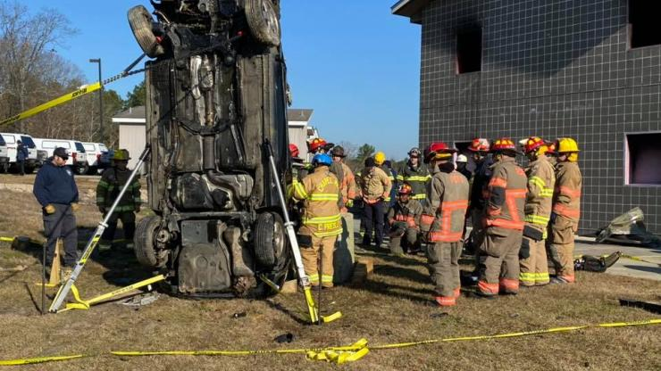
FIRE RESCUE TRAINING
Special Schools
  Breathing Equipment School
  High Angle School
  Extrication School
  Leadership Academy
  Tactics Academy

Slide 23
FIRE RESCUE TRAINING
Direct Delivery Courses
  Fire Investigation Technician
    Tyler Moore, Program Manager
  Hazardous Materials Technician
    Lance Foulk, Program Manager
  Fire Instructor III
    Jason Edwards, Program Manager
  Fire Officer III
    Jason Edwards, Program Manager
  Fire Officer IV
    Jason Edwards, Program Manager

Slide 24
OSFM FIRE RESCUE COMMISSION STAFF
Kim Williams - Deputy Director, Fire and Rescue Commission
Monna Gillespie - Certifications, NFIRS / Image Trend / NFA
  Certification Specialists
  Shawn Haynes - Region 1
  Michael Caviness - Region 2
  Matt Thorpe - Region 3
  Scott Hackler - Region 4
  Greg Palmer - Region 5
  Development Staff
  Caitlin Rollins - Test Bank Admin
  Adam Blythe - GIS

Slide 26
OSFM FIRE RESCUE COMMISSION STAFF
National Fire Incident Reporting System (NFIRS)
State Fire and Rescue Incident Reporting System (Image Trend)
Manage the voluntary certification system
  Transcripts
  Delivery Agencies
    Community Colleges
    Fire Departments
  High School Fire Academies
Indoctrination Course
School Director’s Course

Slide 27
INDOCTRINATION CLASS
Required for any instructor that does not hold a subject qualification
  New instructors
  Existing instructors that want to add new qualifications
  Existing instructors that have lost their qualifications
Must be completed prior to registering for Qualification School
Six-hour class
Covers all policies and procedures for instructors

Slide 28
OSFM FIRE RESCUE COMMISSION STAFF
Research & Program Development
  NFPA interpretation
  Curriculum and Training Development
    Write lesson plans and practical skills
    Oversee pilot program process
  Test bank creation, management, and validation
  Accreditation
  Pocket Tools Training
  Podcasts (in conjunction with Training Staff)

Slide 29




ACCREDITATION
International Fire Service Accreditation Congress (IFSAC)
National Board on Fire Service Professional Qualifications (Pro Board)

Slide 30

OSFM CONTACT INFORMATION
Physical Address Mailing Address
Albemarle Building OSFM Senior Staff & Support
325 N. Salisbury St 1202 Mail Service Center
Raleigh NC, 27603 Raleigh NC 27699-1202
800-634-7854
919-647-0000

Slide 31
Section 2
You, the School Director

Slide 32
WHO IS REQUIRED?
All School Directors affiliated with an approved Delivery Agency
  Community College or Fire Department
  Fire service background or not
Any new School Director within 6 months of their appointment date
  Fire Rescue Commission ruling
  Will lose ability to deliver certification classes

Slide 33
POLICIES & PROCEDURES
NC Fire & Rescue Commission Certification Board Policy & Procedures Manual (dated Oct 2020)
  Section 1: Overview & Acknowledgments
  Section 2: Certification Board Governance
  Section 3: Policy For Testing
  Section 4: Fire & Rescue Delivery Agencies
  Section 5: Community College Delivery Agencies
  Section 6: High School Certification Program
Delivery Agency Policy & Procedures Manual

Slide 34
POLICIES & PROCEDURES
    PPM 300.01
    General Testing Requirements
    Practical Testing Requirements
    Written Test Requirements
    PPM 400.01 and 500.01
    Administration of Delivery Agency
    Responsibility of the School Director
    General Overview of Fire / Rescue Training Delivery Support
    Reporting of Test Grades to the NCFRC
    Delivery Agency Site Visit Audit
    Agreement to Comply with NCFRC Delivery Status
    PPM 400.02 and 500.02
    Accountability for Delivery Agencies

Slide 35
RESPONSIBILITIES
Site visits
OSFM 24 – The Portal
Course records
Memorandums of Understanding (MOUs)
Written test administering & security
Lesson Plans / PowerPoints / Skill Books
Training props
Course audits
Injury reports
Instructor / proctor selection & conduct
Live fire notifications / requirements
Information sharing

Slide 36
SITE VISITS
Yearly
  Updates contact information
  Review policy and procedures
  Discuss weaknesses and strengths the program
5 year
  Audits all policies
  Audits to make sure MOU’s meets the intent.
  Performs an audit
Your policies shall be written as to how you are doing business. Don’t write a policy just to write a policy, if you are no longer doing business that way change the policy.

Slide 37
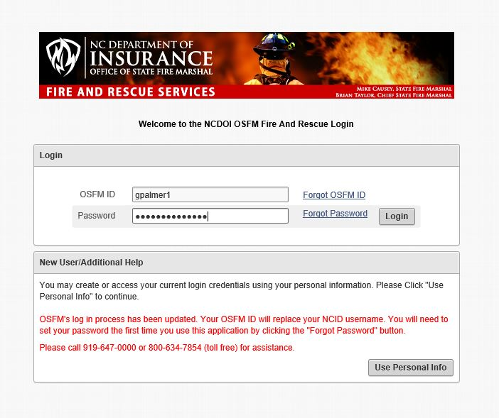

OSFM 24 – THE PORTAL

Slide 38
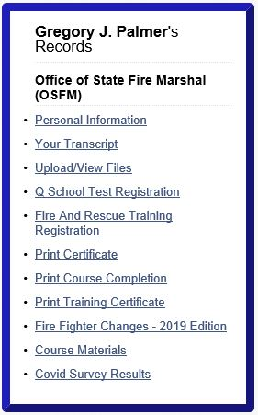
OSFM 24 – THE PORTAL
Personal records
  Personal information – VALID EMAIL
  Transcripts
  Q School registration
  Fire Rescue training registration
  Print certificates
  Program updates
  Course materials

Slide 39
OSFM 24 – THE PORTAL
Delivery Agency responsibility
Registration of all classes for certification 24 hours prior to start date
Automatically checks the instructor’s / proctor’s qualifications
Immediate upload to transcript (if uploaded by the school)

Slide 40
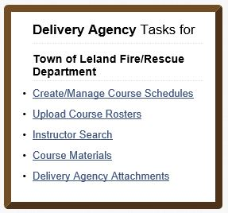
OSFM 24 – THE PORTAL – SCHEDULES

Slide 41
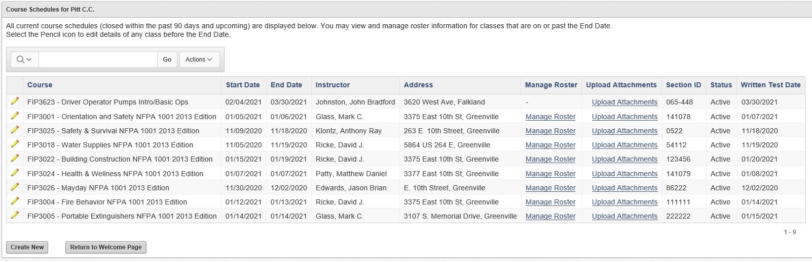
OSFM 24 – THE PORTAL – SCHEDULES

Slide 42
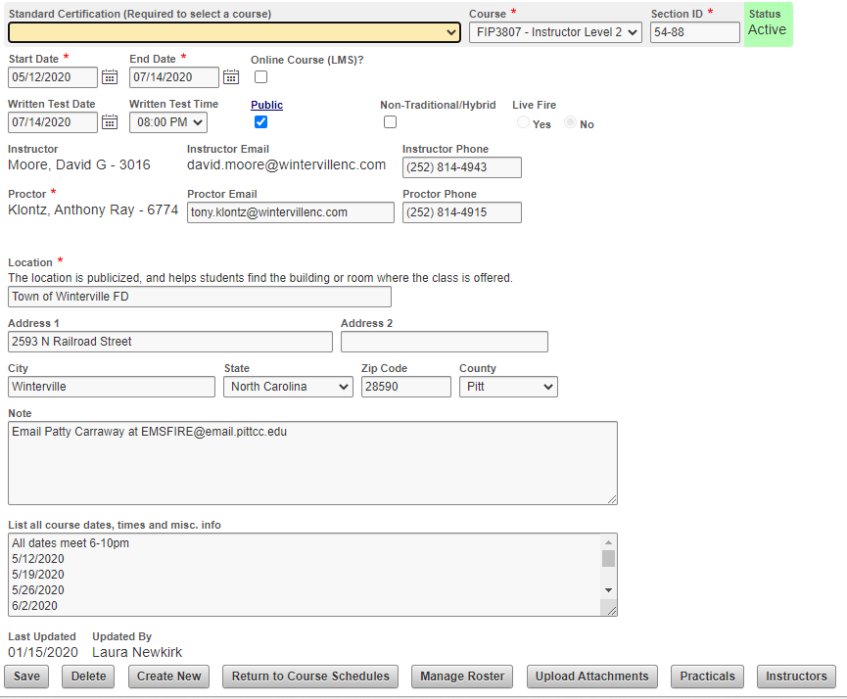
OSFM 24 – THE PORTAL – SCHEDULES

Slide 43
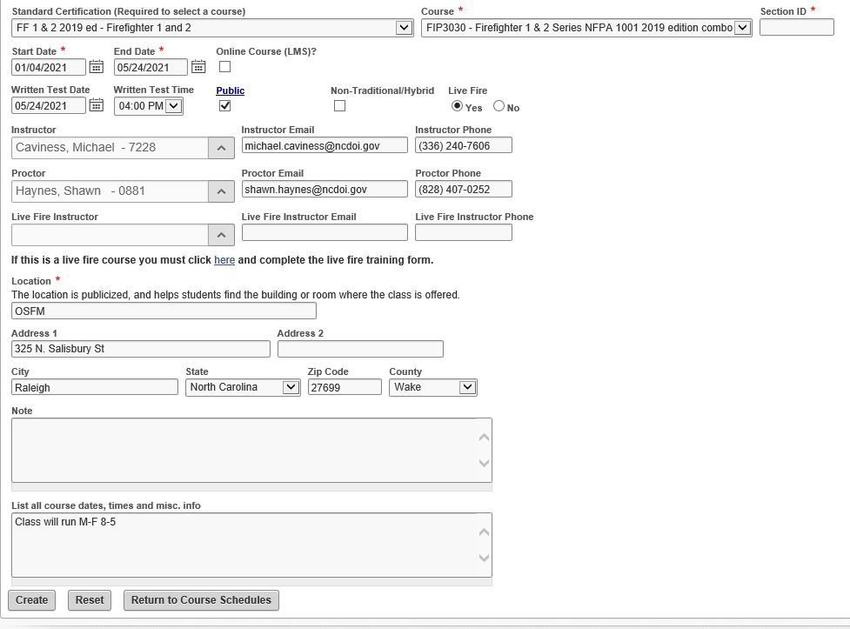
OSFM 24 – THE PORTAL – SCHEDULES

Slide 44
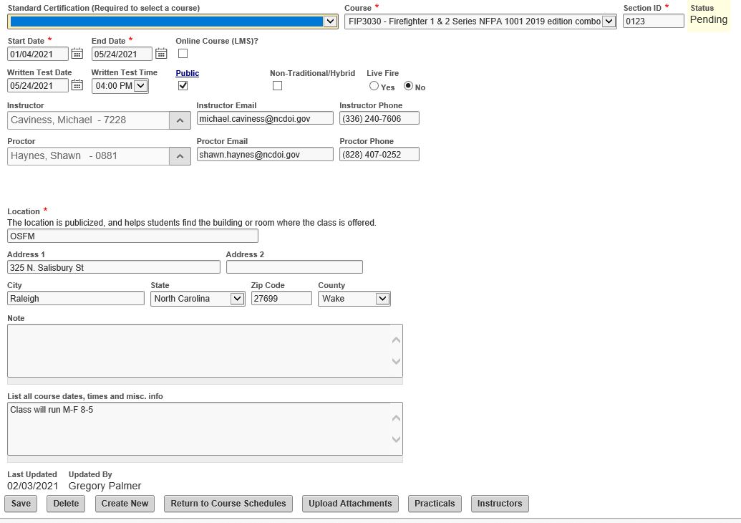
OSFM 24 – THE PORTAL – SCHEDULES

Slide 45
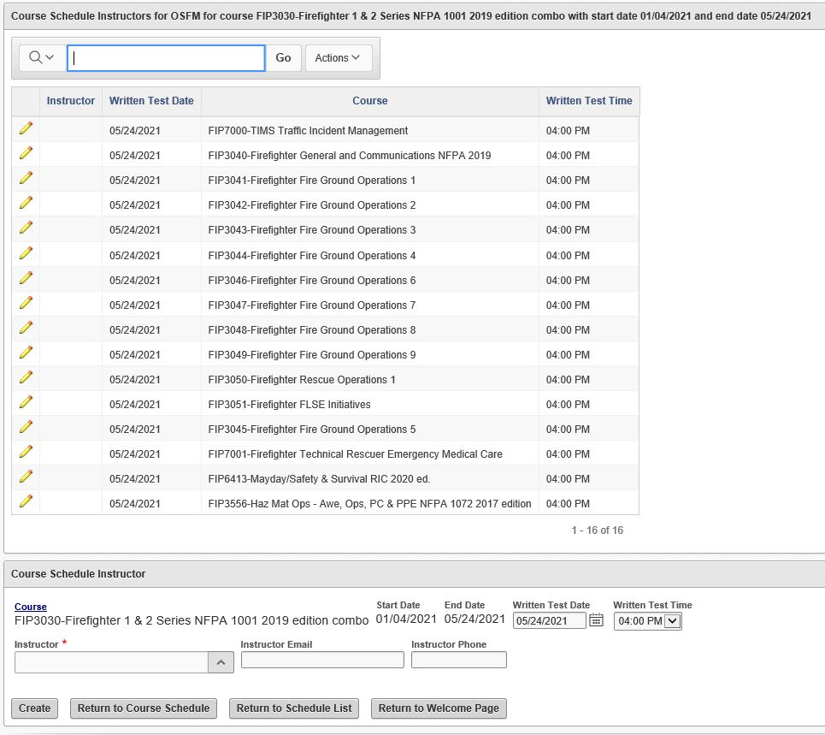
OSFM 24 – THE PORTAL – SCHEDULES

Slide 46
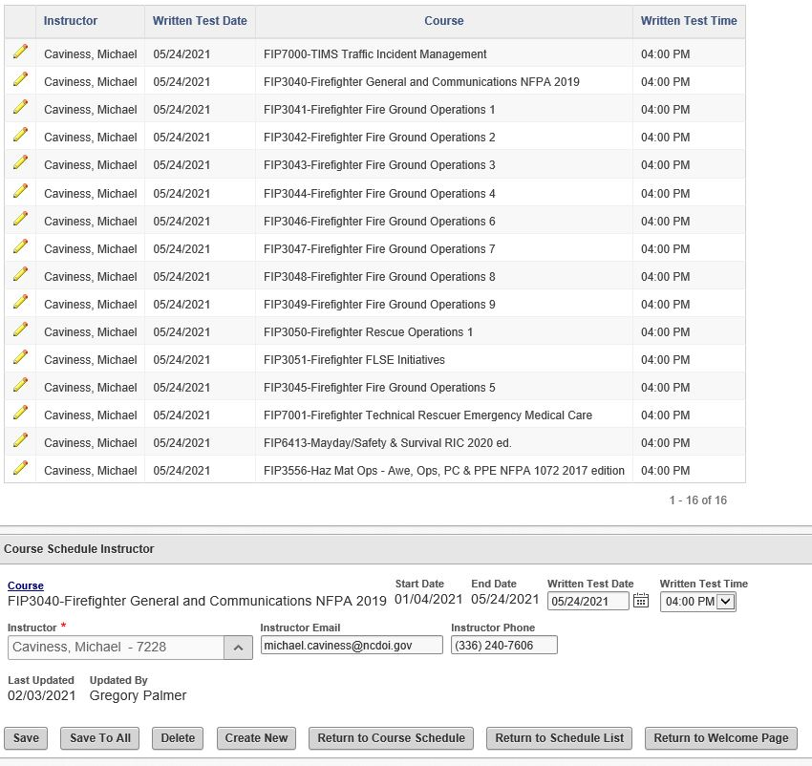
OSFM 24 – THE PORTAL – SCHEDULES

Slide 47
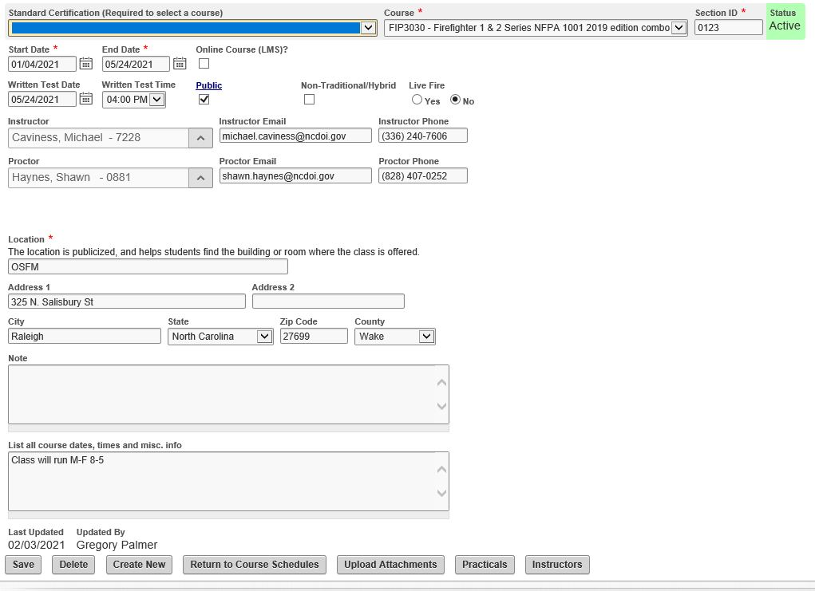
OSFM 24 – THE PORTAL – SCHEDULES

Slide 48
OSFM 24 – THE PORTAL – SCHEDULES
Section ID must match Datatel for Community Colleges
Fire Department courses are not public
If name is not listed in the instructor / proctor boxes
Location must match the physical location of the class
All course dates & times MUST be entered

Slide 49
OSFM 24 – THE PORTAL – ROSTERS

Slide 50
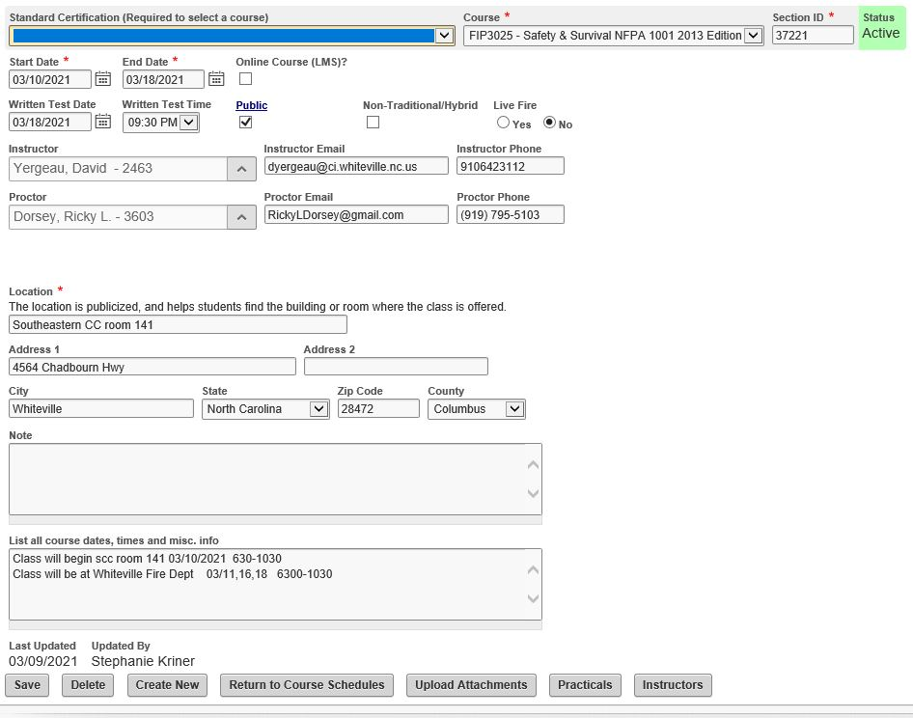
OSFM 24 – THE PORTAL – ROSTERS
If class has not reached the end date, there will be no “Manage Roster” button

Slide 51
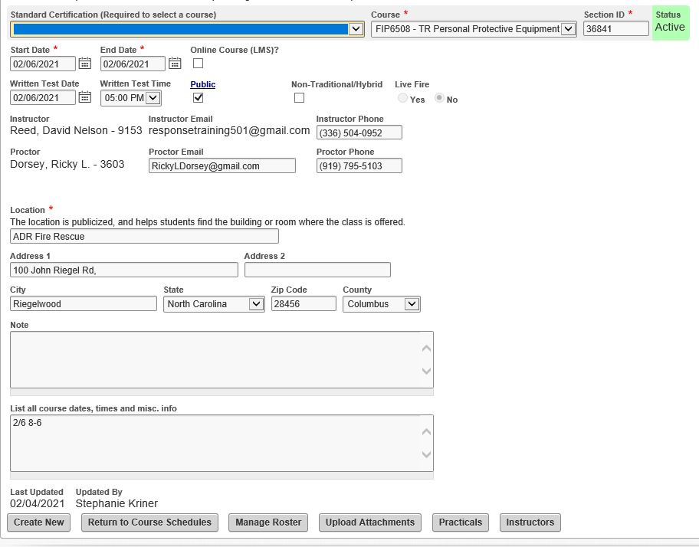
OSFM 24 – THE PORTAL – ROSTERS

Slide 52
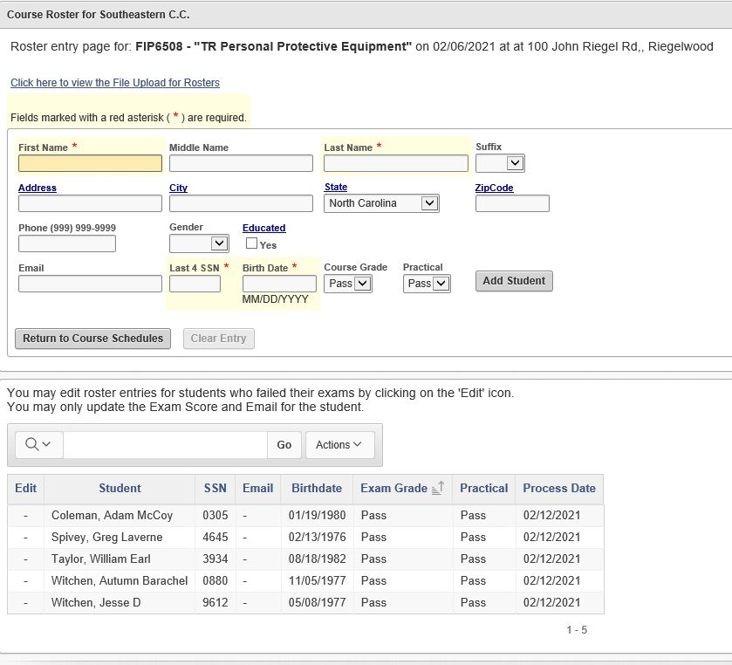
OSFM 24 – THE PORTAL – ROSTERS

Slide 53
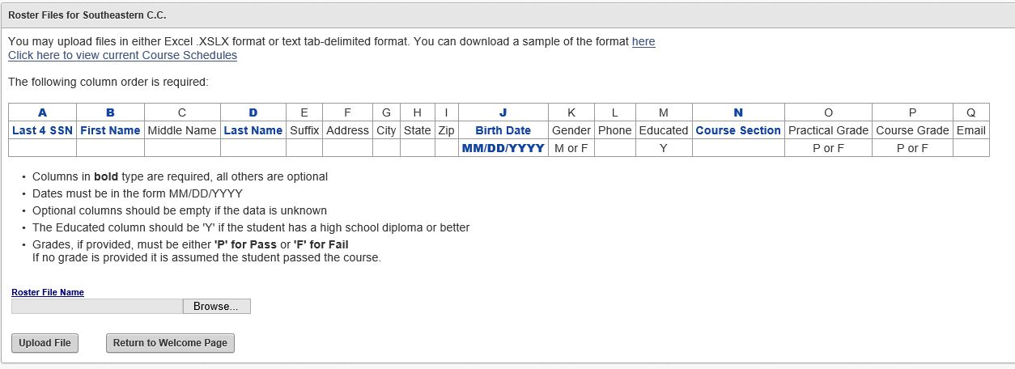
OSFM 24 – THE PORTAL – ROSTERS

Slide 54
OSFM 24 – THE PORTAL – SEARCH

Slide 55
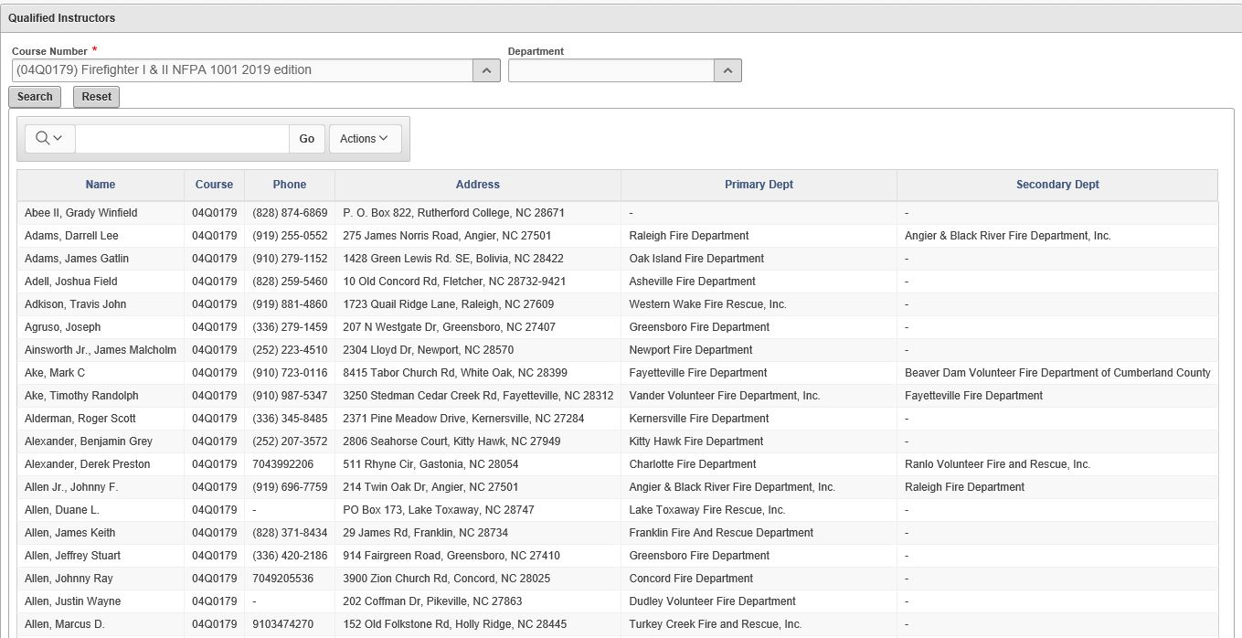
OSFM 24 – THE PORTAL – SEARCH

Slide 56
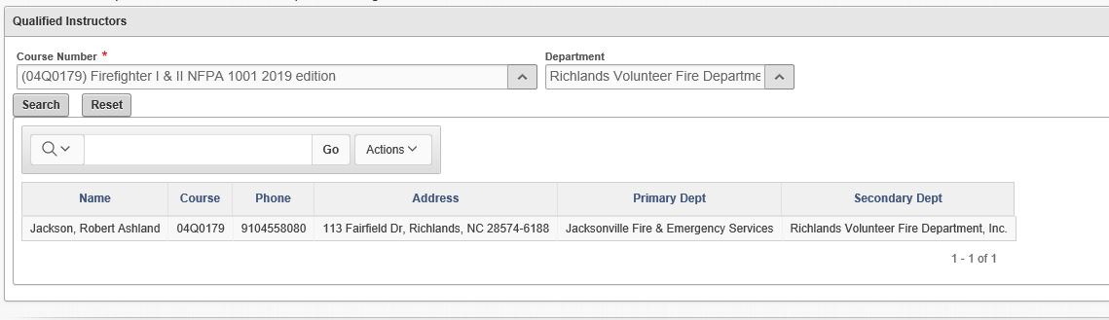
OSFM 24 – THE PORTAL – SEARCH

Slide 57
OSFM 24 – THE PORTAL – MATERIALS

Slide 58
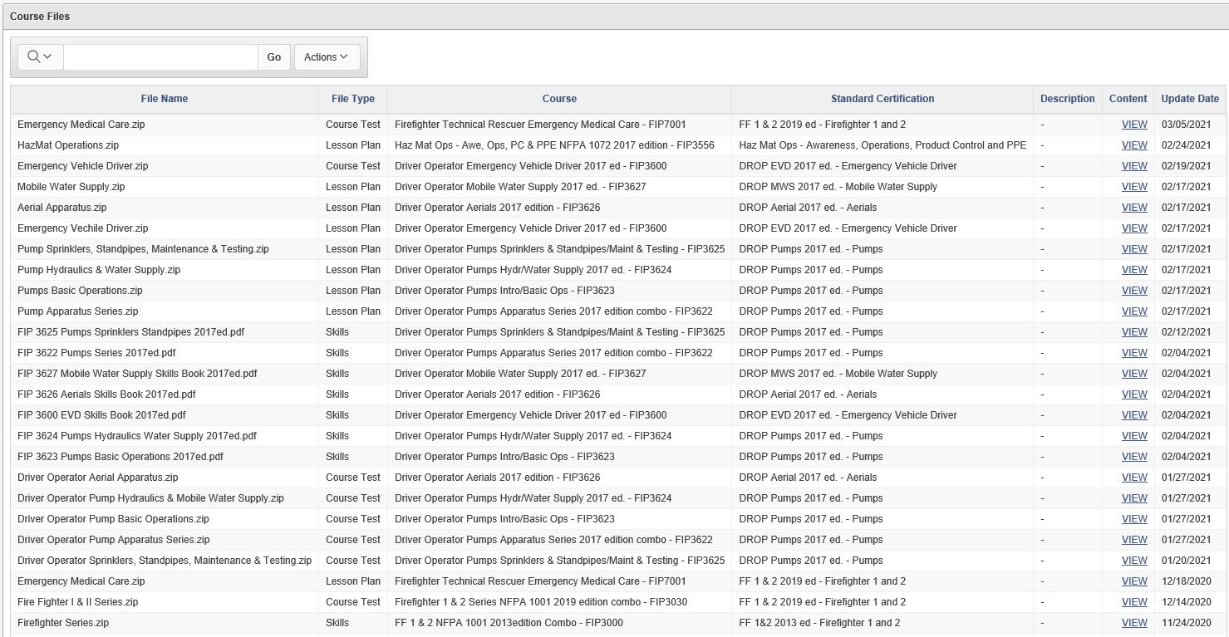
OSFM 24 – THE PORTAL – MATERIALS

Slide 59
OSFM 24 – THE PORTAL – ATTACHMENTS

Slide 60
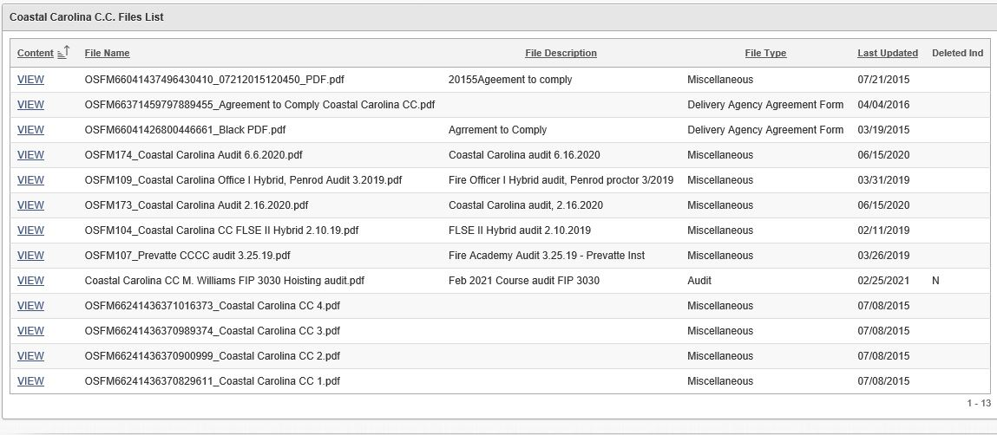
OSFM 24 – THE PORTAL – ATTACHMENTS

Slide 61
COURSE RECORDS
Delivery Agency responsibility
Must be able to determine if student passed / failed courses
At a minimum, retain the skills check off sheet with P / F for written exam
Skill sheets for failures should be turned in by instructor
If tests and / or answer sheets are kept, must be secured at all times

Slide 62
COURSE RECORDS
  What is the most important, objectives or hours?
    Objectives - we must turn out students that can perform the objectives
    Hours - suggested by us to the community college systems office
      Can go below minimum hours
      Cannot go above maximum hours

Slide 63
COURSE DELIVERY OPTIONS
Single Course - any one course within a certification program, for example:
  Fire Behavior (FIP 3004, 2013 Edition)
  FF Fire Ground Ops 3 (FIP 3043, 2019 Edition)
  TR Victim Management (FIP 5807)
  D / O Pumps: Intro and Basic Pumps (FIP 3623, 2017 Edition)
Practical skills conducted throughout course hours
Written exam given at the end of the course
Series of Instruction - a complete sequence of single courses, for example:
  Fire / HazMat / TIMS / Safety & Survival Academy (FIP 3030)
  TR Confined Space Series (FIP 5900)
Practical skills conducted throughout series
Written exam given at the end of the series

Slide 64
COURSE DELIVERY OPTIONS
Block of Instruction- any group of single courses put together for a certification program, for example:
  High School Program (Fire Tech I, II, and III)
Practical skills are conducted throughout the block of instruction for each topic
Written exam covering all topics within block given at the end
High school configuration can be taught at community colleges/ fire depts

Slide 65
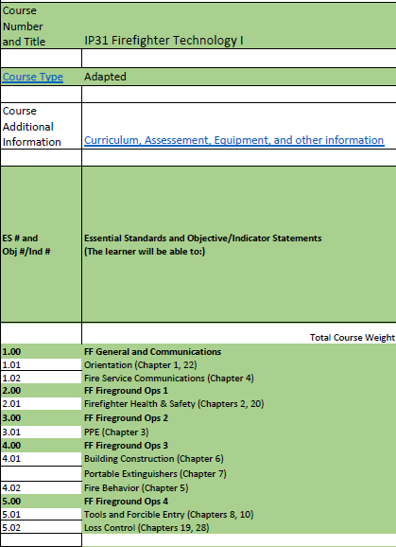
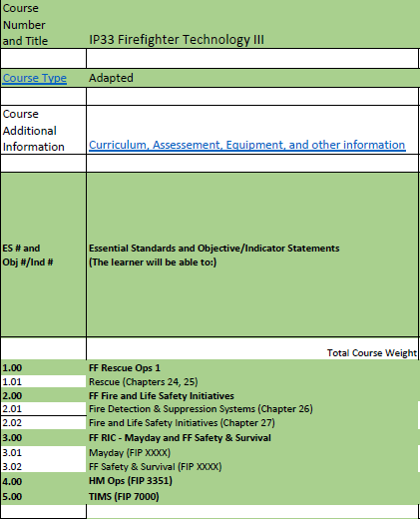
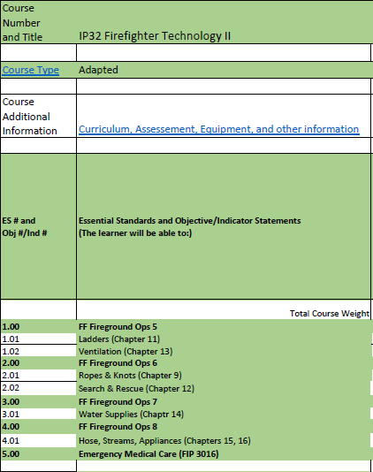
COURSE DELIVERY OPTIONS

Slide 66
WRITTEN TESTING
Delivery agency responsibility / access
Students must pass 100% of practical skills to test
Proctor must be used – cannot have helped teach any portion of class
Test cannot be graded in the classroom
Tests have an “A” and “B” version – use accordingly
Must be returned to the delivery agency within 72 hours
  Or provided a tracking number within time if mailed

Slide 67
PRACTICAL SKILLS TESTING
100% Testing
  During class, each practical skill is demonstrated and practiced
  Once practice is done, instructor clearly denotes testing session by reading the “Instructor Statement” to each student
  All students are then tested on that practical skill
  This is repeated until all practical skills are covered and tested
  There are no time requirements for any practical skills

Slide 68
COURSE MATERIALS
Who has access:
  Delivery agency
  Qualified instructor
  OSFM
Textbooks should be required/encouraged
Lesson plans and skills books should be made available
Blank copies of skills books should be provided in the event of failures

Slide 69
TRAINING PROPS
Delivery Agency responsibility to maintain
Instructor responsibility to let the delivery agency know what is needed
Courses requiring some type of prop:
  Forcible Entry / Fireground Ops 4
  Ladders / Fireground Ops 5
  Ventilation / Fireground Ops 5
  Safety & Survival / Mayday Safety & Survival
  Fire Control / Fireground Ops 9
  Rescue / Fireground Ops 6 / FF Rescue Ops 1
  ARFF
  Marine Firefighter

Slide 70
MOU’S
Delivery agency responsibility
MOUs show that the delivery agency has access to all equipment, props, and facilities needed for a class
These will be checked during the site visits

Slide 71
COURSE AUDITS
Audits are unannounced visits to courses being conducted
Audits are documented and attached to the instructor / proctor and delivery agency
Audits check the following:
  The instructor
  The delivery agency
  Lesson plans / course materials
  Props / equipment
  Skill books
  The proctor
  The process

Slide 72

INJURY REPORTS
Delivery agency responsibility to notify OSFM within 72 hours
  Live fire
  Certification
Questions or issues, contact:
  Anthony Killough Anthony.Killough@ncdoi.gov
  Devin Cockrell Devin.Cockrell@ncdoi.gov

Slide 73
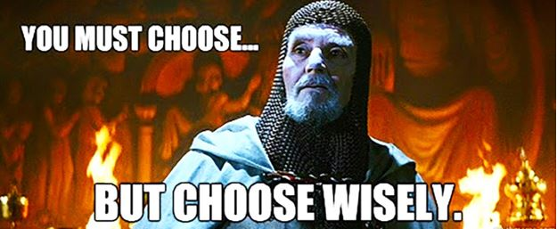
INSTRUCTOR / PROCTOR
Delivery agency responsibility
Qualified does not automatically equal quality
Things you should be checking:
  Each of your instructors / proctors at least once
  Lesson plans / textbooks
  Skill books
  Training props / equipment / facilities
  Practical skills execution
  Written exam execution

Slide 74
INSTRUCTOR / PROCTOR
What constitutes a discussion between you and the instructor
  Failure to return paperwork in a timely manor.
  Rumblings (no complaint) of instructors doing wrong
  Students all making around the same grades (may not be passing) or missing the same questions
  Accidents that are not a result of trying to break the rules

Slide 75
INSTRUCTOR / PROCTOR
What constitutes you notifying your Certification Specialist
  Complaints
  Evidence of cheating
  Testing Issues
  OSFM 24
  Certification issues
  Transcript issues
  OSFM ID Issues
  Needs assistance (everything else)

Slide 76
INSTRUCTOR / PROCTOR
Agencies are allowed to have two additional proctors
  Do not need to meet Instructor requirements
  Can have no fire service experience
  Must be affiliated with the delivery agency
    Employee (hourly or time sheet, not contract)
    Volunteer at the fire department

Slide 77
CERTIFICATION VS QUALIFICATION
Certification
  Means a person has taken a class; met a minimum standard
  Once certified, always certified
Qualification
  Means a person can teach a class
  This is a North Carolina process governed by the Cert Board
  Must take requalification class every 5 years or as the standard changes
  Failure to do so will result in losing their qualification in that subject
Notes:
If you miss re-qualification you can still obtain it, but you have to test.

Slide 78
INSTRUCTOR 1 CERTIFICATION
21 years of age
High school diploma / equivalent
TIMS
Three years certified as FF, TR, FLSE, or Hazmat Operations
  Cannot take Instructor 1 before the three-year requirement
Successfully complete an Instructor 1 class

Slide 79
INSTRUCTOR 2 CERTIFICATION
Completed Instructor 1 requirements
Successfully complete an Instructor 2 class
May choose to take the Proctor Qualification

Slide 80
QUALIFICATION PROCESS
Instructor 1 and / or Instructor 2
Indoctrination Class
Qualification School / Field Tested Qualification
National Fire Academy Courses

Slide 81
QUALIFICATION PROCESS
Qualification School
  Firefighter
  Airport Firefighter
  Driver / Operator*
  Fire & Life Safety Educator
  Fire Officer
  HazMat Operations*
  Instructor
  Marine Firefighter
  Rescue Officer
  Technical Rescuer – Vehicle

Slide 82
QUALIFICATION PROCESS
Field Tested Qualification
  Technical Rescuer
  Technical Rescuer Confined Space
  Technical Rescuer Machinery & Agriculture
  Technical Rescuer Structural Collapse
  Technical Rescuer Trench
  Technical Rescuer Water
  Technical Rescuer Wilderness
  Rapid Intervention Crew
  Chief 101

Slide 83
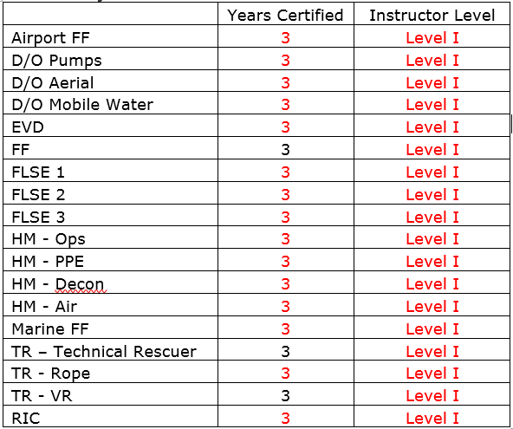
QUALIFICATIONS FOR INSTRUCTOR 1
Now eligible if certified for three years in the following:

Slide 84
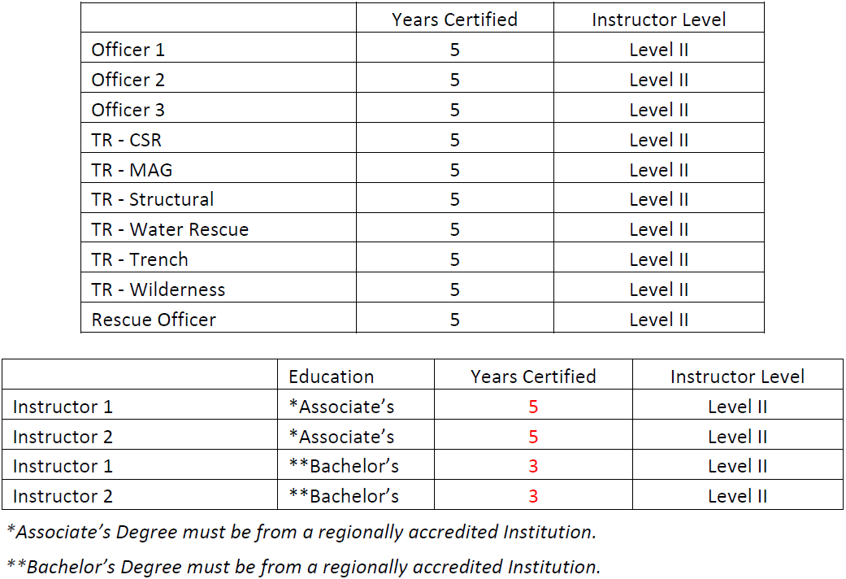
QUALIFICATIONS FOR INSTRUCTOR 2
Now eligible to qualify if certified for five years in the following:

Slide 85
PROCTOR TRAINING
Instructor(s) – A person who is a minimum of a NC Instructor 1 and has been qualified to teach in the subject area being offered
Proctor(s) – A person who is a minimum of a NC Instructor 2 and has completed an additional qualification to become a recognized NCFRC Proctor and has had no participation in the class being proctored
  Eligible people:
    Any Instructor II
    School Director
    Testing Coordinator; must be affiliated with a delivery agency

Slide 86
PROCTOR TRAINING
Must be at least an Instructor 2
If not an Instructor 2, designated by name, by a delivery agency, to be a testing coordinator
Take the proctor training offered by OSFM

Slide 87
PROCTOR TRAINING
Packet should be sealed / secured
Packet should have the test date and time clearly marked
Have all skills been completed prior to written testing?
  Everyone must pass 100% of the skills
Skills sheet needs to be completed and signed off by the instructor
Check ALL identification cards of students present
Proctor signs skills sheet in appropriate space
Read Checklist for Testing before administering test

Slide 88
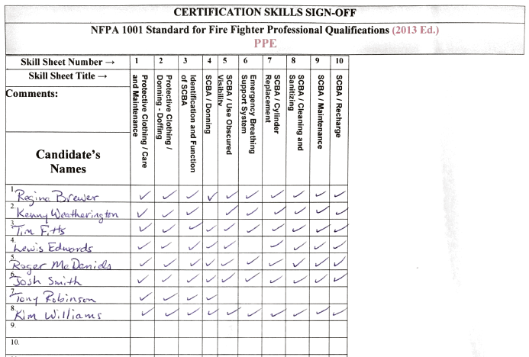
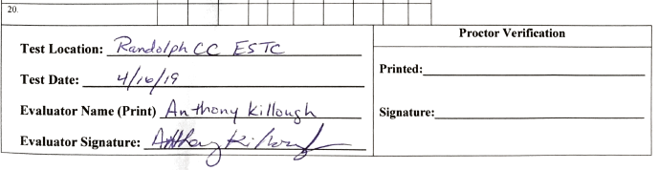
PROCTOR TRAINING

Slide 89
PROCTOR TRAINING
Reasonable Accommodations
  Verbal tests
  Extended time beyond the 60 seconds per question guideline
  Providing a distraction free environment with an extra proctor
  Provide test up to 36 font print for visually impaired candidate

Slide 90
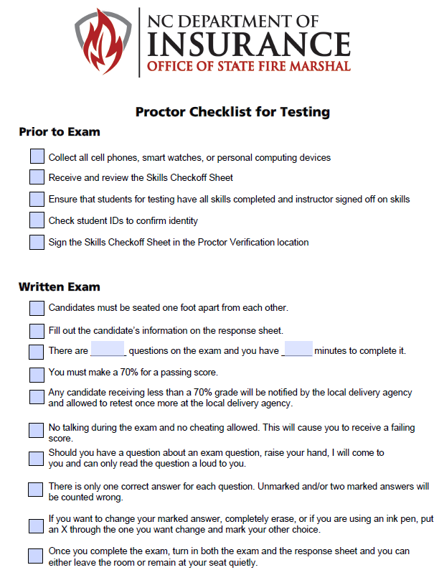

Slide 91
PROCTOR TRAINING
Collect all testing materials
Reseal packet
Return the packet to school director / staff within 72 hours

Slide 92
TRENDING MISTAKES / ISSUES
Not demonstrating practical skills to students
Not allowing students time to practice practical skills
Not reading instructor statement before practical skills evaluation
Not having skills sheet with you while testing
Conducting written exams prior to time scheduled
Not checking IDs prior to written test
Proctors filling out skills check off sheet
Students filling out skill books
Testing too early

Slide 93
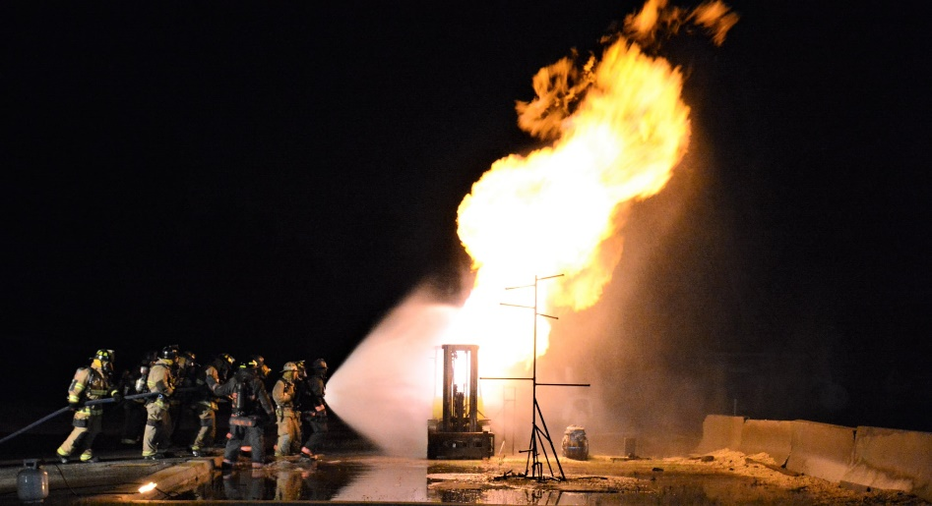
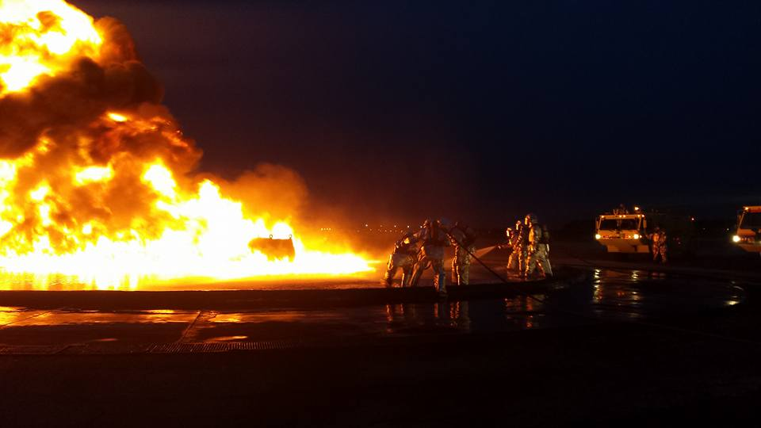

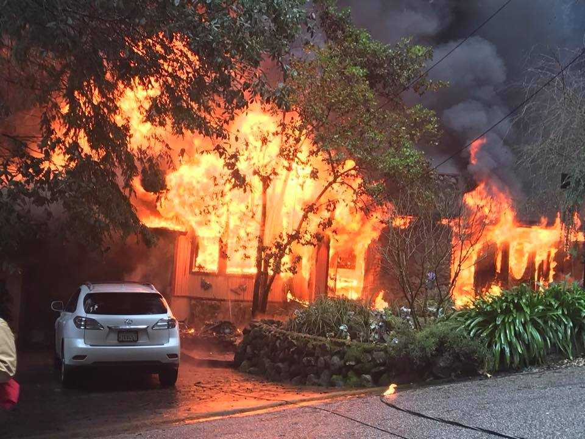
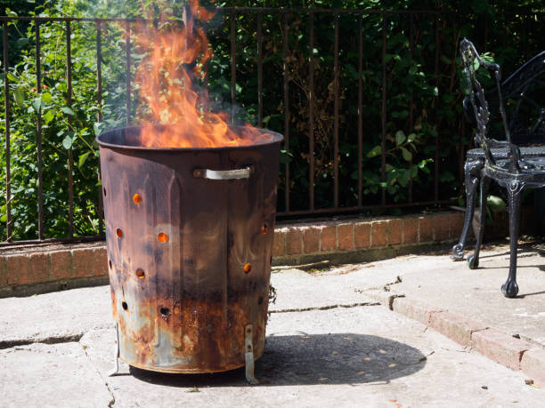
LIVE FIRE

Slide 94
LIVE FIRE REQUIREMENTS
General definitions
  Live Fire – Any unconfined open flame or device that can propagate fire to the building, structure, or other combustible materials
  Structure types
    Acquired Structure – A building or structure acquired by the authority having jurisdiction (AHJ) from a property owner for the purpose of conducting live fire training evolutions
    Training Structure – A structure specifically designed for conducting live fire training evolutions on a repetitive basis
  Prop – Any prop shall produce live fire as defined by NFPA 1402 – 3.3.22 Live Fire. Any open flame capable of emitting thermal load or toxic by-products of combustion that would necessitate the use of personal protective equipment (PPE)

Slide 95
LIVE FIRE REQUIREMENTS
  Acquired structure requirements:
    Live fire qualified instructor
    Notify NC OSFM via Live Fire Registration at least 10 prior to the burn
    Acquire all air quality and demolition permits
    Report all injuries within 72 hours of the incident
  Live fire training structure requirements:
    Reported to NC OSFM through the delivery agency portal
    Use a qualified live fire instructor for that actual live fire training burns

Slide 96
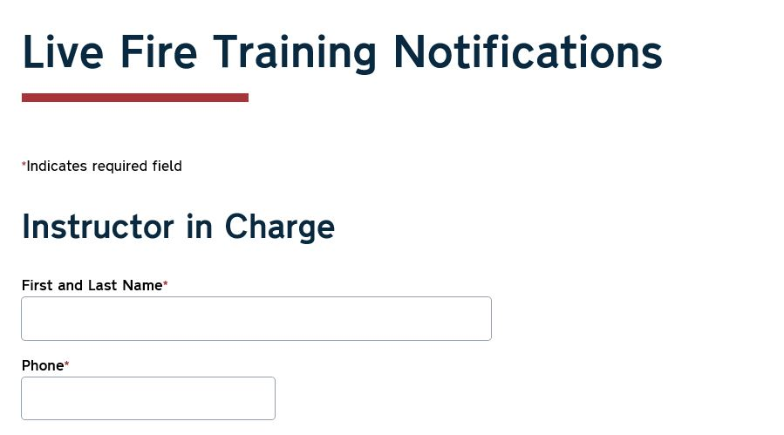

LIVE FIRE REQUIREMENTS

Slide 97
LIVE FIRE REQUIREMENTS

Slide 98
LIVE FIRE QUALIFICATION REQUIREMENTS
18 years old
High school diploma / equivalent
Successful completion of all five phases
TIMS
Fire Service Instructor Level II certified
Qualified firefighter instructor for 5 years
Current firefighter instructor qualification
Participate in the 5-phase qualification process
  Complete 100% of practical evolutions
  Score 80% or higher on the final written test

Slide 99
LIVE FIRE REQUIREMENTS
NFPA 1403 – Live Fire Training
  Live Fire Instructor and Live Fire Instructor in Charge fall under NFPA 1041
  To get certified / qualified, 5-phase process
    Phase 1 – online in Moodle
      Annually, Oct 1 – Dec 31
    Phase 2 – face to face course with written test
    Phase 3 – start completing your task book
    Phase 4 – conducting burns
    Phase 5 – OSFM certified and qualified
      Phases 2-5 will be announced on the OSFM Training Scheduler

Slide 100
LIVE FIRE REQUIREMENTS
  Face to face requalifications ongoing until June 2021
  Live Fire and LP qualified requires upgrade between now and Sept
  Live Fire only must register for LP class to get qualification
  LP only must go through the entire Live Fire process

Slide 101
LIVE FIRE REQUIREMENTS
  The 2018 edition of NFPA Standard 1403 requires that: “Students participating in live fire training evolution who have received the required minimum training and prerequisites from other than the authority having jurisdiction shall not be permitted to participate in any live fire training evolution without presenting prior written evidence of having successfully completed the prescribed minimum training to the levels specified in 4.3.1 (required minimum training) and 4.3.2.1 through 4.3.2.5 (prerequisites).”
  To be a student / participant in live fire training evolutions:
    18 years old (ID must be checked)
    Signatures on Form 200.14A

Slide 102
LIVE FIRE REQUIREMENTS
  NFPA 1403
    4.3.1 Required Minimum Training
      Safety
      Fire Behavior
      Portable Extinguishers
      Personal Protective Equipment (PPE)
      Ladders
      Fire Hose, Appliances, and Streams
      Overhaul
      Water Supply
      Ventilation
      Forcible Entry
      Building Construction

Slide 103
LIVE FIRE REQUIREMENTS
NFPA 1403
    4.3.2.1 Fire Dynamics All participants shall have received training for the following:
      The conditions necessary for flashover to occur
      The components of fire and definition of a fire
      The three mechanisms of heat transfer – conduction, convection, and radiation
This information is covered in the Fireground Ops 3 course material

Slide 104
LIVE FIRE REQUIREMENTS
  NFPA 1403
    4.3.2.5 Nozzle Techniques and Door Control All participants shall have received training for the following:
      Factors influencing the effectiveness of extinguishment by cooling
      The application of indirect attack direct attack
      Key door entry size-up and risk assessment factors
      Integrated door control and fire gas cooling to reduce the risk of flashover during door entry
      Effective door entry and control procedures
This information is covered in the Fireground Ops 3, 4, and 8 course materials

Slide 105
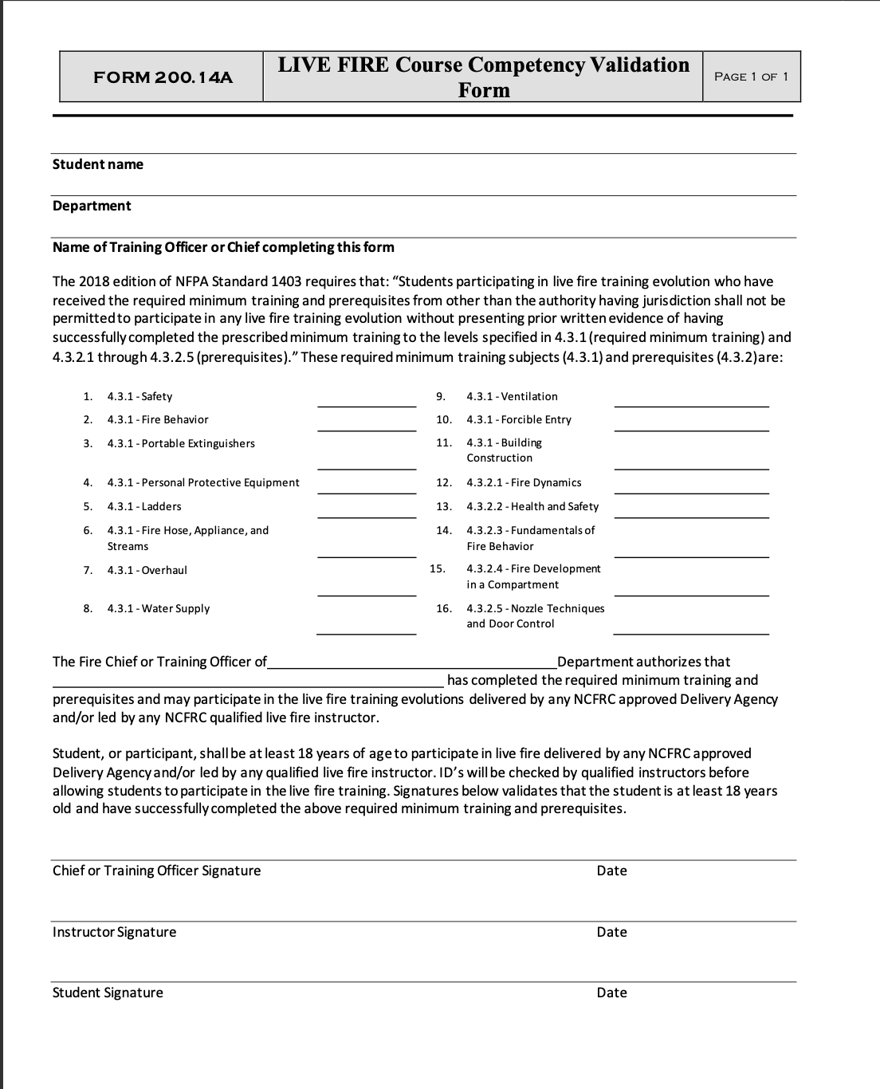
LIVE FIRE REQUIREMENTS

Slide 106
INFORMATION SHARING
Information received from OSFM / Cert Board / FRC should be shared with:
  Your instructors
  Your students
Your inbox should not be a graveyard for information

Slide 107
Section 3
Case Studies
Practical Application

Slide 108
CASE STUDY #1
During a FF class, an instructor goes through the supplied PowerPoint from the book. He then tells the class that he doesn’t have any equipment for the practicals. No practical skills are completed as part of the class but are told to fill out a practical sheet and grade how well they thought they did on the practical. The class is concluded when a proctor delivers the written test, following all rules for the written testing policy.
Following the class, the school director was informed of this when they returned from vacation by a fire chief in the county. After OSFM staff arrived and interviewed all the students, the school director was asked what they knew and were told, “they knew of it all and had made the decision to fire the instructor, so the problem had been taken care of.” When asked about the props the school director was able to show where the props and the equipment needed had been provided, the instructor had chosen not to use them.

Slide 109
CASE STUDY #2
An instructor is contracted to teach a FF Rescue class. The instructor teaches the class at a training center with a burn building. The delivery agency has a trailer with hydraulic tools / cribbing and a fire truck with hand tools, rope and equipment available. The instructor stated they had everything they needed for the class.
The instructor completes the locating a victim skill, which was done without the use of a rope or handline. When completing the vehicle extrication portion of the class the instructor taught that entire section via PowerPoint.
When test night came up the students were told to fill out the student information and the rest would be taken care of for them, no practical testing was conducted. The students were only at the training center for about a half hour. Also, the instructor returned the test packet to the college via unqualified member of a department.

Slide 110
CASE STUDY #3
While conducting live fire training, multiple students received burns that required medical treatment by EMS. The students were transported to the local hospital for evaluation. OSFM found out about the injuries from a complaint by a fire chief and started an investigation.
While conducting the investigation it was found that no pre-fire plan had been completed and that there were multiple violations of NFPA 1403 and NCFRC Policy 200.14.

Slide 111
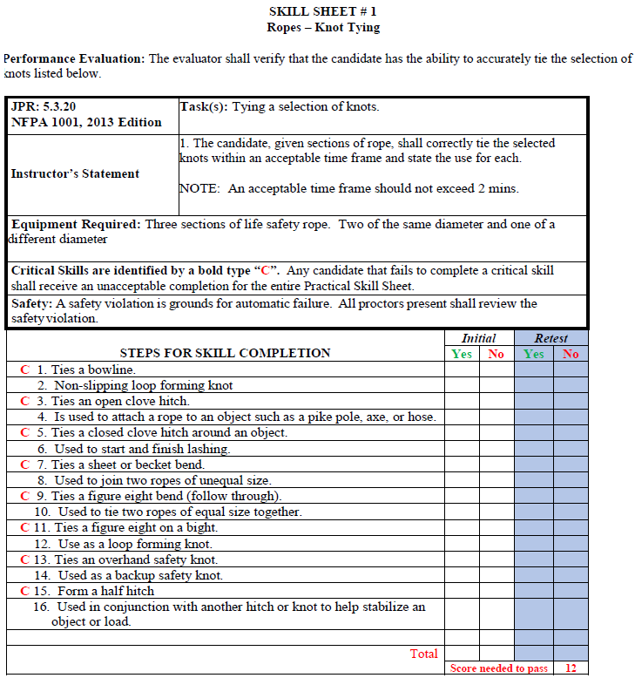
PRACTICAL SKILL (2013 ED. FF)

Slide 112
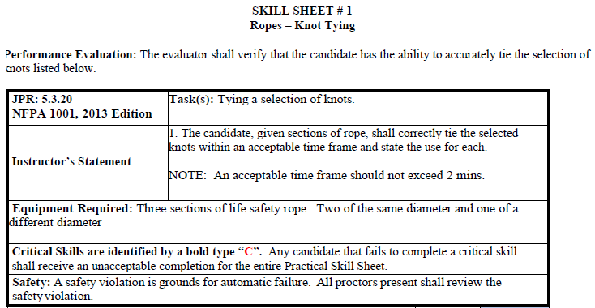
PRACTICAL SKILL (2013 ED. FF)

Slide 113
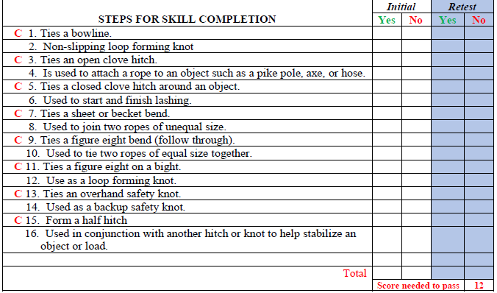
PRACTICAL SKILL (2013 ED. FF)

Slide 114
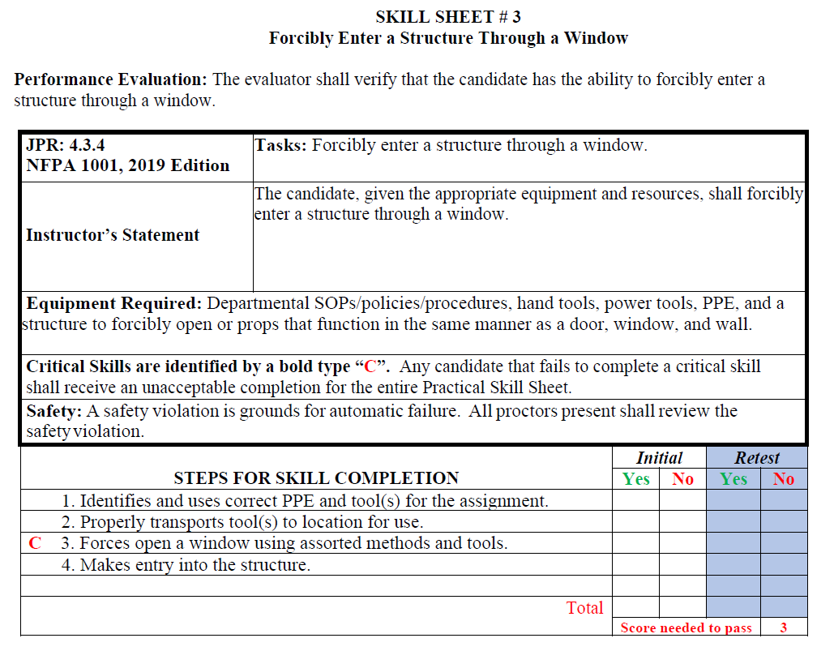
PRACTICAL SKILL (2019 ED. FF)

Slide 115
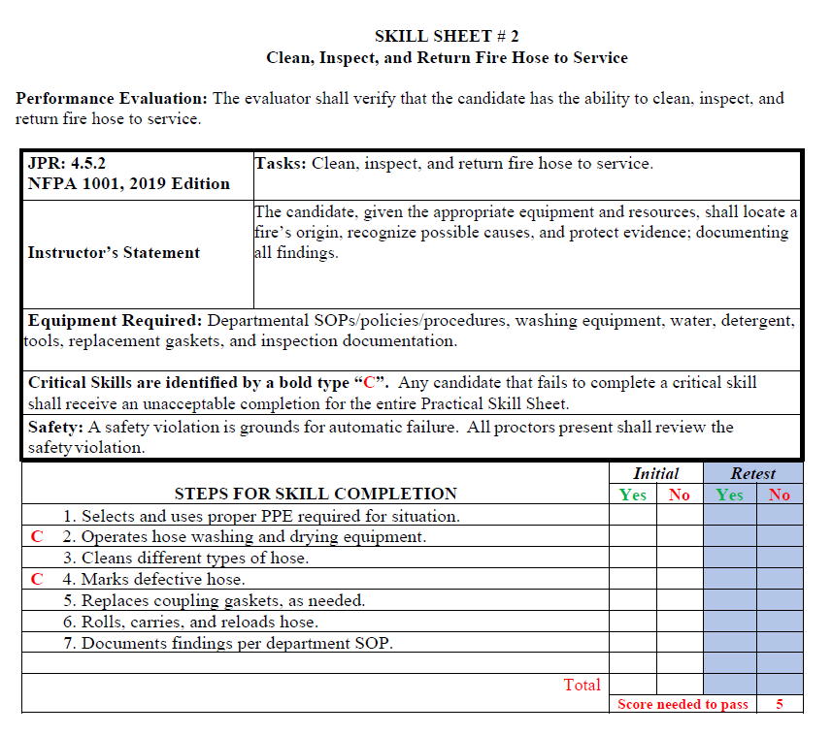
PRACTICAL SKILL (2019 ED. FF)

Slide 116
Section 4
Program Updates

Slide 117
PROGRAM CHANGES
NFPA 1021 – Fire Officer
NFPA 1006 – Technical Rescue
NFPA 1035 – Fire & Life Safety Educator
NFPA 1403 / 1041 – Live Fire

Slide 118
Questions?
Roster

Slide 119


NC SOCIETY OF FIRE RESCUE INSTRUCTORS
Benefits:
  Instructor mentorship
  Instructor resources
  Free accident sickness policy
  Optional Errors and Omissions Insurance policy
  Training opportunities
  Scholarships
  Fellowship
  Training materials

Slide 120
CONTACT INFORMATION
Shawn Haynes – shawn.haynes@ncdoi.gov
  919-218-1588
Michael Caviness – michael.caviness@ncdoi.gov
  336-813-0088
Matt Thorpe – matthew.thorpe@ncdoi.gov
  919-302-8262
Scott Hackler – scott.hackler@ncdoi.gov
  919-621-9497
Greg Palmer – greg.palmer@ncdoi.gov
  919-600-9516

