Slide 1
Risk Management
State Electrical Division
North Carolina Department of Insurance
Office of State Fire Marshal
2017 State Electrical Code
90.2(B)(5) Utility Conductors
and Equipment

Slide 2
Notice:
The following illustrations are approved by the State Electrical Division of the North Carolina Department of Insurance, Office of State Fire Marshal. These illustrations are intended to demonstrate but not supersede the official written interpretations found at the following web address:
http://www.ncdoi.com/OSFM/State_Electrical_Division//Default.aspx?field1=State_Electrical_Code_and_Interpretations
Joseph Starling
Chief State Electrical Engineer & Inspector
Illustrated by:
Danny Thomas
State Electrical Inspector

Slide 3
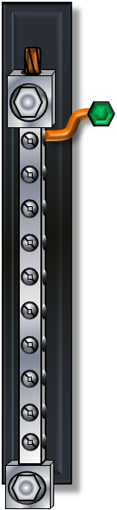
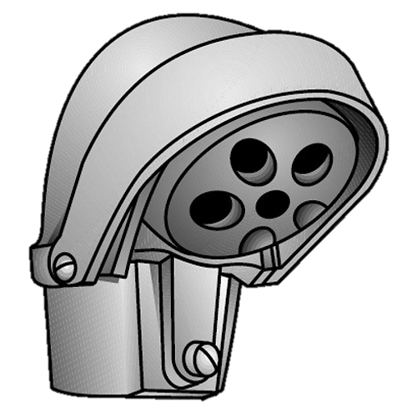

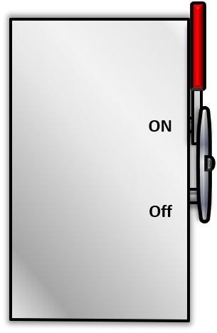
Date: February 19, 2019
2017 Electrical Code
Subject: Electrical Utility Conductors
Section: 90.2(B)(5)
Question 1:
If service drop or lateral conductors are installed under the control of the electrical utility, does the State Electrical Code have jurisdiction to regulate any portion of the utility’s installation?
ON
OFF
400 amp
Utility Transformer
Utility Transformer

Slide 4
Date: February 19, 2019
2017 Electrical Code
Subject: Electrical Utility Conductors
Section: 90.2(B)(5)
Answer 1:
The State Electrical Code includes the 2017 NEC with State amendments. Section 90.2(B)(5) of the NEC designates electrical utility service drop or lateral installations as “Not Covered” within the scope of the NEC; thus such utility drop or lateral conductors cannot be governed by the State Electrical Code. Additionally, there is no exception that grants the State Electrical Code the authority to regulate electrical utility service drop or lateral installations when installed within customer owned equipment.

Slide 5
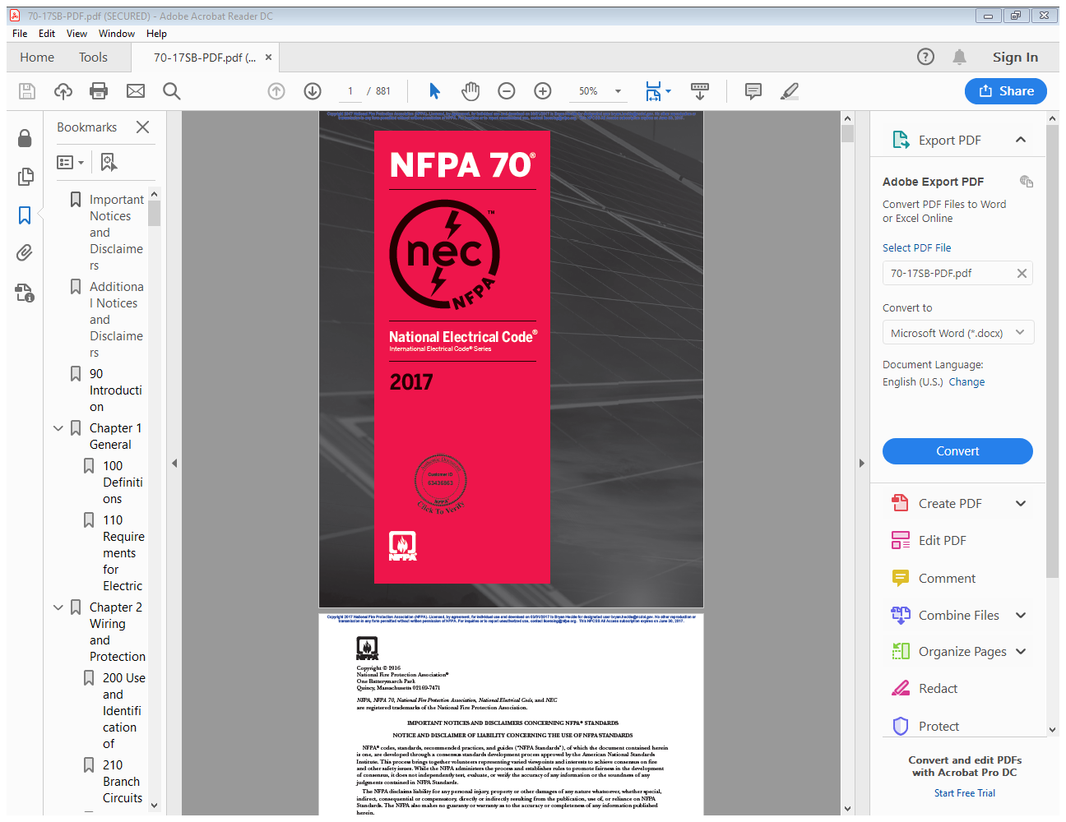
Date: February 19, 2019
2017 Electrical Code
Subject: Electrical Utility Conductors
Section: 90.2(B)(5)
Answer 2:
Illustration
90.2 Scope.
Covered. This Code covers the installation and removal of electrical conductors, equipment, and raceways; signaling and communications conductors, equipment, and raceways; and optical fiber cables and raceways for the following:
Public and private premises,
including buildings, structures,
(B) Not Covered. This Code does not cover the following:
(5) Installations under the exclusive control of an electric
utility where such installations a. Consist of service drops or service laterals, and associated
metering,

Slide 6
Date: February 19, 2019
2017 Electrical Code
Subject: Electrical Utility Conductors
Section: 90.2(B)(5)
Question 2:
If the electrical utility’s service drop or lateral conductors are installed under the terminal lugs of a customer owned molded case breaker (which is the service disconnect), must extra provisions be made to insure the electrical utility conductors do not violate sections 240.4(B), 240.4(C) or 310.15 of the State Electrical Code?
ON
OFF
Building Service Equipment (Customer Owned)
400 amp
Utility Transformer
Utility Transformer

Slide 7
Date: February 19, 2019
2017 Electrical Code
Subject: Electrical Utility Conductors
Section: 90.2(B)(5)
Answer 2:
Sections 240.4(B) and 240.4(C) are restrictions for the ampacity of overcurrent devices with respect to the conductors being protected by such devices. Sections 310.15 generally regulates the ampacity of electrical conductors. The State Electrical Division interprets sections of 240.4(B), 240.4(C), and 310.15 as being applicable only to within the NEC’s scope.
The State Electrical Division interprets the “service point” in Article 100 as the specific location in the electrical system that separates the State Electrical Code’s jurisdiction from the electrical utility's jurisdiction. The State Electrical Code stays silent on the method of connection required to create the “service point”. If the lugs on a molded circuit breaker installed by the Electrical Contractor is the method of connection to the electrical utility, then the State Electrical Code’s jurisdiction ceases where the lug makes contact with the utility conductor. Therefore, the Electrical Inspector’s jurisdiction to enforce the State Electrical code also ceases where the lug makes contact with the uitity contractor.

Slide 8
Date: February 19, 2019
2017 Electrical Code
Subject: Electrical Utility Conductors
Section: 90.2(B)(5)
Service Point as defined in Article 100 of the NEC.
Customer owned service equipment with molded case circuit breaker as the service disconnect.
Answer 2:
Illustration
ON
OFF
400 amp
Utility Transformer
Wiring does not fall under NEC requirements until the load side of the molded case circuit breaker.
Utility Transformer
Utility's service lateral conductors

Slide 9
Date: February 19, 2019
2017 Electrical Code
Subject: Electrical Utility Conductors
Section: 90.2(B)(5)
Certificate of Compliance
Installation does meet the State Electrical Code Requirements
Question 3:
Can a “certificate of compliance” be withheld or denied for an electrical installation that is regulated by the State Electrical Code and does not comply with provisions required by the serving electrical utility?
Installation does not meet the State Electrical Code Requirements
Inspector Date

Slide 10
Date: February 19, 2019
2017 Electrical Code
Subject: Electrical Utility Conductors
Section: 90.2(B)(5)
Answer 3:
Electrical installations that meet the provisions of the State Electrical Code are entitled to a certificate of compliance in accordance with section 204.8.2 of the NC Administrative Code and Policies. Compliance with the “Duke Energy White Book”, adherence to site plans when the installation is Code prescriptive, or installations that exceed the scope of the NEC as described in section 90.2(B).

Slide 11
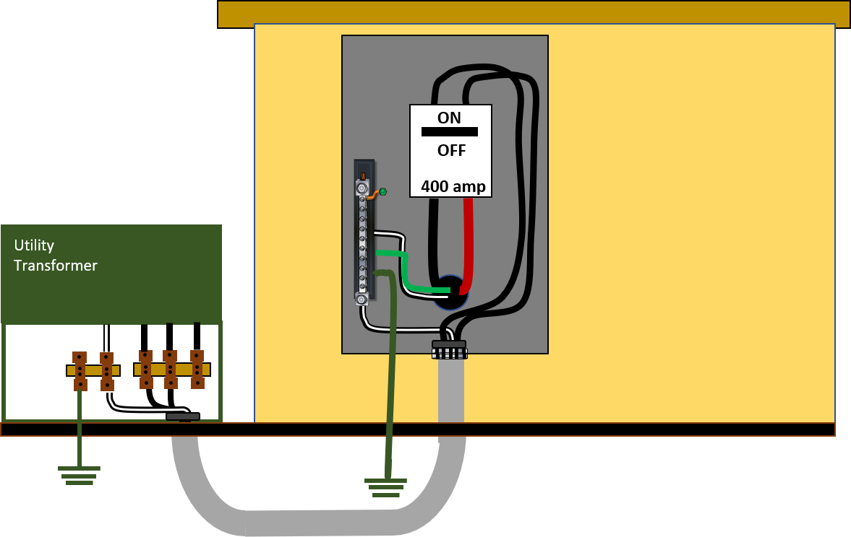
Date: February 19, 2019
2017 Electrical Code
Subject: Electrical Utility Conductors
Section: 90.2(B)(5)
Certificate of Compliance
Answer 3:
Illustration
This installation does meet the State Electrical Code Requirements
This installation does not meet the State Electrical Code Requirements
John Doe 1/22/2019
Inspector Date

Slide 12
Date: February 19, 2019
2017 Electrical Code
Subject: Electrical Utility Conductors
Section: 90.2(B)(5)
ON
OFF
Question 4:
Who determines where the “service point” will be located?
400 amp
Utility Transformer
Utility Transformer

Slide 13
Date: February 19, 2019
2017 Electrical Code
Subject: Electrical Utility Conductors
Section: 90.2(B)(5)
Answer 4:
The service point can be described as the point of demarcation between where the serving utility ends and the premises wiring begins. The serving utility generally specifies the location of the service point based on the “conditions of service.” 2017 NEC Article 100 Definition of Service Point Informational Note.

Slide 14
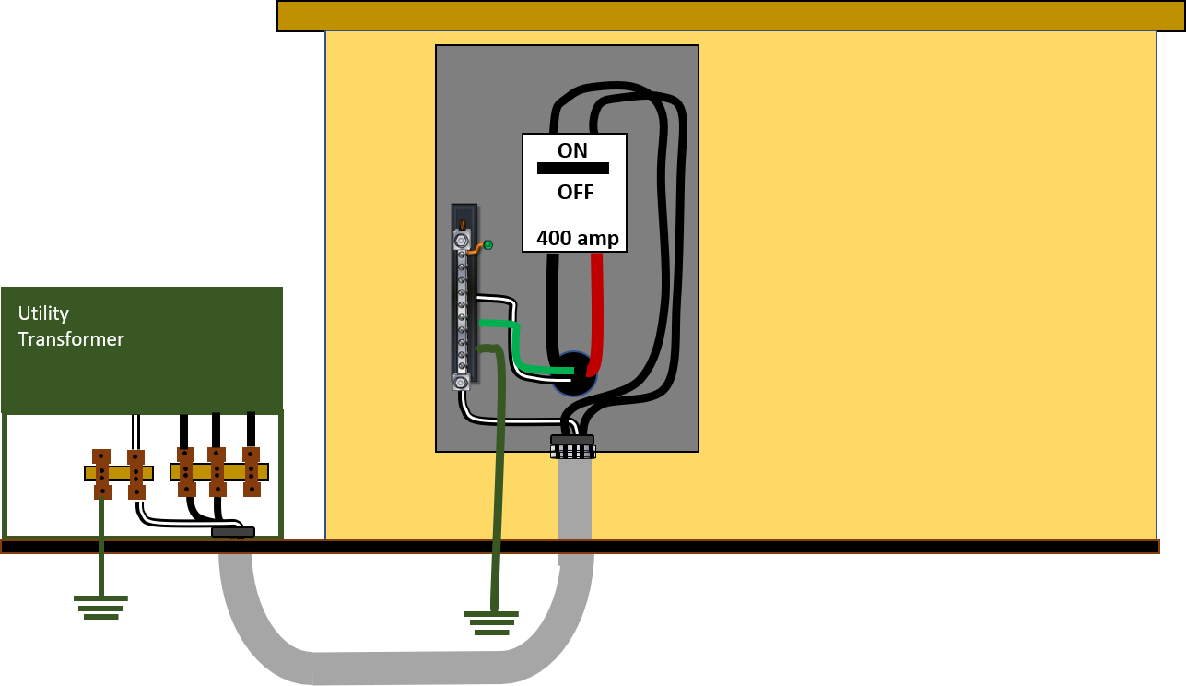
Date: February 19, 2019
2017 Electrical Code
Subject: Electrical Utility Conductors
Section: 90.2(B)(5)
Service Point as defined in Article 100 of the NEC.
Answer 4:
Illustration 1
“point of demarcation between where the serving utility ends and the premises wiring begins”
Utility's service lateral conductors

Slide 15
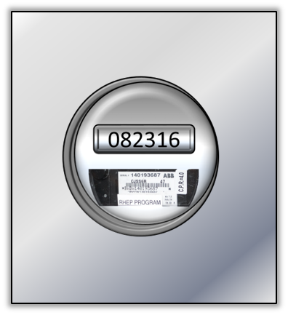

Date: February 19, 2019
2017 Electrical Code
Subject: Electrical Utility Conductors
Section: 90.2(B)(5)
“point of demarcation between where the serving utility ends and the premises wiring begins”
Answer 4:
Illustration 2
Service Point

Slide 16

Date: February 19, 2019
Service Point as defined in Article 100 of the NEC.
2017 Electrical Code
(If utility service lateral conductors.)
Subject: Electrical Utility Conductors
Section: 90.2(B)(5)
Answer 4:
Illustration 3
Utility Transformer
“point of demarcation between where the serving utility ends and the premises wiring begins”
Utility Transformer

Slide 17
Date: February 19, 2019
2017 Electrical Code
Subject: Electrical Utility Conductors
Section: 90.2(B)(5)
Answer 4:
Illustration 4
Utility Transformer
“point of demarcation between where the serving utility ends and the premises wiring begins”
Utility Transformer
Service Point as defined in Article 100 of the NEC.
(Only if customer owned conductors.)

Slide 18
Date: February 19, 2019
2017 Electrical Code
Subject: Electrical Utility Conductors
Section: 90.2(B)(5)
Answer 4:
Illustration 5
Service Point
“point of demarcation between where the serving utility ends and the premises wiring begins”

