Slide 1




COQB Candidate Information Bulletin
WARNING!
Candidates are responsible for all content within the COQB Candidate Information Bulletin (CIB). Failure to comply with the CIB may result in test failure, and additional test fees.
This presentation is not a substitute for the CIB.
Notes:
Welcome to the overview for the Code Officials Qualification Board Candidate Information Bulletin.
This presentation is an overview and cannot be used in place of reading the Candidate Information Bulletin also referred to as the CIB. The actual CIB contains screenshots of every letter and every step necessary for a successful test administration.
Warning! Candidates are responsible for all content within the Code Officials Qualification Board CIB. Failure to comply with the CIB may result in test failure, forfeiture of test fees, up to and including civil penalties and possible criminal charges.
Be prepared by reading the Candidate Information Bulletin!

Slide 2
OVERVIEW
This section is an overview of the OSFM QUEST Test.
What is the OSFM QUEST Test?
Test Blocks
Navigation
Computer Requirements
I hate waterlemons.
You that read wrong.
You read that wrong too.
This is how your test attempt may fail and cost you additional fees.
Read the CIB carefully.
PART I – GENERAL INFORMATION
Notes:
This section is an overview of the OSFM QUEST Test.
What is the OSFM QUEST Test?
Test Blocks
Navigation
Computer Requirements
Please read the sentences in the blue cloud.
Read the CIB carefully.

Slide 3

OSFM QUEST TEST
The NC Code Officials Qualification Board contracted with Questionmark to manage the OSFM QUEST testing process.
Remote
Secure internet connection
Undisturbed room
Your home
On-line
Desktop or Laptop Computer
Live – Proctored
Room check
ID check
Observed throughout the test
Excludes
Tablets, iPads, Chromebooks, Phones
Notes:
The North Carolina Code Officials Qualification Board contracted with Questionmark to manage the Office of State Fire Marshal QUEST testing process.
This process is remote, on-line, and live-proctored.
Remote includes a secure, stable internet connection. A private room which may be in your home.
On-line includes either a desktop or laptop computer. Notice that tablets, iPads, Chromebooks, phones and any other electronic device may not be used.
A live proctor will check your ID, be sure the registered name and the ID are the same.
If you have accommodations, you will be notified by the proctor.
You will follow directions on the screen and then the proctor will provide some additional instructions through the integrated chat feature.
A proctor will observe you throughout the test.

Slide 4
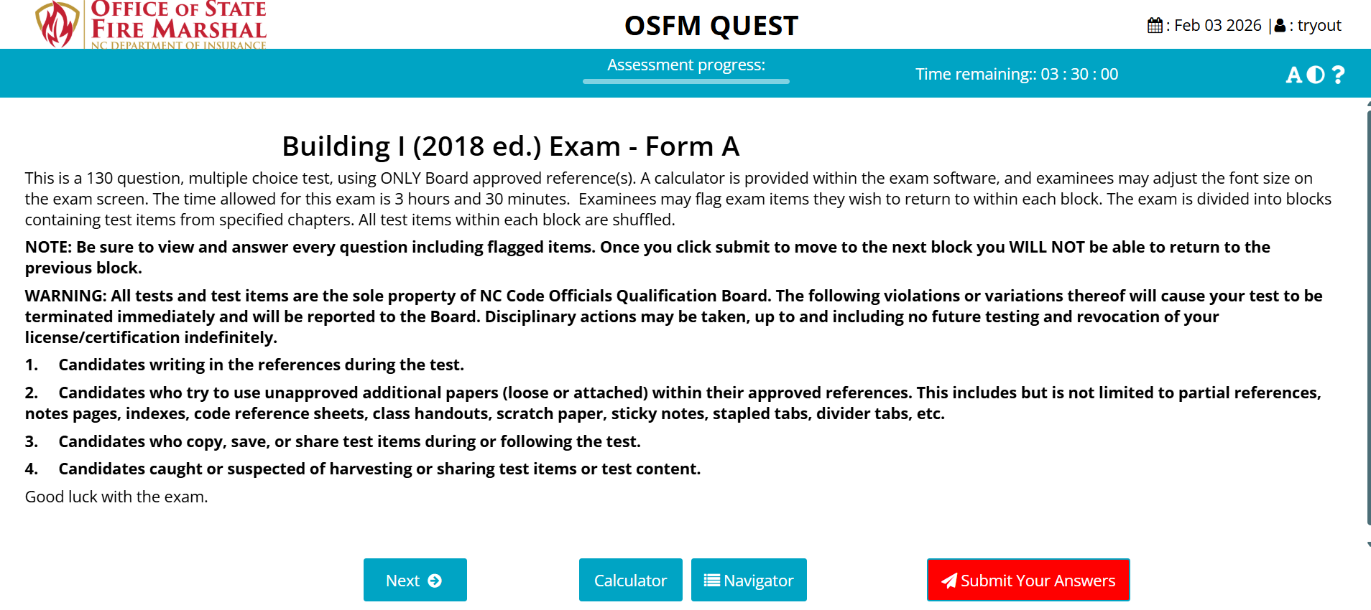
TEST BLOCKS
1. General Information
2. Specific to the trade and level
3. Each test is ordered by Code
4. Divided into blocks by specific chapter
See section “X Test Content Outlines”
Submit Your Answers Button will advance to the next block.
NOTE: All test items must be answered before moving to another block.
Once you click the Submit Your Answers Button, you cannot return to previously answered test items or blocks.
First Block General Info
Notes:
The test is divided into blocks.
Section..
1 – General information.
2 - The remainder of the test is specific to the trade and level.
3 – Each test is ordered by code.
4 – Divided into blocks by specific chapter,
See section 10 Test Content Outline in the CIB. Section ten lists all chapters for each trade and level.
After all the test items in a block have been answered and you are ready to move forward, you will click on the red Submit Your Answers button. On this slide, it is the red button with a star. On your exam it will be the red button.
Important
Once you click the Submit Your Answers button, you cannot return to any previous block. You may only move forward.

Slide 5
Test Navigation
Previous
Not Pictured
Previous test item
Next
Next test item
CALCULATOR
Calculations
Navigator
View flagged or unanswered test items
MARK QUESTION – Not Pictured
View flagged or unanswered test items
Notes:
Please see the numbers and flag symbol on the left.
Find the corresponding numbers and symbol on the white and blue screenshot of the General Information page.
There is a previous button before the next button which is used to move back to the previous test item.
The Next Button takes you to the next test item.
The Calculator Button brings up a calculator.
The Navigator Button shows all the test item numbers, which ones need to be answered, in addition to the test items which were flagged.
The Flag is used to identify questions you want to come back to and review.
The Submit Your Answers Button will only allow moving forward after all test items have been answered.

Slide 6
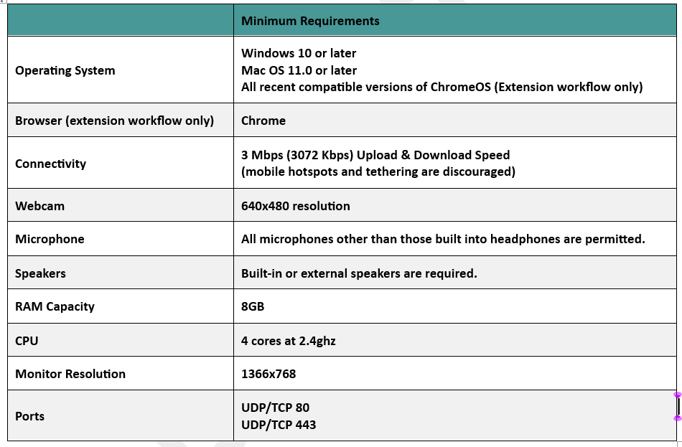

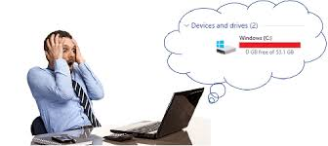
COMPUTER REQUIREMENTS
WARNING! You MUST TEST YOUR COMPUTER BEFORE TEST DAY in an environment that is identical or close to your testing location. If the computer does not meet the minimum requirements, you may forfeit your test fee. Check ahead of time.
TEST DAY
or
Notes:
Meeting at least the minimum computer requirements is vital to a successful administration. You must take the test on a computer that meets the minimum requirements.
In the Reservation and Reminder Emails, you will see the link, “Test your Equipment”.
Click on this link and the program will let you know if your computer meets the minimum requirements for the test software to operate properly.
Important: Test your computer before your test appointment.
If your computer does not pass the test, you will need to find another computer. Some people have borrowed a computer from a family member or friend. It is your responsibility to use a computer that meets the minimum requirements.
If you start your appointment and your computer does not meet at least the minimum requirements, you will forfeit the test fee.
Others have already experienced not testing their computer and have forfeited their exam fee.

Slide 7

WARNING – BUYER BEWARE
Test preparation is your responsibility.
You may not use any training class or Pass-the-Exam class as a reason for NOT passing the test, nor does it exempt you from additional test fees.
Information contained in the test is not provided to any COQB Instructor.
Notes:
Buyer Beware
Test preparation is your responsibility.
Any training class or Pass-the-Exam class cannot be used as a reason for not passing the test, nor does it exempt you from additional test fees.
Information contained in the test is not provided to any COQB Instructor.

Slide 8
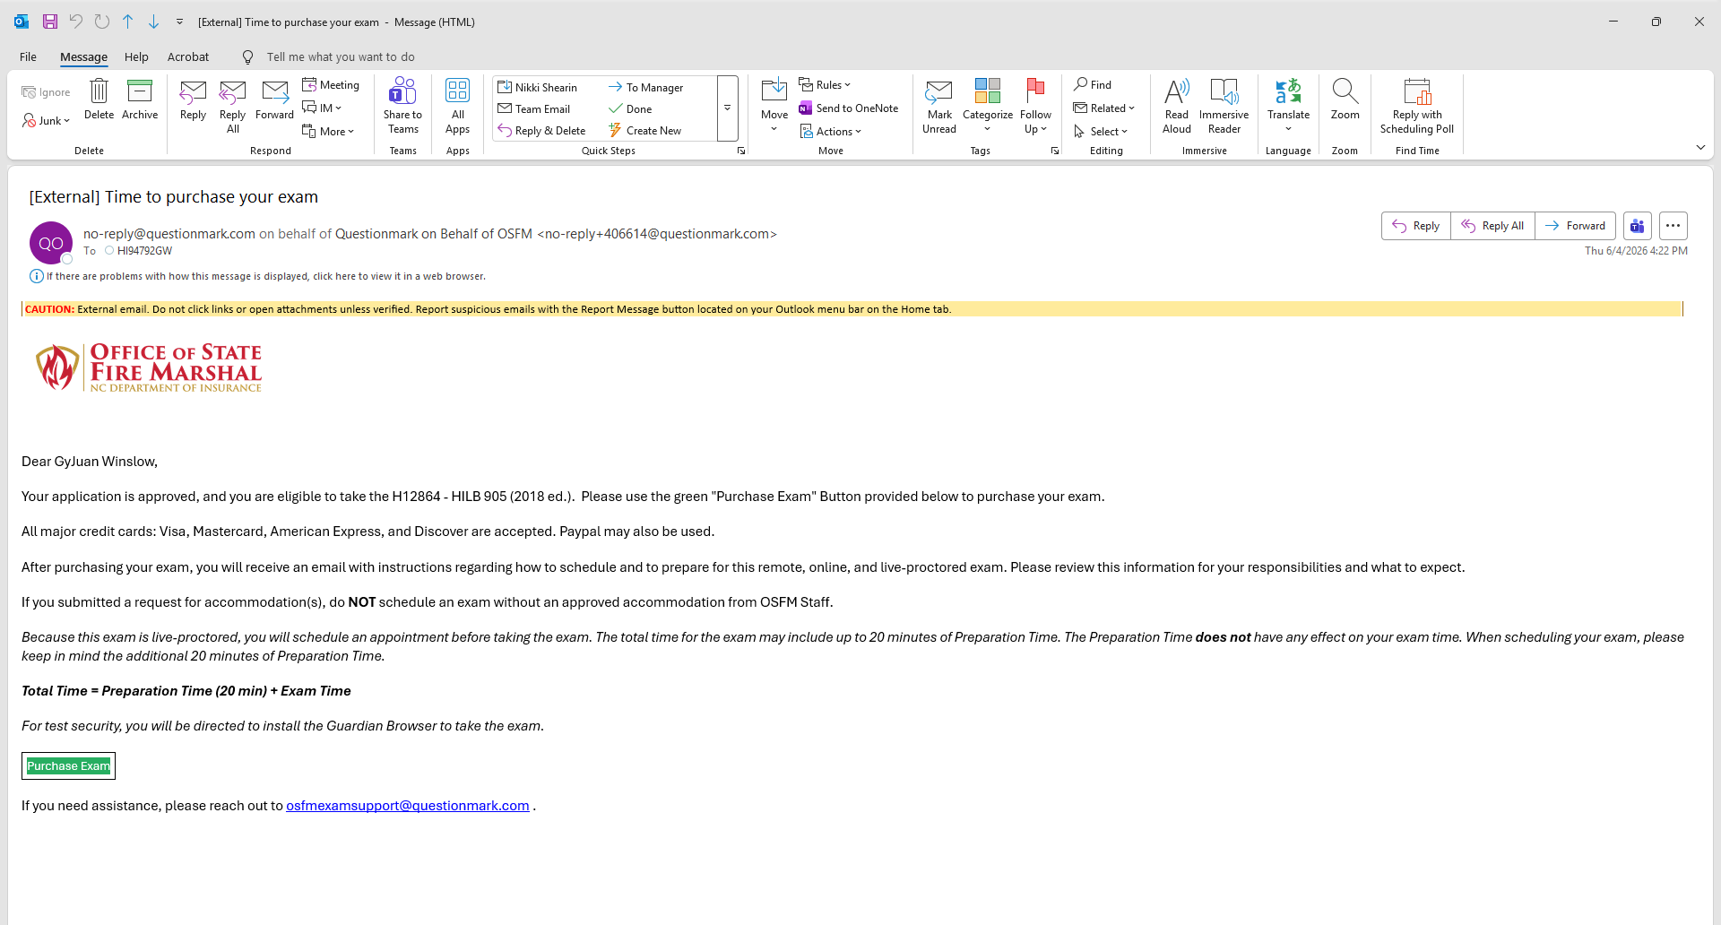
PURCHASING & SCHEDULING A TEST
IMPORTANT: An eligibility to qualify for a test. You will receive an application approval email with a link to your profile and instructions. Taking a test with an expired eligibility forfeits the score and test fee.
WARNING: Emails from no-reply@questionmark.com and “noreply”@questionmark.com to purchase and schedule, in addition to appointment reminders. Verify with your business cyber-security team or personal computer email settings that you can receive these email addresses.
Check junk and spam folders for these emails.
noreply@questionmark.com
You must receive emails from both sender addresses.
PART II – PURCHASING & SCHEDULING A TEST
Notes:
Purchasing and Scheduling a test.
First. You must have an approved eligibility. Taking a test with an expired eligibility forfeits the score and test fee.
Within the application process, you will be able to choose the testing method.
QUEST or PSI.
Very Important!
Emails will come from no hyphen reply at questionmark dot com, and no reply at questionmark dot com.
Whether using a business or personal computer you must ensure that the email server will accept emails which begin with no hyphen reply and no reply.
You will see a note when you click on the test method button in your profile. The note states that you will receive an email within two business days. There is a contact email on the same page if it has been more than two business days. The day that you click on the test method button does not count as one of the two business days.
Please check your spam and junk folders before sending an email for assistance.

Slide 9
TEST ACCOMMODATIONS
ADA compliant
Candidate needs
Documentation required from
  Medical professional
  School
  Institution
Sample document on website
IMPORTANT
Accommodations are tied to the schedule;
Therefore,
if you need to retest, you MUST report the retest appointment scheduled date/time
Approved accommodation required before scheduling.
Report date/time for scheduled appointment.
Accommodations are manually added to each scheduled attempt.
Section II TEST ACCOMMODATIONS
Notes:
Accommodations…
The test software is ADA compliant. Font size may be increased, and high contrast is also an option.
To receive an accommodation, signed and dated documentation from a medical professional, school, or other institution, is required.
On the OSFM Website, you will find two documents.
The first document is for you to complete and the second is a sample document for the person approving the need for an accommodation.
The CIB details the process for submitting the accommodation to OSFM Staff for review and approval.
WARNING!!
If you do not have an approved accommodation for your specific scheduled date and time from OSFM, you will not receive any accommodations and forfeit testing fees.
Communicate to OSFM Staff the appointment information each time the test is attempted.
In the QUEST system, the accommodation is assigned to the appointment not the individual.

Slide 10

BEFORE SCHEDULING A TEST
You must have an eligibility
Approved accommodation(s)
Plan additional time (20 minutes) for test set-up
Notes:
Before scheduling a test
1. You must have an approved eligibility
2. If appropriate, an OSFM approved accommodation.
3. A block of time which includes 20 minutes of test security steps, and the time allotted for the test.

Slide 11

TEST PURCHASING AND SCHEDULING
Be prepared to test at your scheduled time to avoid additional test fees.
Valid Eligibility
Test Your Equipment
If needed, accommodation approval
An appropriate testing area (More about this later)
In an emergency, you may cancel and reschedule. Instructions may be found in the CIB, Reservation email and Reminder emails.
Section IV of the CIB
Notes:
Be prepared to test at your scheduled time.
This includes, but is not limited to, having each of the following,
A valid approved eligibility.
A computer which meets the minimum requirements based on Test Your Equipment.
If needed, an approved accommodation for the specific test appointment from OSFM.
An appropriate testing area,
(More about this later.)
In an emergency, you may cancel and reschedule using the instructions from the Reservation Email or Reminder Emails you receive.

Slide 12
CANCELED OR MISSED APPOINTMENTS AND REFUNDS
Canceling Test Appointment
Candidates may reschedule their test 24 hours prior to the start time.
Missing Test Appointment
IMPORTANT: If you miss your appointment, you will not be able to take the test as scheduled, and you will forfeit your test fee.
Refunds
Change in life circumstances, illness, or no longer need the license.
Cases of an erroneous transaction, such as a candidate being accidentally charged or paying twice.
Notes:
Cancelling a test appointment…
You may cancel and reschedule your appointment twenty-four hours prior to the start time.
Missing test appointment…
If you miss your appointment, you will not be able to take the test and you will forfeit your test fee. More information is found in the CIB.
Refunds…
If you have a change in life circumstances, illness, or no longer need the license.
Another situation may be an erroneous charge for the test.
Contact and procedure information is in the CIB.

Slide 13
REFERENCE MATERIALS & TIME
COQB Approved References
3.5 Hours
130 Multiple Choice
Average 1.5 minutes per item
Part III Reference
Notes:
Code Officials Qualification Board approved references, specific to each test, are permitted.
You will have 3 and a half hours to answer 130 multiple choice test items.
You must average approximately 1.5 minutes, per test item, to finish in the time allotted.

Slide 14

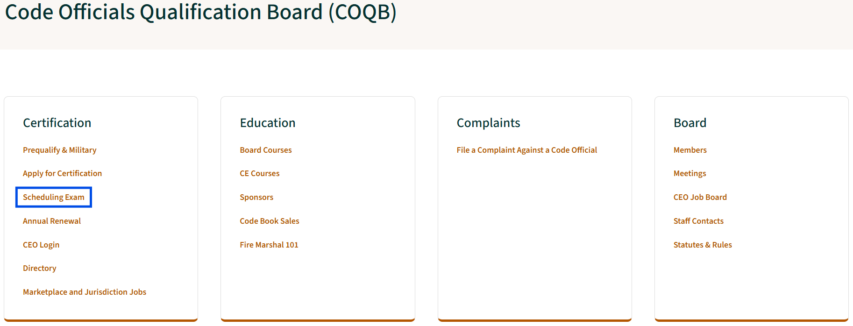
WEBSITE
NCOSFM.gov
NCOSFM.gov/licensing-certification
Scheduling Exam
Notes:
These are screenshots from the COQB webpage.
On the Code Officials Qualification Board Webpage, you may review scheduling an exam with Questionmark or PSI.

Slide 15

TESTING REQUIREMENTS
Test Taker Responsibilities
Computer
Stable power source
Reliable internet connection
Working internal or external webcam
Microphone
Speaker
Testing location
WARNING! (Prior to scheduled test date)
Read the Candidate Information Bulletin thoroughly.
Prepare for the test.
Test your computer BEFORE scheduled test date. Failure to follow instructions may result in additional test fees.
Download Guardian Browser prior to scheduled test date.
PART IV – TESTING REQUIREMENTS
Notes:
Test taker, your, responsibility…
The computer must have a stable power source.
A reliable internet connection.
A working internal or external webcam.
A microphone.
A Speaker or speakers.
And an appropriate testing location.
Prior to your appointment to take the test…
Be sure to read the Candidate Information Bulletin thoroughly.
Prepare for the test.
Test your computer.
And download the Guardian Browser.

Slide 16

GUARDIAN BROWSER State of NC Approval
QUEST tests require the ProctorU Guardian Browser to be downloaded and run on the computer used for testing.
We strongly urge the use of personal computers for the QUEST tests.
IMPORTANT: Notice to Businesses
OSFM IT Support crafted a letter regarding the safety of the Guardian Browser for appropriate use with QUEST tests. If you need a copy, please email OSFM.QUEST@ncdoi.gov.
Notes:
The Guardian Browser is the application which locks down your computer, so you cannot open other windows and is the browser used to administer the test.
A link with instructions for downloading the Guardian Browser may be found in the CIB, Reservation email and subsequent Reminder emails.
IMPORTANT…
If you are taking the test on a business computer, the cyber security or IT department may restrict downloading and running unapproved applications.
The Office of State Fire Marshal Technical Support crafted a letter regarding the safety of the Guardian Browser for appropriate use with QUEST Tests.
If you need a copy, please email OSFM.QUEST@ncdoi.gov.

Slide 17
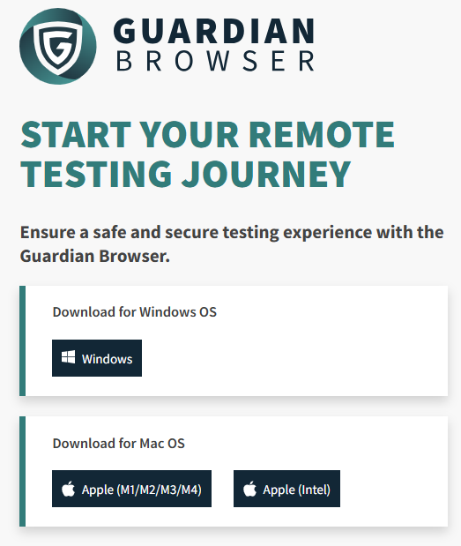
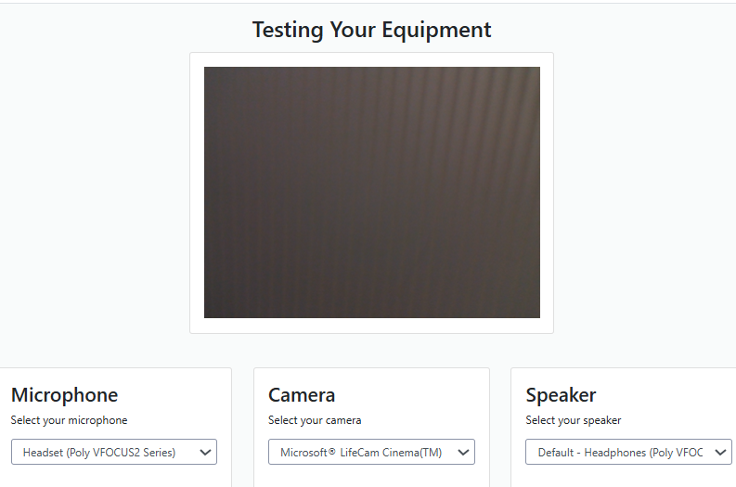
GUARDIAN BROWSER AND TESTING YOUR COMPUTER
WARNING! If you do not test your equipment and your computer disconnects during the test, you will pay another test fee to reschedule. Test your equipment before scheduling and before the appointment time. Take a screenshot for your records in the case of a dispute.
Hyperlinks for the Guardian Browser and Testing Your Equipment are in CIB, Reservation Email and all Reminder Emails.
Notes:
Warning!!
If you do not test your equipment and your computer disconnects during the test, you will pay another fee to reschedule.
Test your equipment before scheduling and before the appointment time.
Take a screenshot of the Testing Your Equipment results for your records in the case of a dispute.
Hyperlinks for the Guardian Browser and Testing Your Equipment are found in the CIB, Reservation Email, and all subsequent Reminder Emails.

Slide 18
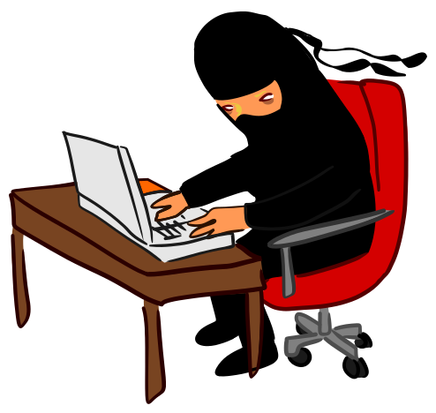
PROHIBITED COMPUTER APPLICATIONS
(3rd party applications)
Screenshot and Remote Access Applications
The Guardian Browser detects prohibited applications after you connect with a proctor.
If you are unable to uninstall the application/program, you will need to reschedule and may forfeit the test fee.
Prohibited apps or programs discovered during the test will be considered cheating.
***Note: “Gaming” computers tend to have prohibited applications.
Prohibited
Virtual Machines
Remote Access Programs
Screenshot Applications
See CIB for more information
Notes:
Several test takers have had to repay to take their test due to prohibited computer applications.
The Testing Your Equipment does NOT, look for these applications.
Uninstall these applications before the appointment. If the Guardian Browser detects a prohibited application, you will be asked to uninstall the application.
If you do not know how to uninstall the applications, be sure to speak with someone who does before the test.
Also, make sure the person tells you how to uninstall applications if you need to uninstall one during the test check-in process.
The proctor will not uninstall any applications or programs.

Slide 19
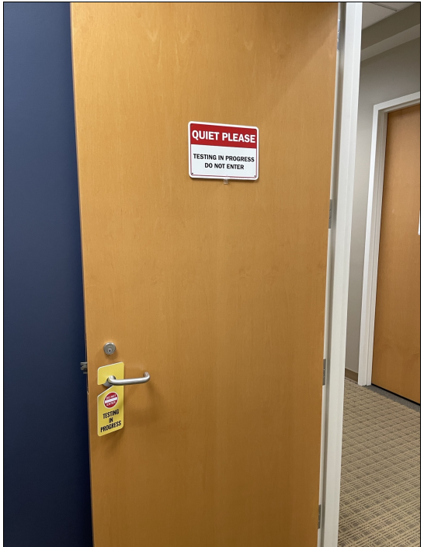
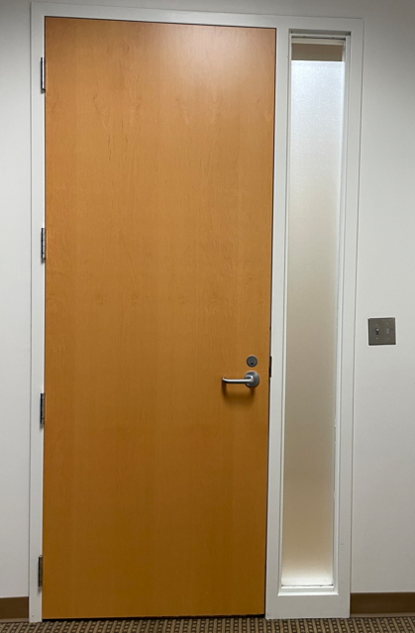
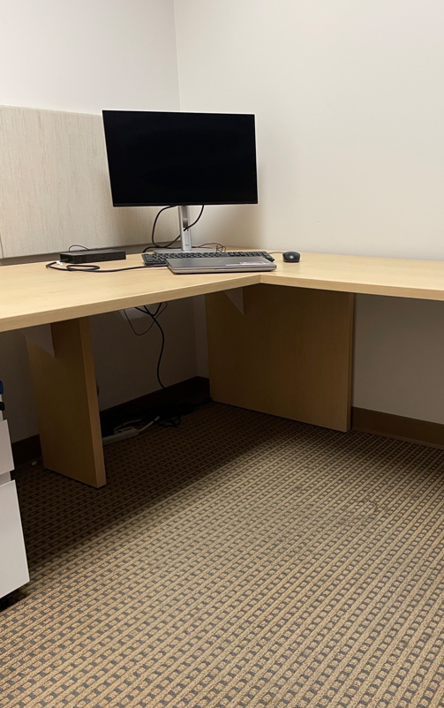
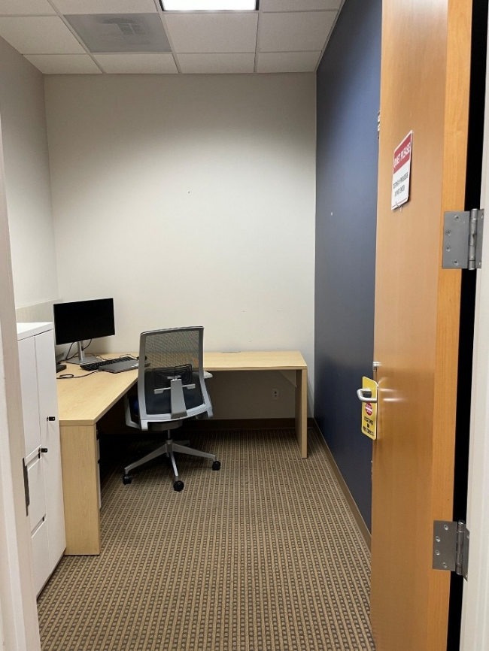
PHYSICAL LAYOUT OF TESTING ROOM
OSFM, QuestionMark, and Meazure Learning do NOT approve testing rooms ahead of the test. The proctor will grant final approval at the time of the test.
Door closed & Frosted window
Nothing on walls related to test
Clear desk & “daylight” lighting
Sign on Door
Notes:
We will NOT pre-approve your testing area!
Neither Office of State Fire Marshal nor Questionmark nor Meazure Learning will pre-approve the testing area.
The proctor will grant final approval before the test.
Let’s review the photos…
First picture: A do not disturb sign on the door.
Second picture: The door closed and no window that would allow someone to see the test items.
Third picture: Nothing on the walls related to the test
Fourth picture: A clear desk and daylight lighting.

Slide 20

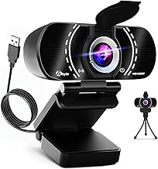
TEST ENVIRONMENT (Top 10)
The online testing environment should mimic “in-class” testing.
Stable power source and secure internet connection
Clear desk or table
Single monitor
No pets or children in the room or where they may be a distraction
Room lighting bright - “daylight” quality
Proctor must be able to see you for the duration of the test
Internal or external cameras allowed
Testing from a hard surface (No bed, couch, floor, etc.)
Room with a door, preferably a private room with restricted access.
Webcam, speakers, and microphone must remain on throughout the test
External Camera
Sample Only
Notes:
The online testing environment should mimic in-class testing.
Here are the top ten requirements.
Stable power source and secure internet connection.
Clear desk or table.
Single monitor.
No pets or children in the room or where they may be a distraction.
Room lighting bright - “daylight” quality.
Proctor must be able to see you for the duration of the test.
Internal or external cameras allowed.
Testing from a hard surface - (No bed, couch, floor, etcetera).
Room with a door, preferably a private room with restricted access.
Webcam, speakers, and microphone must remain on throughout the test.

Slide 21

DAY BEFORE TEST
Desk area - meets requirements.
Prepare a “Do Not Disturb” sign to be posted on test day.
IMPORTANT: People entering the test area may result in score cancellation and forfeiture of your test fee.
Check your set-up – your head (chin to forehead) visible from your camera
IMPORTANT: If you are not ready for your test due to lack of preparation, you will not be allowed to take the test and will forfeit your test payment.
Review the Candidate Information Bulletin regarding the ID policy.
IMPORTANT: If you do not have OSFM approval for your accommodation, you will not receive it. We recommend cancelling your appointment and rescheduling.
Test screenshots see APPENDIX A
Notes:
The day before the test check list.
Desk area meets requirements.
Prepare a “Do not disturb” sign.
If people enter the test area during the test, your score may be cancelled and your test fee forfeited.
Your head, chin to forehead, must be visible from your camera.
If you are not ready, cancel and reschedule or you may forfeit your test fee.
Review the CIB regarding the ID policy.
If you have not received OSFM approval for your accommodation, you will not receive it. Cancel your appointment and reschedule. Then, follow the steps for receiving OSFM accommodation approval in the CIB.

Slide 22
TEST DAY
The COQB Test is a remote, on-line, live proctored test. Therefore, if there is a system failure such as a power outage, loss of network connectivity, software failure, or a candidate closes their browser window, the candidate may use the resume feature. If a connection cannot be re-established, the test must be rescheduled.
  If the technical issue is on the QUEST side, a fee will not be charged for rescheduling.
  If the technical issue is on the candidate side, an additional test fee may be required.
  As stated in the Reservation Confirmation and Reservation Reminder emails, be sure to test your system prior to test day.
  If unable to reconnect to the test, send a detailed email to osfmexamsupport@questionmark.com
  Unresolved testing issues: osfm.quest@ncdoi.gov
Notes:
The COQB test is a remote, on-line, live proctored test. Therefore, if there is a system failure due to a power outage, loss of network connectivity, software failure, or a candidate closes their browser window, the candidate may use the resume feature. If a connection cannot be re-established the test must be rescheduled.
If the technical issue is on the QUEST side, a fee will not be charged for rescheduling.
If the technical issue is on the candidate side, an additional test fee may be required.
As stated in the Reservation Confirmation and Reservation Reminder emails, be sure to test your system prior to test day.
If unable to reconnect to the test, send a detailed email to osfmexamsupport@questionmark.com.
For unresolved testing issues, send a detailed email to osfm.quest@ncdoi.gov.

Slide 23

RULES OF CONDUCT
This section describes the rules of conduct adhered to and enforced by the proctoring service.
WARNING!
Candidates are responsible for ALL content within the COQB CIB.
Respectful behavior is expected and required!
Aggressive behavior will not be tolerated including, but not limited to, verbal harassment, abusive or foul language, threats, and failure to respond to proctor instructions.
Incidents may result in test termination and additional test fees.
PART V – RULES OF CONDUCT
Notes:
The CIB contains details surrounding the rules of conduct which apply to taking the test online.
You are responsible for all content in the CIB.
Respectful behavior is required at all times.
Aggressive behavior will not be tolerated including, but not limited to, verbal harassment, abusive or foul language, threats, and failure to respond to proctor instructions.
Incidents may result in test termination, forfeiture of eligibility and additional test fees.

Slide 24
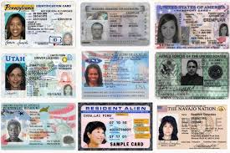
IDENTIFICATION REQUIREMENTS
Provide one (1) form of original, valid (non-expired), signature-bearing government-issued identification with photo.
Register with LEGAL first and last name as it appears on your government-issued identification.
Identification below must match the first and last name under which the candidate is registered.
WARNING:
Failure to present proper identification
Not allowed to test.
Test fee not refunded.
Notes:
When you check in with the proctor, you will need to show your original, valid, signature bearing, government issued identification with photo.
Use your legal first and last name as it appears on the government ID on your application.
For example, if your legal first name is Joseph, the application cannot have Joe as your first name.
Without proper identification, you will not be allowed to test, and your test fee will not be refunded.

Slide 25

RESTROOM BREAKS?
Restroom Breaks During the Test
With proctor approval, candidates may take two (2) restroom breaks.
After a completed test block and before the next text block.
You may not return to any block already submitted.
The test time clock never stops.
Breaks may not exceed 15 minutes.
You may not disrupt the virtual environment (access internet, check email, chat, etc.).
Do not communicate with anyone.
After the break, the physical environment will be resecured.
Other Considerations
Drinks are permitted.
Must be fully clothed as you would for an in-person test.
Notes:
You are permitted up to two restroom breaks during the test; however, you may only take the break when you are between test blocks.
After one test block ends and before the next one begins.
Notify the proctor through the imbedded chat function and wait for approval.
Note:
The timer for the test does not stop during a break.
Maximum break time is 15 minutes.
No access to a phone, email, chat or other form of communication is permitted.
Do not communicate with anyone.
After the break, the proctor will resecure the test environment.
Drinks are permitted.
Be fully clothed as you would for an in-person test.

Slide 26

WHAT IS NOT ALLOWED?
NO – Do Not Do – Do Not Have
Food
Smoking/vaping/dipping/chewing or any form of tobacco
Writing instruments (Except: Expo markers for a whiteboard)
Paper
Hats
Sunglasses
Watches
Calculators
Radio, TV or sound device in the background
Copying, Recording, Photographing, or another electronic device
Leaving your seat without permission
Headphones, earbuds, or earplugs – (Hearing aids need an approved accommodation.)
Notes:
Strictly not allowed during the test.
Food.
Smoking, vaping, dipping, chewing or any form of tobacco.
Writing instruments.
Paper.
Hats.
Sunglasses.
Watches.
Calculators.
Radio, TV, or sound device in the background.
Copying, Recording, Photographing, or using another electronic device.
Leaving your seat without permission.
Headphones, earbuds, or earplugs – (Hearing aids need an approved accommodation.)

Slide 27



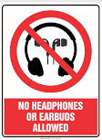








WHAT IS NOT ALLOWED?
You may not use your phone during the test; however, you will need to show your phone to the proctor. The proctor will advise you to move the phone out of reach and then show where you placed your phone.
Notes:
A picture is worth a thousand words.
You will need to show your phone to the proctor.
You will be advised to place it out of reach and show the proctor where it is placed.

Slide 28
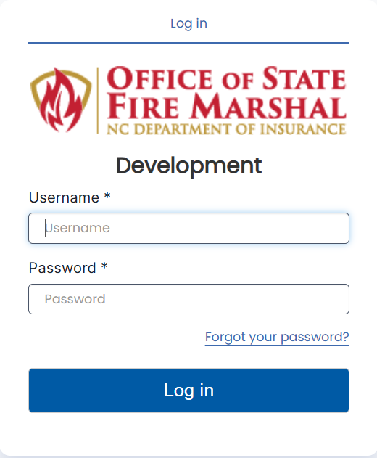
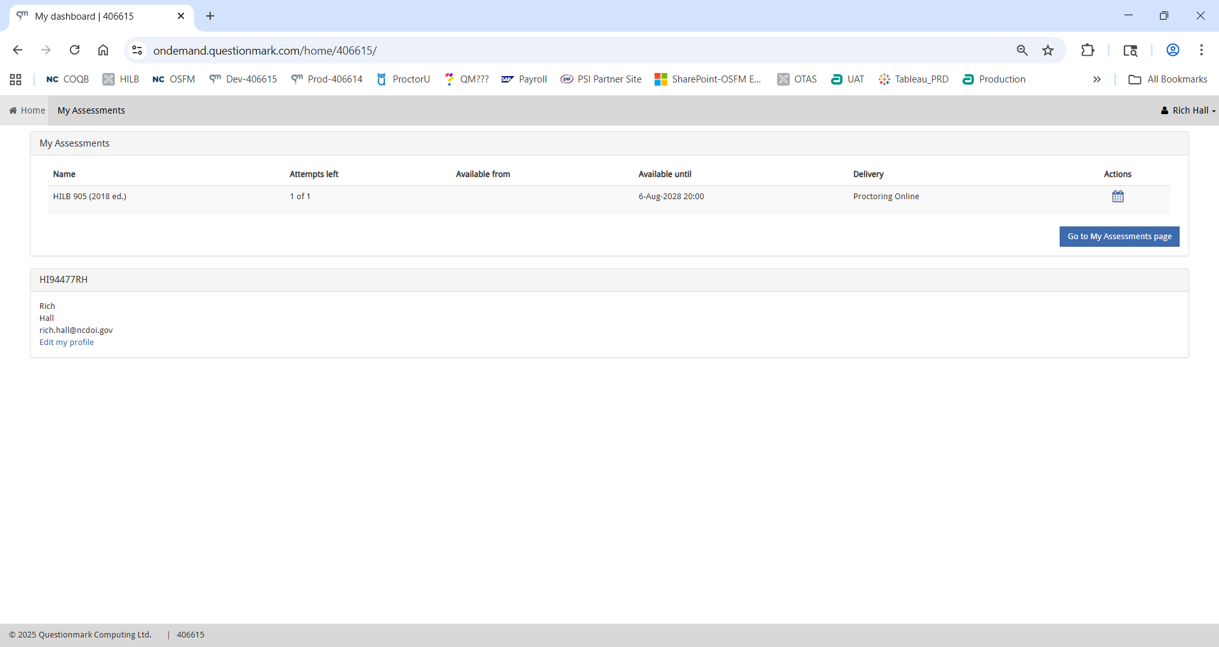
LOG IN ON TEST DAY
Username is C “+” (CEO ID)
Example: CEO ID is 12354
Username for QUEST is C12354
Changes 5 minutes before appointment time to a play button
C12354
PART VI – TEST DAY AND AFTER THE TEST
Notes:
Notice the steps to access your test. Your username is found in the Schedule Email. It begins with a ‘C’ added to your CEO ID.
For example, if the CEO ID is 12354, then the username for QUEST would be
C12354.
Look at the last screenshot.
The calendar icon will change to a play button 5 minutes before the appointment time.
When you see the play button, you may click on it to begin the process for the test.

Slide 29
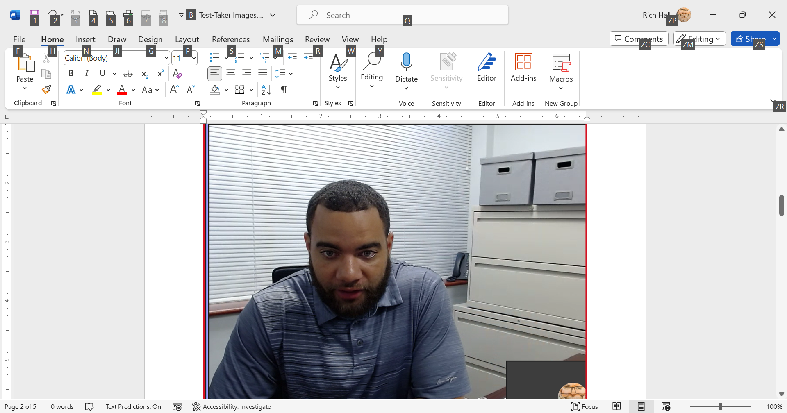
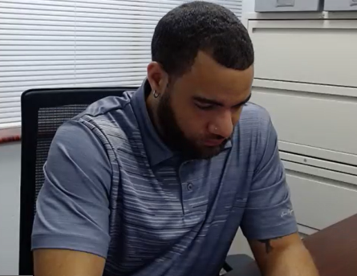
EYE/HEAD MOVEMENT PARAMETERS DURING THE TEST
Your face, chin to forehead, must always be in the camera view.
The red line in the images indicate eye/head movement parameters.
Any other movement will be flagged. If the behavior continues, the proctor may stop the test. If the test is stopped for this behavior, you will forfeit this attempt, the test fee, and may not be allowed to retest.
Notes:
Notice the second and third pictures allow movement of the head and eyes within the red triangle parameters.
Do not look around during the test as it will lead the proctor to believe you may be looking at information pertaining to the test which would be considered Cheating.
Your face from chin to forehead must always be in camera view.
Any other movement will be flagged and, if the behavior continues, the proctor may stop the test. If the test is stopped for this behavior, you will forfeit this attempt, the test fee, and may not be allowed to retest.

Slide 30

TECHNICAL ISSUES DURING THE TEST
If you are aware of technical issues prior to taking the test, reschedule until resolved.
Important
Neither proctors nor technicians will uninstall any applications or programs.
If there are technical issues, there will be a delay for a technician.
Be patient and do not panic!
If the issue is not resolved within 20 minutes, the test will be stopped, and OSFM Staff will be notified.
Notes:
If you are aware of technical issues prior to taking the test, reschedule until the issues are resolved.
Neither proctors nor technicians will uninstall any applications or programs.
If you experience technical difficulties during the test, a technician will be alerted to work with you for a solution.
Often there is a delay for a technician to be connected.
Please be patient and know that everyone is working in your best interest.
If no resolution is possible within 20 minutes, the test will be stopped OSFM staff will be notified.

Slide 31
AFTER THE TEST
Passing Score >=70%
Failing Score <70%
Passing notification
Certificate (Mondays)
No numerical score
Failure notification
Coaching Report
Wait 30-days; retake
Notes:
When you pass the test with a 70% or greater, you will be notified on the screen and sent an email.
Within 24 hours, your passing notice will be available in the COQB Database.
You will not see or be able to receive your actual score, per policy.
Certificates are printed and mailed on Mondays.
If you do not pass the test, you will be notified on the screen, and an email will be sent with a coaching report which will include your score.
Per general statute, you must wait 30 days to retake the test.
Within 24 hours, your grade will be posted in the COQB Database.
If you have another attempt, you will be sent a Purchase Email.
The available dates will begin 30 days from your last test date.

Slide 32
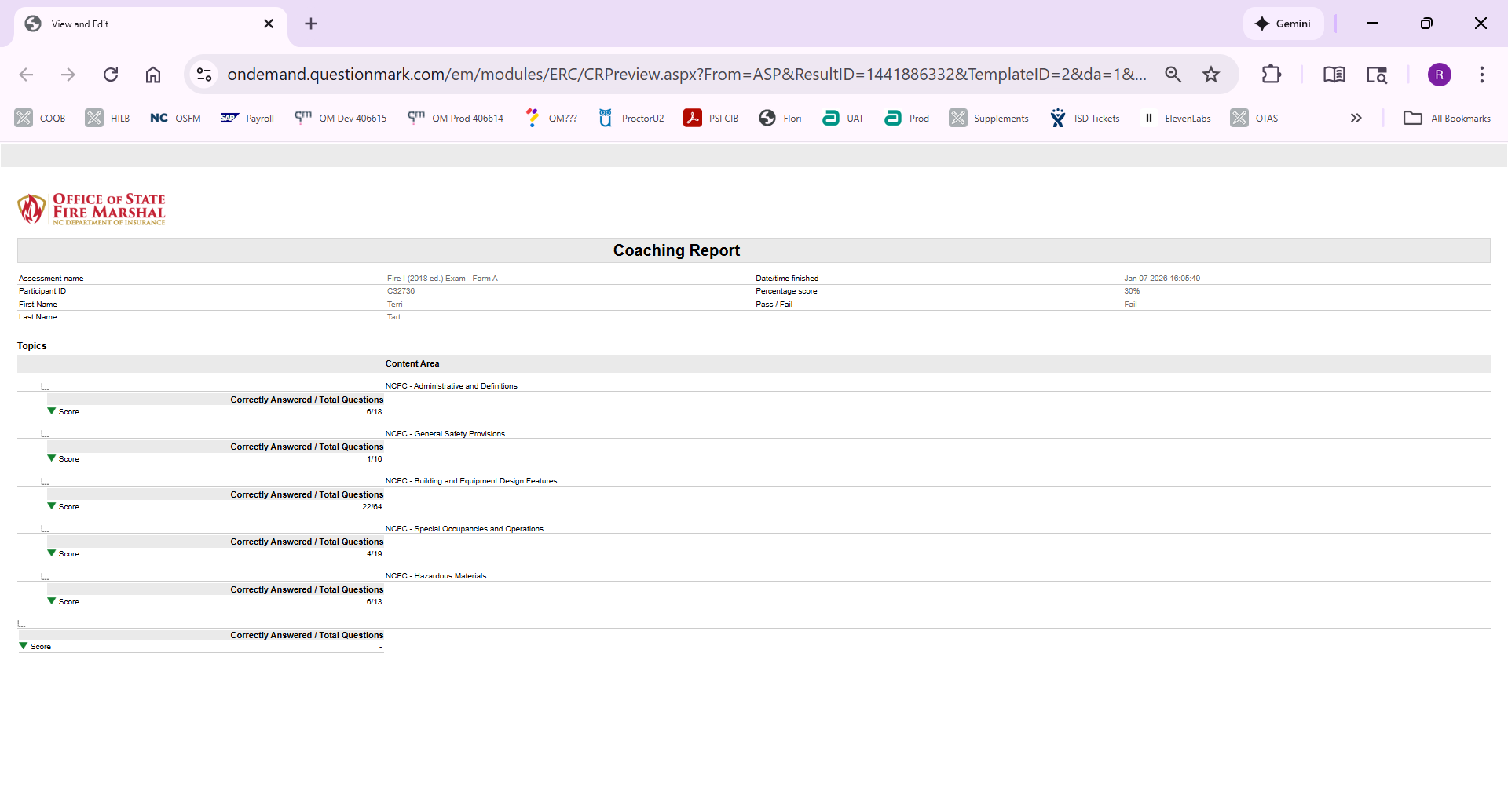
COACHING REPORT
There is no test review/item challenge for this test. If the test is failed, a coaching report will be sent to show areas for further study. The coaching report shows the total number of questions per content area. Example: The candidate correctly answered 22 out of 64 questions for NCFC – Building and Equipment Design Features.
SAMPLE COACHING REPORT
Be sure to check your SPAM or JUNK email.
Notes:
If you fail the trade test, you will receive a Coaching Report.
The report is designed to identify areas where further study may be needed.
The report displays the number of questions answered correctly out of the total number of questions in the content area.
It may be used to identify areas for further study.
In this example, the test taker correctly answered 22 out of the 64 test items in the NCFC - Building and Equipment Design Features.
If you don’t receive it within 24 hours, check your spam and junk folders.

Slide 33
SEE APPENDIX A FOR TEST SCREENSHOTS
CIB
The CIB is several pages because it includes screenshots of every screen, every email and detailed instructions for every step in the process.
As a reminder, this presentation is an overview and does not replace reading the CIB.
Read the CIB thoroughly!
Notes:
The CIB is several pages because it includes screenshots of every screen you will see, every email you will receive, and detailed instructions for each step of the process.
This presentation is an overview and does not replace reading the CIB.
Make sure you have read the CIB thoroughly.

Slide 34

WARNING!!
All examination materials, including test questions and test items, are the sole property of the North Carolina Code Official Qualification Board and are confidential. No test items or examination content may be copied, reproduced, retained, disclosed, transmitted, or shared during or after the examination.
Any examinee who is found or suspected to have harvested, copied, shared, disclosed, or otherwise misappropriated examination content; released confidential examination materials; or engaged in fraudulent or improper testing practices may be reported to the Board for investigation. Such conduct may result in disciplinary action, including denial of an application, suspension or revocation of a license, civil penalties as authorized by law, and referral to appropriate authorities for criminal investigation or prosecution.
Notes:
Legal warning
All examination materials, including test questions and test items, are the sole property of the North Carolina Home Inspector Licensure Board and are confidential.
No test items or examination content may be copied, reproduced, retained, disclosed, transmitted, or shared during or after the examination.
Any examinee who is found or suspected to have harvested, copied, shared, disclosed, or otherwise misappropriated examination content; released confidential examination materials; or engaged in fraudulent or improper testing practices may be reported to the Board for investigation.
Such conduct may result in disciplinary action, including denial of an application, suspension or revocation of a license, civil penalties as authorized by law, and referral to appropriate authorities for criminal investigation or prosecution.

Slide 35

COQB SUPPORT
Applications & Eligibilities
Terri Tart, terri.tart@ncdoi.gov
Renita Denton, renita.denton@ncdoi.gov
Board Courses
Jennifer Hollyfield, Jennifer.Hollyfield@ncdoi.gov
Who To Email
osfmexamsupport@questionmark.com
Charged or paid twice
Purchasing
Scheduling
Rescheduling
Technical Issues
osfm.quest@ncdoi.gov
Test Accommodation(s)
Refunds
Unresolved testing issues
Notes:
If you need support, we have divided the topics based on the email addresses.
You will receive a card with contact information from your instructor.
Thank you for your attention!

