Slide 1
Chief 101 (2025 edition)

Slide 2
Chief 101 Course
This class consists of several programs that together will satisfy the 9S inspection criteria as specified by the North Carolina Administrative Code. The primary objective of the course is to inform current and future chief officers of the various aspects and complexities surrounding the operations and organization of North Carolina fire departments.

Slide 3
Chief 101 Course
A requirement of becoming a fire chief in North Carolina is that you complete the Chief 101 class within one year of appointment as defined in NC Administrative Code.
  11 NCAC 05A .0907 TRAINING (c)
Your department is rated by OSFM. A requirement to remain rated requires you to complete a Chief 101 course, provided by OSFM and the community college system, within a year of your appointment and then required upgrades.
3

Slide 4
Chief 101- 2025 Course
New initial course, Chief 101-2025, will be released 08/01/2025
Initial course will be delivered, in-person, by a qualified instructor
Chief 101-2025 will be released on or before 07/01/2025 release
Will be delivered online for all Chief 101-2020 certified Fire Officers
This opportunity will be available until 10/01/2026

Slide 5
Chief 101- 2025 Course
Chief 101-2025 annual updates
Must complete all five of the above, to receive Chief 101-30
Or complete the Chief 101-30 initial course again
Chief 101-2026 – released on 10/01/2025 (on-line)
Chief 101-2027 – released on 10/01/2026 (on-line)
Chief 101-2028 – released on 10/01/2027 (on-line)
Chief 101-2029 – released on 10/01/2028 (on-line)
Chief 101-2030 – released on 10/01/2029 (on-line)

Slide 6
New Fire Chief Requirements and Responsibilities
Completion of the Chief 101 class within one year of appointment as defined in 11 NCAC 05A .0907 TRAINING (c)
36 hours of training as defined in NCGS 58-86-2 (13)
Provide notice to agencies concerning your appointment
Submit the Annual Fire Department Roster and Relief Fund Board of Trustees Report to the NCSFA (December 1 - January 15)
6

Slide 7
New Fire Chief Requirements and Responsibilities
Submit the Annual Fire and Rescue Pension Fund Membership Turnaround Document to the State Treasurer’s Office
Become Familiar With Your Relief Fund Board of Trustees
Required Annual Relief Fund Reports
7

Slide 8
Provide Notice of New Chief
You must notify the following agencies concerning your appointment by email or phone and provide them with your complete contact information;
  NC State Firefighters’ Association (NCSFA) at 800-253-4733 or barry@ncsfa.com
  NC Office of State Fire Marshal (OSFM) at 800-634-7854 or brian.taylor@ncdoi.gov
  Fire and Rescue Pension (office at the Department of State Treasurer) at 877-627-3287 or NC.Fire&Rescue@nctreasurer.com
  NC Association of Fire Chiefs (NCAFC) at 888-502-4433 or sburnette@ncafc.com

Slide 9
Provide Notice of New Chief
The workers compensation provider for your department, your departments treasurer or accountant, your departments Relief Fund treasurer, your departments insurance carrier, banks and financial institutions with departmental accounts, County Fire Marshal or EM Director, City and/or County Government, and anyone else with whom your department does business.
By notifying NCSFA or OSFM the information will be shared among all three agencies.

Slide 10
Submit the Annual Fire Department Roster and Relief Fund Board of Trustees Report to the NCSFA
As Fire Chief, you are responsible for the accuracy of the NCSFA Fire Department Membership Roster and The Relief Fund Board of Trustees report, ensuring that it is submitted correctly, on time, and kept current.
Changes should be made to your Roster and BTR as they occur during the year. Between December 1st and January 15th, the annual correction and certification period for rosters is open and required.
Rosters and the Relief Fund Board of Trustees Report must be certified and submitted annually by midnight January 15th of each year to the NCSFA.

Slide 11
Submit the Annual Fire Department Roster and Relief Fund Board of Trustees Report to the NCSFA
After the roster is submitted by the fire chief, the NCSFA forwards it to the State Treasurers Office.
This credits your certified members for one year of service with the Fire and Rescue Pension program and membership in our association.
At the same time, you have the option to select membership with the National Volunteer Fire Council.

Slide 12
Submit the Annual Fire Department Roster and Relief Fund Board of Trustees Report to the NCSFA
You can get your roster log-on credentials and instructions by calling our office at 800-253-4733. We will assist you with instructions to correct, certify, and submit your roster. If you miss the January 15th deadline, you could jeopardize benefits for your firefighters.

Slide 13
Submit the Annual Fire and Rescue Pension Fund Membership Turnaround Document to the State Treasurer’s Office
You will receive a quarterly "Turnaround Document" status report from the State Treasurers Office on Fire and Rescue Pension membership for your personnel. You are responsible for responding to the Treasurer's Office with accurate information about any changes to your member's pension or service records. Completion of the turnaround document should be done as soon as you receive it.
Remember, “Paid” versus “Years of Service” may not match, depending upon when dues are paid. Retirement at 20 years depends upon 20 years of service being paid.

Slide 14
Become Familiar With Your Relief Fund Board of Trustees
As Fire Chief, you are an ex-officio, non-voting member, of your Local Relief Fund Board unless you already serve in an appointed position. Contact your Relief Fund Chairperson and Treasurer to make sure they know you are the new Chief. If you are unaware of who they are, the NCSFA can provide that information. You should be intricately involved in the activities of this Board and promote the appropriate use of the relief funds for your members.

Slide 15
Required Annual Relief Fund Reports
Two relief fund reports are due each year. Your Relief Fund Treasurer must submit a relief fund financial report and supporting bank or financial statements to the NCSFA by October 31st of each year for the previous fiscal year ending June 30th.
You, as Fire Chief, must also submit a Board of Trustees Report discussed previously on Rosters.
Failure to get these reports in correctly and on time will result in the loss of your relief fund monies for the following year.

Slide 16
New Fire Chief Requirements and Responsibilities
Workers Compensation
Grant Paperwork
Know Your Financial Controls
Keep Fire Reports Current
Use Resources

Slide 17
Roster Submittal Flow Required by NCGS 58-86 (Certified Roster) and NCGS 58-84 (Relief Fund BTR)
Chief Completes Roster/BTR between Dec. 1st and Jan.15th
Submitted to the NCSFA by Jan 15th deadline
NCSFA submits to the State Treasurer for Pension Credit by January 30th statutory deadline
17

Slide 18
Relief Fund Submittal Flow Required by NCGS 58-84
Treasurer Completes Financial Statements on-line and Submits Bank Statements between July 1st and Oct. 31st
Submitted to the NCSFA by Oct 31st statutory deadline
NCSFA submits to Office of State Fire Marshal for next years relief fund disbursement eligibility
18

Slide 19
NC Firefighter Requirements
Firefighter Training Requirement (36 hours annually) – must be met to count towards a department's membership for the 9S rating and if you want to participate in the NC Fire and Rescue Squad Pension Fund.
A member does not have to be certified as a firefighter by the Fire and Rescue Commission to be counted on your roster or to participate in the North Carolina Fire and Rescue Pension Fund.
  Holding a state certification as a firefighter, by the Fire and Rescue Commission, has nothing to do with being “certified on the required annual roster”; 36-hours of annual training is required to be eligible for the NC Fire and Rescue Squad Pension Fund.

Slide 20
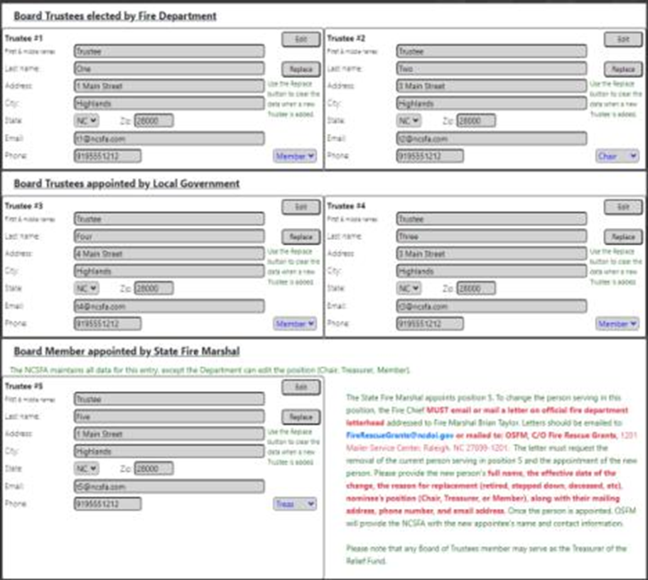
Board of Trustees Report (BTR) – Relief Fund – January 15th
Board of Trustees Report
Due December 1- January 15th (Roster Period)
Must be electronically submitted
NOTE: Fire Chief’s username and password will gain access to this report on the roster.

Slide 21
Roster and BTR Reporting Process
Step 1 Chief Corrects and Verifies Roster
    Chief signs in and reviews roster
    Adds/Deletes members
    Verifies “Certified” by checking box and assigns classification for each member.
    Ensure members personal contact information and SSN# is correct.
    Question asked. “Have you completed updates”
It is critical to add members as soon as they join the Department so they are covered by benefits. There is no waiting period!

Slide 22
Roster and BTR Reporting Process
Step 2 Chief is directed to RF Board of Trustee Report “BTR”
    System gives notice of requirement to complete Board of Trustees Report
    System shows uploaded current Board
    Chief verifies and corrects BTR if necessary

Slide 23
Roster and BTR Reporting Process
Step 3 Submittal and Validation
    Chief is allowed review of Roster and BTR
    Once verified, Chief signs off
    Chief gets printout of validated certificate indicating they have properly submitted
    Large banner on exit if the roster or BTR is not submitted. (You have not Submitted your roster or BTR)

Slide 24
Personnel Beneficiary Designation Form
You can find the Personnel Beneficiary Designation Form on the NCSFA website under “Forms.”
This form may be used for multiple Policies when designating the same beneficiary or beneficiaries.
Use a separate form when designating different beneficiaries for each Policy.
  Encourage members to review and update the form annually.
This form should be retained by the fire department with a copy to the insured member.

Slide 25
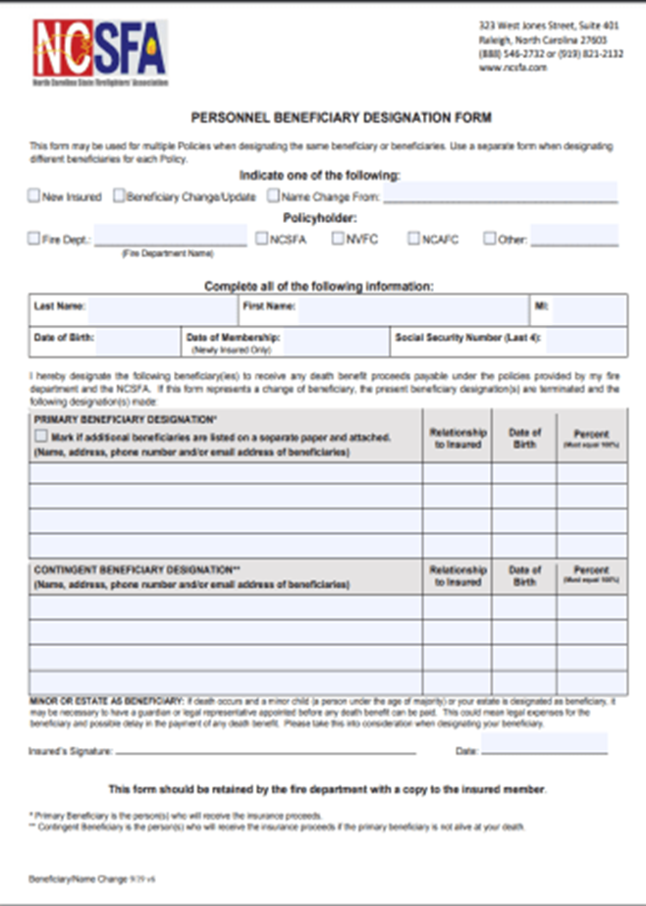
Personnel Beneficiary Designation Form
Beneficiary Form can be Download at NCSFA.com Under “Forms”

Slide 26
FAQ’s
I’ve already had Chief 101, do I have to take this course every five years?
  Yes, it is in the 9S requirements for Fire Chief’s.
Will our NCRRS rating be revoked if “the chief” doesn’t take this course?
  No, but before getting your next inspection, “the chief” will have to complete the course and until they do your department will be in non-compliance and can move to probationary status if not completed.
I prefer to delegate these responsibilities to others in the department, is that acceptable?
  Great idea, but “the chief” is still responsible.

Slide 27
Questions?

Slide 28
NC State Firefighters’ Association - Rosters

Slide 29



NCSFA Membership Roster – The Anchor to Ensure Benefits
The NCSFA Roster and Board of Trustees Report completed each year by January 15th, is the anchor to most benefits and service requirements for your firefighters. Failure to complete and submit it on time, and correctly, can jeopardize benefits and service credit.

Slide 30
Roster Renewal by January 15th - Critical
Annual Roster Due Date
January 15th of Each Year
Includes Roster and Board of Trustees Report (BTR)
Roster and BTR reporting opens December 1st
Note: If your Relief Fund Treasurer is a non-member, they must still be added to your department roster. You do not have to pay dues for a non-member.

Slide 31
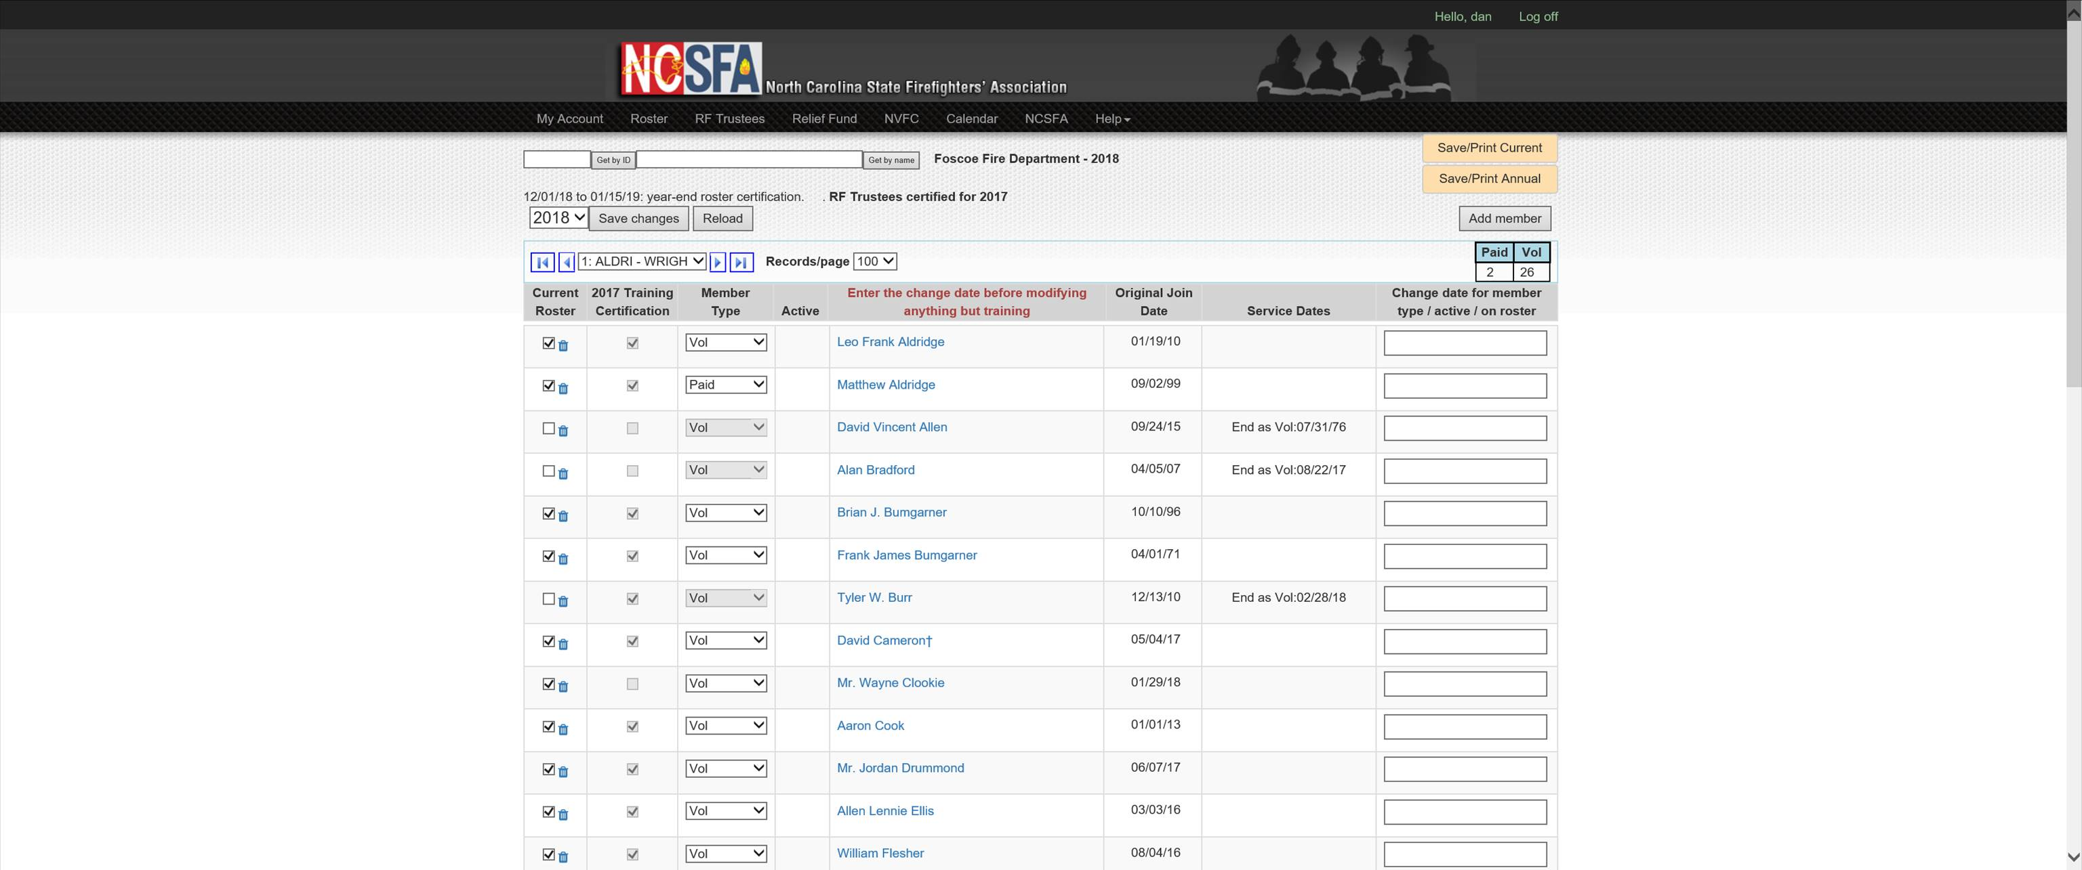
NCSFA Roster Example
End of active service or record change date
Member Type
Individual has completed 36 hrs of Training
Back to Index
Back to Index

Slide 32
Roster Categories
Junior Junior Firefighter. A member that is under the age of 18 and 14 years of age or older. They are not eligible for retirement benefits until they reach the age of 18.
Life DO NOT USE. This designation is for internal purposes only.
Member Roster member who is not serving as a firefighter - not eligible for training certification.
When designating someone as a member, the department will pay dues for that person, and that
person will be eligible for AD&D benefits.
Non-Mem Non-Member - not a firefighter and not participating in training certification. Departments will
often have a Relief Fund Treasurer who is not a member.
NM FF Non-Member Firefighter - not eligible for training certification, pension, Cancer, or LODD benefits
Most NCSFA benefits require membership to the Association and dues are required to be paid no later than March 31 of each year. If a member is added to the roster during the year, the chief has 30-days to pay their dues after being added to the roster. Dues are $25 annually/member.

Slide 33
Roster Categories
  Paid A career firefighter or a firefighter who is paid by the department. This includes anyone that receives hourly monetary compensation, such as part-time or
    hourly per call. Stipends do not apply. Must receive 36 hours of training
    annually.
  Rescue An Emergency Rescue Technician. Only departments that are
    classified as having this kind of member will see this member
    type. Must receive 36 hours of training annually.
  Vol Volunteer Firefighter. A firefighter who is considered volunteer and does not receive monetary compensation other than a stipend. Must receive 36 hours of training annually.
Ret Active Retired Active Firefighter - has completed 20 years of certified service, are age 55 and
receiving their Fire and Rescue Pension and still responds to calls and is actively engaged
in emergency operations. If a member’s status is changed to Retired, the system will
automatically designate them as active. A retired active firefighter must receive 36
    hours of training annually to be eligible for the state LODD benefit.

Slide 34
Roster Categories
  Ret Inactive Retired Inactive Firefighter - has 20 years of certified service in the state and is no longer
  actively engaged in emergency operations. If a member’s status is changed to Retired,
  the system automatically designated them as active. To be inactive you will need to
  uncheck the box. This membership category provides a $25,000 supplemental Accidental Death and Dismemberment Benefit for your retiree, makes them eligible for the State Firefighter Cancer Benefit, and allows the member to take advantage of other discounted Benefit programs and benefits offered by the NCSFA.
NM Retired A retired nonactive Non-Member firefighter who has retired from the department after
  20 years of creditable service that remains on the roster at no cost to the department.
        Although the retiree with this member designation is eligible for the cancer benefit, they however are not eligible for the Non-Line of Duty Accidental Death and Dismemberment Benefit, or any other discounted benefit programs offered by NCSFA.
Note: This membership category is not included in your total department membership roster count and does not affect your calculated relief fund minimum and maximum balance.
It is noted that changing your current Retired-Inactive members to NM Retired will lower your roster count and your calculated relief fund minimum and maximum balances.
  If a member of your department is NOT on the roster, they are NOT eligible for any NCSFA benefits.

Slide 35
Questions?

Slide 36
Governmental Benefits

Slide 37
Governmental Benefits Provided to Eligible Firefighters
There are several benefits provided to eligible firefighters from the State of North Carolina and the Federal Government.
In most cases these Benefits are dependent upon members being listed as “Certified” on the Annual Fire Department Roster discussed Previously.

Slide 38
North Carolina State Benefits
State Line of Duty Death Benefit. $100,000
    Heart attack, stroke, and trauma
    This benefit pays a total of $100,000.00 in a lump sum payment.
    No “remarriage” penalty.
Covered Cancers (as defined in NC General Statute 143-166.2)
    Mesothelioma
    Testicular cancer
    Cancer of the small intestine
    Esophageal cancer
    Oral cavity cancer
    Pharynx

Slide 39
North Carolina State Benefits
N.C. Firefighter Cancer Insurance Program
N.C. Fire and Rescue Squad Workers Pension Fund
  $175 Per Month after reaching age 55 and having 20 years of eligible service
Volunteer Safety Workers Comp Program
Tuition Free School Attendance for LODD Dependents.
  Tuition Free only includes State Supported
  Universities (UNC System), Colleges, and Community Colleges

Slide 40
Federal Benefits Available To Eligible Members
Public Safety Officers Support Act of 2022 (PSOSA) currently pays $448,575.00 for eligible deaths and disabilities occurring 10/01/2024 – 09/30/2025 (FYE 2025).
Hometown Heroes Survivors Benefits Act of 2003; President signed into law December 15, 2003.
  This bill is to ensure that a public safety officer who suffers a fatal heart attack or stroke while on duty shall be presumed to have died in the line of duty.
Federal PSOSA also includes an education benefit, usually covered by our State benefits.

Slide 41
Federal Benefits Available To Eligible Members
Who may file a claim under PSOSA for deaths or injuries related to suicide or a suicide attempt?
  Generally speaking, a survivor or injured officer may be eligible for death or disability benefits based on the public safety officer’s death by suicide, or attempt to die by suicide, if the action intended to bring about the officer’s death occurred on or after January 1, 2019.

Slide 42
Federal Benefits Available To Eligible Members
Who may file a claim under PSOSA for deaths or injuries related to suicide or a suicide attempt?
  As the law makes these provisions retroactive to January 1, 2019, the PSOB Program will extend the filing times for claims or applications for benefits, so that claimants seeking death benefits in suicide cases or disability benefits for exposure-related or attempted-suicide related injuries are given the same amount of time to file an application as if the exposure or attempted suicide occurred on the date of PSOSA’s enactment on August 16, 2022.

Slide 43
Federal Benefits Available To Eligible Members
Who may file a claim under PSOSA for PTSD (post-traumatic stress disorder), ASD (acute stress disorder), or other T/SD (trauma and stress related disorders)?
  Generally speaking, an individual may be eligible for disability benefits based on personal injury resulting from PTSD, ASD, or other T/SD in any of the following circumstances:
      officer took an action intended to cause the officer’s death;
      officer’s action was the direct and proximate cause of the officer’s death or permanent and total disability;
      officer’s action was not inconsistent with a psychiatric disorder.

Slide 44
Questions?

Slide 45
Firefighters’ & Rescue Squad Workers’ Pension

Slide 46
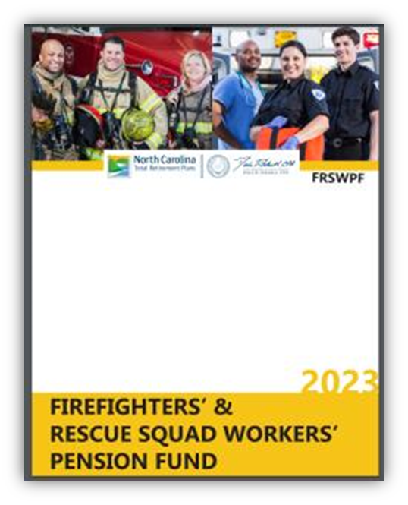
NC Fire and Rescue Pension
Firefighters’ & Rescue Squad Workers’ Pension Fund Handbook
Firefighters’ and Rescue Squad Workers’ Pension Fund (FRSWPF) | My NC Retirement

Slide 47
Firefighters’ & Rescue Squad Workers’ Pension
Definition of a Firefighter –
  G.S. 58-86-2 and titled eligible firefighters: "Eligible firefighter" means all persons 18 years of age or older who are firefighters of the State of North Carolina or any political subdivision thereof, including those performing such functions in the protection of life and property through firefighting within a county or city governmental unit. "Eligible firefighter" shall also mean an employee of a county whose sole duty is to act as fire marshal, deputy fire marshal, assistant fire marshal, or firefighter of the county.
  Requires eligible firefighters to attend 36 hours of training and be certified on the roster each calendar year.

Slide 48
Firefighters’ & Rescue Squad Workers’ Pension
Training Sessions –
  “Training sessions” for eligible firefighters means sessions in which attendance will result in the preparation of, or knowledge gained by, the member in the area of fire prevention, fire suppression, or protection of life and property. Such drill or training sessions held by the eligible fire department to meet the requirements of the Article shall be held for the purpose of providing a learning or preparation experience for the members.

Slide 49
Firefighters’ & Rescue Squad Workers’ Pension
Military Service Exemption –
  You may take a leave of absence for military service and earn service credit during that period if you continue making your Fund contributions during your tour. After your return, you will need to submit a copy of your military discharge papers, such as DD214, that reflect the date you entered and the date you were released from active duty. Contact the Pension Fund for further information and instructions.
  See - NCGS 58-86-95(g)

Slide 50
Firefighters’ & Rescue Squad Workers’ Pension
If you are an active member of FRSWPF and you die in the line of duty, and you have one eligible principal beneficiary named to receive the return of undistributed contributions living at the time of your death, that beneficiary must make a choice to receive a lump-sum return of undistributed contributions or receive a lifetime monthly survivorship benefit (currently $175) beginning the month after the month you would have turned 55.
If you are killed in the line of duty and you are already receiving a monthly FRSWPF retirement benefit, your beneficiary will receive the same amount monthly for life, beginning the month after your death. All monthly survivor benefits end at the death of the monthly survivor beneficiary. No other beneficiaries are eligible for any benefits after the death of the monthly survivor beneficiary.

Slide 51
Firefighters’ & Rescue Squad Workers’ Pension
YOU NEED TO DESIGNATE A BENEFICIARY!!!
  Form 2FR Designating Beneficiary(ies) for the Firefighters’ and Rescue Squad Workers’ Pension Fund.
  It is recommended you complete Form 2FR as soon as possible and return by email to Specialty.Plans@nctreasurer.com.
  Form may also be mailed to: Firefighters’ and Rescue Squad Workers’ Pension Fund Department of State Treasurer 3200 Atlantic Avenue Raleigh, NC 27604

Slide 52
Questions?

Slide 53
Firefighters’ Cancer Program

Slide 54

North Carolina Firefighter Cancer Coverage
A cancer diagnosis can happen at any time and leave you emotionally, physically and financially overwhelmed. While traditional health insurance is valuable coverage, it may not cover all of the expenses related to your treatment and recovery.
The State of North Carolina recognized the need to support its 55,598 firefighters and their families by creating a pilot program to provide certain cancer benefits for eligible employed and volunteer firefighters.

Slide 55

North Carolina Firefighter Cancer Coverage
In response to this requirement, The North Carolina Firefighter Cancer Benefit Program was created to help bridge the financial gaps that may follow a cancer diagnosis, so you can focus on recovery. This program has been funded by the North Carolina Legislature through the 2024-2025 Budget Biennium. It is available to active rostered firefighters, employed and volunteer, who meet certain conditions at no cost to either firefighters or the Fire Departments. The effective date is January 1, 2022. Only compensable cancer illness diagnosed on or after January 1, 2022, will be eligible.

Slide 56
North Carolina Firefighter Cancer Coverage
Active North Carolina Firefighters who have served 5 years on a NC Fire Department prior to diagnosis and are currently on an NCSFA roster may be eligible for benefits under the Firefighter Cancer Benefit Program.
The Cancer must meet the definitions of the program and must have been diagnosed on/after January 1st, 2022.
The Program is administered by the Office of State Fire Marshal utilizing a Third-party administrator.

Slide 57
North Carolina Firefighter Cancer Coverage
Lump Sum Benefit
$37,000 for each diagnosis of cancer
$74,000 Lifetime Maximum Lump Sum benefit
  Excerpt from Session law 2024-29 – Not to exceed a total of seventy-four thousand dollars ($74,000), a lump sum benefit of thirty-seven thousand dollars ($37,000) for each diagnosis of cancer shall be payable to an eligible firefighter upon sufficient proof to the insurance carrier, the Department, the Office of the State Fire Marshal, or other applicable payor of a diagnosis of cancer by a board-certified, licensed physician in the medical specialty appropriate for the type of cancer diagnosed.

Slide 58
North Carolina Firefighter Cancer Coverage
Total Disability Benefit - Overview
Non-Volunteer Firefighters (Class 1)
  75% of Monthly Salary or $5,000 per month, whichever is less
Volunteer Firefighters (Class 2)
  $1,500 per month
Benefit Waiting Period
  36 months after the date of the Total Disability
Maximum Benefit Period
  36 consecutive months

Slide 59
North Carolina Firefighter Cancer Coverage
Total Disability Benefit - Excerpt from Session law 2024-29
Disability benefit. – Upon sufficient proof to the insurance carrier, the Department, the Office of the State Fire Marshal, or other applicable payor of total disability resulting from the diagnosis of cancer or that the cancer precludes the firefighter from serving as a firefighter, the following disability benefits shall be paid to an eligible firefighter beginning six months after the total disability or inability to perform the duties of a firefighter, whichever applies:
  For a non-volunteer firefighter – A monthly benefit that is either (i) equal to seventy-five percent (75%) of the firefighter's monthly salary or (ii) five thousand dollars ($5,000), whichever is less.
  For a volunteer firefighter – A monthly benefit of one thousand five hundred dollars ($1,500).

Slide 60
North Carolina Firefighter Cancer Coverage
For more information, please visit any of these websites:
  https://ncsfa.com/north-carolina-firefighter-cancer-coverage
  https://www.ncosfm.gov/risk-mgmt/north-carolina-firefighter-cancer-benefit-program.
  You can also contact LaTarsha Silver, OSFM Risk Management, at 919.647.0065 and Latarsha.silver@ncdoi.gov for additional assistance.

Slide 61
North Carolina Firefighter Cancer Coverage
Please Note:
  All NCSFA rostered NC Firefighters are protected by the NCSFA LODD Benefit regardless of membership in the association or a local relief fund.

Slide 62
Questions?

Slide 63
Line of Duty Death Benefits
Assistance Program

Slide 64
Line of Duty Death Benefits
The purpose of assistance programs is to assist fire departments and rescue squads in assuring that all state and federal benefits are pursued for the surviving spouse and/or family and provide other services, as requested by the department, squad or family.
Because of the need for correct reporting, action, and follow-up to ensure benefits, handling of LODD’s deserves a separate and detailed discussion.

Slide 65
Line of Duty Death Benefits
Federal Public Safety Officers Death Benefit
On-duty Fatality Defined
LODD recognized cancers are defined in G.S. 143-166.2(c)
Covered Cancers
  Mesothelioma
  Testicular cancer
  Cancer of the small intestine
  Esophageal cancer
  Oral cavity cancer
  Pharynx

Slide 66
Line of Duty Death Assistance – OSFM
The purpose of the LODD assistance program within OSFM is to support fire departments and rescue squads in assuring that all state and federal benefits are pursued for the surviving spouse and/or family, and provide other services as requested by the department, squad or family.

Slide 67
Line of Duty Death Assistance
On-duty fatalities include any injury or illness sustained while on-duty that proves fatal
The term “on-duty” refers to being involved in operations at the scene of an emergency, whether it is a fire or non-fire incident; responding to or returning from an incident; performing other official duties such as training, maintenance, public education, inspection, and investigations
LODD Benefits also may cover heart attacks and strokes that prove fatal, if the onset occurs within 24 hours of a response or training event.

Slide 68
Line of Duty Death Assistance
In NC General Statutes certain cancers are recognized for LODD as defined in G.S. 143-166.2(c). (Requires proof, and is not eligible for federal benefits)
  Mesothelioma
  Testicular cancer
  Cancer of the small intestine
  Esophageal cancer
  Oral cavity cancer
  Pharynx

Slide 69
Your Role As a Chief Fire Officer With an LODD
Call for assistance
Start an information log
Secure all PPE and anything that could be a contributing factor to the death
Appoint someone to handle the press/media
Have a press release prepared

Slide 70
OSFM’s Role Upon Contact
OSFM will notify appropriate Associations and Agencies
  NC Industrial Commission (Worker’s Comp)
  NC Pension Fund
  NC Department of Labor
  NC State Firefighters Association
  NC Fallen Firefighters
  VFIS
  USFA
  NFPA
  NIOSH
  Volunteer Safety Workers Compensation Board or appropriate
  Workers Compensation Carrier
  PSOB

Slide 71
Examples of Required Documentation
Documentation for the deceased:
      Social security card number
      Beneficiary card
      Training records
      Marriage license
      Divorce documents (if applicable)
      Birth certificate/ Adoption papers
      Original Death Certificate
Documentation for the spouse and/or dependent(s):
  Full name(s)
  Address(s)
  Social security number(s)
  Date(s) of birth(s)
  Copies of birth certificate(s)
  Reports needed (all with original signature):
  Law Enforcement
  Toxicology
  Hospital
  Ambulance/1st Responder
  Fire Incident Reports
  Casualty Reports
  Press release and news articles
Statements needed from:
      The chief
      All involved personnel
      Any witnesses

Slide 72
NCFFF’s Role if Requested
If requested by the family, the NC Fallen Firefighters (NCFFF) will assist in planning the funeral and memorial services
Chaplaincy services in conjunction with:
  N.C. State Firefighters’ Association
  N.C. Association of Fire Chiefs
  N.C. Office of State Fire Marshal
Family transport van provided by Hendrick Autogroup
OSFM will arrive on site to assist the department and NCFFF if needed

Slide 73
Contact Information
OSFM
Monday-Friday 8am-5pm
1-800-634-7854
After Hours:
Brian Taylor (919) 218-1511
Mike Williams (919) 368-0643
Deral Raynor (919) 538-5696
  NCFFF
  N.C. Fallen Firefighter Foundation
  P.O Box 144
  Mocksville, NC 27028
  336-416-1752
www.ncfff.org

Slide 74
Private Sector Resources
The Dignity Memorial Public Servants Program offers dignified and honorable tributes at no cost for career and volunteer firefighters, law enforcement officers, and emergency services personnel who fall in the line of duty. The Dignity Memorial Bereavement Program includes various discounts and other benefits. For more information call 919-828-4311 or go to www.ncpublicservants.com.
The Wilbert Burial Vault offers a vault at no charge to the family, for career and volunteer firefighters who fall in the line of duty.

Slide 75
State Fallen Firefighter Memorial
Memorial at Nash Square – Raleigh
  Memorial service held in Raleigh and posted annually
  All NC LODDs approved by General Statute 143

Slide 76
National Fallen Firefighter Memorial
Memorial at National Fire Academy – Emmitsburg, MD
  Memorial service held in Emmitsburg and posted annually
  All LODDs approved for PSOB honored
  Any state LODD recognized for cancer after 1/1/2018

Slide 77
Questions?

Slide 78
NC Peer Support

Slide 79
North Carolina Peer Support
Peer Support Defined
Trained Peer Supporters
Peer Support Access
Peer Supporters On the Continuum of Behavioral Health
Bridge To Other Resources
Common Peer Support Requests

Slide 80
Peer Support Defined
NCPS: Peer Support is defined as assistance provided by a trained individual or group of trained firefighters and emergency responders who answer the call to their brothers and sisters in need, regardless of the need.
Trained Peer Supporters are members of the fire service who seek out and talk to other peers about behavioral health concerns and connect members with helpful services. (IAFF Definition)
Peer Support must be voluntary
Only provided to individuals and groups of firefighters who request it
This makes NCPS different from other services that can be mandated through the chain-of-command

Slide 81
Peer Supporters On the Continuum of Behavioral Health
CISM
Chaplain
EAP
Clinician
Supervisor
Bridge to other resources?

Slide 82
Common Peer Support Requests
“I have been dealing with a lot on my own for a while.”
“my spouse left me?”
Divorce
Drinking
Financial
Loss of connection with family
Grief and loss both at home and through work
Acute traumatic incidents at work

Slide 83
What You Can Do
Listen
When we want to offer the power of a conversation to another. Establish a positive dialog
Validate
When we may not have that same story but know that what they feel makes sense
Relate
When we have a similar story and can relate

Slide 84
What works
Making it SAFE!
Power of a Conversation
No one understands a firefighter like a firefighter
Brothers and Sisters helping one another
Coffee table conversation - You are already doing this
“It is ok to not be ok for today”

Slide 85
What Peer Support Is Not
Peer supporters are not therapist
Peer supporters are not trained counselors
Peer supporters do not offer advice on how to resolve an issue, they offer an open ear and a bridge to resources
Peer support does not take the place of EAP, CISM, or other organizational resources
We are not supposed to “fix”
Peer Support will not work as a mandated service

Slide 86
Urgent Resources
National Hotlines
  Safe Call Now- 24/7 hotline (206) 458-3020, www.safecallnow.org
  National Suicide Prevention Lifeline- 24/7 hotline is now - 988
  Crisis Text line- text “START” to 741741
  www.suicide.org
911
  Call 911 or go to the nearest hospital and let them know you need to see the psychiatrist on call
Critical Incident Stress Debrief Team
  North Carolina Law Enforcement Assistance Program (NC LEAP) - www.nc-leap.org

Slide 87
Urgent Resources
Responder Assistance Initiative
  The Responder Assistance Initiative (RAI) is a service for NC Department of Public Safety personnel and our North Carolina public safety agency partners including Law Enforcement, Fire, Emergency Medical Services, Emergency Management, Telecommunicator/Dispatch or any staff within the Department of Public Safety.
RESPONDER ASSISTANCE INITIATIVE (RAI)
Information & Resource Line
(866) 731-6901
https://www.ncdps.gov/RAI

Slide 88
Nonurgent Resources
North Carolina Firefighter Peer Support
  24/7 hotline (855) 7NC-PEER or www.ncffps.org
  Someone will always answer the phone and get you to the person that can best help you.
  Team members are made up of local NC firefighters who have gone through special peer support training.
First Responder Assistance Program
  (855) 207-1747 or www.BDAEAP.com,
  Resources and referrals to first responders and their families, organization is PROVIDENT and NCSFA.
Share The Load- 1-888-731-3473
  National Volunteer Fire Council: A support program for Fire and EMS.
  NCDOI/ OSFM Behavioral Health Portal http://www.ncdoi.com/OSFM/BehavioralHealthCrisisPortal.aspx

Slide 89
If you at any time have serious concerns about the physical or emotional welfare of an individual, please contact a Mental Health Professional or take appropriate precautions (i.e. hospitalization, etc.) to ensure their safety.
Suicide Is Preventable!
With Help Comes Hope!

Slide 90
Questions?

Slide 91
Gross Premium Assessment

Slide 92
Gross Premium Assessment History
First Established 1907 for the NC Relief Fund
Two GP Taxes on Fire and Lightning Policies existed until 2006 – the original 1.33% that went to the Relief Fund, and ½ 0f 1% originally instituted to fund the Fire and Rescue Workers Pension Fund
  Both were based on Percentage of Insurance coverage Contract.
  The 1.33 went to Relief Fund, ½ of 1% went to Fire and Rescue Pension until a lawsuit by the insurance industry, and was changed where it all went to the General Fund and served to offset F&R Pension appropriation

Slide 93
Gross Premium Assessment History
2006 SL-196 Dropped additional ½ of 1%, removed percentage charts, and set tax rate at .85% which provided the same funding level. Fire Department Grants were added to be funded in addition to Relief Fund and General Fund.
SL 2007-250 dropped .85 to .74 for revenue neutral due to insurance costs overhaul.
PED studies in 2013/2014 Added Workers Comp to distribution- Grants 20%, Relief Fund 20%, VSWCF up to 20%, and residual to the General Fund (~40%).
  These allocations changed again with Session Law 2024-29 (effective 07/01/2025).

Slide 94
Gross Premium Assessment (Previously Know as Gross Premium Tax)
Now referred to as a Gross Premium Assessment rather than Tax
Gross Premium Assessment (GPA)
  GPA Simple Formula= 0.74 Cents Per $100 from any NC insurance policy containing Fire Coverage (i.e. homeowners, rental, auto, etc.)
  NCGS – 105-228.5(d)(3)

Slide 95
Gross Premium Assessment (Previously Know as Gross Premium Tax)
GPA Distribution – effective July 01, 2025 (per Session Law 2024-29)
  Relief Fund – 20% {pursuant to 58-84-25}
  Volunteer Safety Workers Comp Fund – up to 10% {pursuant to 58-87-10}
    Reserve NOT to exceed $45 million
  Firefighters’ Cancer Insurance Program {pursuant to Article 86A of Chapter 58}
    This annual allotment shall not exceed $10 million
  Volunteer Fire Department Grants – 20% {pursuant to Article 87 of Chapter 58)

Slide 96
Gross Premium Assessment (Previously Know as Gross Premium Tax)
GPA Distribution – effective July 01, 2025 (per Session Law 2024-29)
  The remaining net proceeds, including the net proceeds that exceed the limits established in this subdivision for the Workers' Compensation Fund and the Office of the State Fire Marshal, must be credited to the General Fund.

Slide 97
Gross Premium Assessment Collections
(Total Funds Generated)
 | General Fund Proceeds | Volunteer FD Fund (Grants) | DOI Proceeds (Relief Funds) | Worker's Compensation Fund
FYE 2014 | $11,669,480 | $8,335,343 | $6,668,274 | $6,668,274
FYE 2015 | $13,048,028 | $6,511,402 | $6,519,810 | $6,519,810
FYE 2016 | $13,886,360 | $6,943,180 | $6,943,180 | $6,943,180
FYE 2017 | $14,930,125 | $7,465,051 | $7,465,051 | $7,465,051
FYE 2018 | $15,167,614 | $7,583,807 | $7,583,807 | $7,583,807
FYE 2019 | $15,944,093 | $7,972,047 | $7,972,047 | $7,972,047
FYE 2020 | $16,935,251 | $8,467,625 | $8,467,625 | $8,467,625
FYE 2021 | $18,331,067 | $9,165,533 | $9,165,533 | $9,165,533
FYE 2022 | $20,305,464 | $10,152,732 | $10,152,732 | $10,152,732
FYE 2023 | $22,812,053 | $11,406,022 | $11,406,022 | *0
Pursuant to SL2022-6 sec. 1.4; no funds were to be transferred to VSWCF during FY2022-2023

Slide 98
Questions?

Slide 99
Relief Fund

Slide 100
Relief Fund
Originally established in 1907
Created to provide financial assistance to Destitute Firefighters‘ in cities and towns
Statutes have been amended over the years to allow additional benefits and include all rated fire departments
Local Relief Fund Laws are contained in Chapter 58, Article 84 of the General Statutes
Funding is Provided by proceeds from the Gross Premium Tax on Fire Insurance
It is distributed based on County Population and percentage of property protected in a County to each eligible Fire Department

Slide 101
Local Firefighters’ Relief Fund (LFRF) Eligibility
To be eligible to receive funds for a LFRF, the fire department must follow several guidelines –
  First, be a rated department by the Commissioner of Insurance;
  Then, be a member of the NC State Firefighters' Association (GS 58-84-1);
  Next, appoint a Local Relief Fund Board (LRFB) consisting of five members (GS 58-84-30)

Slide 102
Local Relief Fund Board
The Local Relief Fund Board Consists of Five (5) Members –
  (2) Two members elected by the fire department membership who serve at the pleasure of the department. Shall be either residents of the fire district or active or retired members of the fire department.

Slide 103
Local Relief Fund Board
The Local Relief Fund Board Consists of Five (5) Members –
  (2) Two elected or appointed by the Mayor, Board of Alderman, or City Council if it is a municipal department, or two appointed by the County Commissioners if it is a County Fire Department, to serve at the pleasure of the Board. These two positions must reside in the fire district.

Slide 104
Local Relief Fund Board
The Local Relief Fund Board Consists of Five (5) Members –
  (1) One appointed by the Office of State Fire Marshal. The member appointed in this position shall be either a resident of the fire district or an active or retired member of the fire department.
If the local fire chief is not one of the members appointed, they shall serve as an ex-officio non-voting member of the local Board.

Slide 105
Local Relief Fund Board
The Local Relief Fund Board (LRFB), consisting of these five (5) members, shall meet at least annually, and at the first meeting each year elect a Chairperson, Treasurer, and Secretary.
  The Commissioner’s appointee (position 5) does not have to be the Treasurer.
The Treasurer of the Relief Fund MUST be on the roster.
  Please notify NCSFA of any Treasurer change at any time during the year.
  If there is a RF Treasurer change, contact NCSFA.

Slide 106
Local Relief Fund Board
The Secretary and Treasurer may be the same person, but the Treasurer and Chairman cannot be the same since both have to sign for any disbursement, which requires two signatures.
  The two signatures are required by our Bond Insurance.

Slide 107
Local Relief Fund Board
The funds received from the State Fire Marshal shall be maintained by the Treasurer in a separate and distinct fund, the balance and use of which shall be reported annually to the NC State Firefighters' Association.
  Each year a good and sufficient surety bond must be purchased equal to the amount held.
  The Office of State Fire Marshal purchases one bond for all FRF accounts each year which covers up to $1 million.
  A LRFB Treasurer may assume a statewide bond covers their account unless it exceeds $1 million.
All funds received and any investments earned on these funds, regardless of where they are held, must be reported!

Slide 108
North Carolina Firefighters Relief Fund; Rules and Benefits
Managing Relief Fund Monies – The LRFB shall manage the local funds as prudent trustees of the fund as listed in Chapter 36E of the NC General Statutes.
Board members should review these requirements completely, but basically it requires:
  In managing and investing the fund, the LRFB shall consider the purpose of the fund and the uses allowed by law.
  Each person responsible for managing and investing the fund shall manage and invest the fund in good faith and with the care an ordinarily prudent person in a like position would exercise under similar circumstances.

Slide 109
North Carolina Firefighters Relief Fund; Rules and Benefits
Immunity to Board Members –
  GS 58-84-60 also provides immunity to members serving on the LRFB individually from civil liability for monetary damages as long as, they are acting within the scope of their responsibility in good faith, have not acted with gross negligence or wanton misconduct, and not derived any improper personal financial benefit.

Slide 110
North Carolina Firefighters Relief Fund; Rules and Benefits
Fund Management – Finance Reporting
  The LRFB must keep a correct and accurate account of all monies received and dispersed by them, including annual distributions, interest, and holdings, and report same to the NCSFA annually. (GS 58-84-40). This accounting shall include all monies received and disbursed, all interest earned, and include all monies allocated to the fund for any use. The report must also include a listing of disbursements, and the amount disbursed in each allowable expenditure, and the number of firefighters impacted by each disbursement.
  This must be reported online to the State Firefighters’ Association by the Treasurer, in a format prescribed by them, by October 31st of each year.
    Failure to do so will forfeit the payment the LFRF will receive the following year.

Slide 111
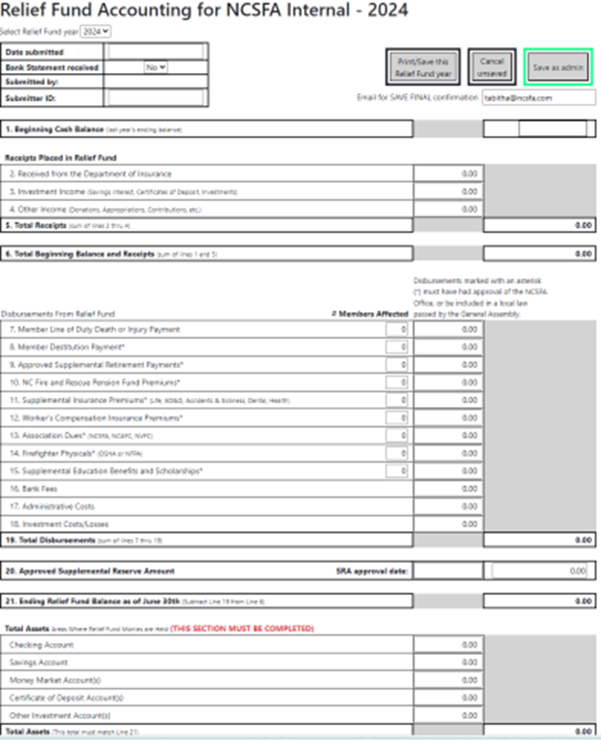
Relief Fund Financial Reporting – By the Treasurer
Financial Reporting Form
Must be completed and submitted electronically between July 1 and October 31 annually.
Must contain all relief fund related activities between July 1 of the previous year and June 30 of the current year.
NOTE: Must use the relief fund treasurer’s 6-digit username and password to gain access to this report.

Slide 112
Local Relief Annual Requirements
File annual report electronically between July 1 and October 31 with NCSFA.
Submit bank statements to support the financial report with NCSFA by October 31.
Chief to certify the Board of Trustees (BTR) by January 15 each year. Remember discussion under required rosters earlier?

Slide 113
Local Relief Fund Disqualification
If a department fails to do any one of the previous 3 items, they will be “disqualified” and will not receive their share of funds in the Fall of the next calendar year.
  Their amount will be distributed to the NCSFA for deposit in the State-wide Relief Fund.
  NCSFA uses these funds to pay scholarships and purchase LODD & AD&D insurance.

Slide 114
Financially Sound Balance and Maximum Balances
The Minimum and Maximum Balances of the LRFB established by law are as follows:
  The Minimum (or financially sound) amount before funds can be used = $500 per member on the roster or $20,000, whichever is greatest
  The Maximum amount before loss of additional funding = $2,500 per member

Slide 115
Local Relief Fund Maximum Balances
The Maximum Balance is calculated by taking the member count from the January 1st roster filing and multiplying by $2,500.00
  Therefore, a department should know before June 30th what their Maximum amount is and can act to be compliant by year end.
What if the June 30th balance in the fund is over the maximum allowed balance?
  You will not receive your allocated amount in the Fall of the next calendar year.
  Your amount will be reallocated among other eligible departments within your County .

Slide 116
North Carolina Firefighters Relief Fund; Rules and Benefits
Allowable Uses of the Fund
The following uses of the fund are considered the primary purpose of the fund and are allowable after the LRFB has reviewed and approved them without NCSFA approval:
  1. To assist financially any firefighter in active service for a sickness or injury contracted in the line of duty. The amount is dependent on need and availability of funds as determined by the LRFB upon review and the annual earning capability of the individual.

Slide 117
North Carolina Firefighters Relief Fund; Rules and Benefits
Allowable Uses of the Fund
The following uses of the fund are considered the primary purpose of the fund and are allowable after the LRFB has reviewed and approved them without NCSFA approval:
  2. To provide reasonable support to family or dependents of a firefighter who may lose their life in the line of duty by accident or sickness. The amount is dependent on need and availability of funds as determined by the LRFB upon review and the annual earning capability of the individual.

Slide 118
North Carolina Firefighters Relief Fund; Rules and Benefits
Allowable Uses of the Fund
The following uses of the fund are considered the primary purpose of the fund and are allowable after the LRFB has reviewed and approved them without NCSFA approval:
  3. (Program no longer available) To pay premiums in the Fraternal Insurance Fund of NC if the firefighter is a member and the LRFB has determined the firefighter cannot pay for reasons of disability.

Slide 119
North Carolina Firefighters Relief Fund; Rules and Benefits
Allowable Uses of the Fund
The following uses are allowable after the LRFB has reviewed and approved them, and a request is made to, and approval has been given by the Executive Director of the NC State Firefighters' Association.
The reason for the review and approval of the NCSFA Executive Director is to insure it is an allowable use, the fund is "financially sound" or stable, and the use will not reduce the funds to an extent where they would not be available for uses 1), 2) and 3) –

Slide 120
North Carolina Firefighters Relief Fund; Rules and Benefits
Allowable Uses of the Fund
The following uses are allowable after the LRFB has reviewed and approved them, and a request is made to, and approval has been given by the Executive Director of the NC State Firefighters' Association.
  4. If a firefighter becomes financially destitute, the LRFB can request the use of funds to be used to assist the firefighter. Destitution must be through no fault of the firefighter (i.e., gambling, poor investments, reckless spending, unwillingness to work, etc., would not be considered), and is defined as the inability to provide basic provisions to themselves or their families. Such basic provisions include but are not limited to, assistance with housing, vehicle or commuting expenses, food, clothing, utilities, medical care, and funeral expenses. The amount is dependent on need and availability of funds as determined by the LRFB upon review and approval of the Executive Director.

Slide 121
North Carolina Firefighters Relief Fund; Rules and Benefits
Allowable Uses of the Fund
The following uses are allowable after the LRFB has reviewed and approved them, and a request is made to, and approval has been given by the Executive Director of the NC State Firefighters' Association.
  5. Upon approval of the LRFB and a request made, and approval given by the Executive Director of the NC State Firefighters' Association, the payment of monthly assessments in the NC Firefighters' and Rescue Workers Pension Fund is allowed.

Slide 122
North Carolina Firefighters Relief Fund; Rules and Benefits
Allowable Uses of the Fund
The following uses are allowable after the LRFB has reviewed and approved them, and a request is made to, and approval has been given by the Executive Director of the NC State Firefighters' Association.
  6. Upon approval of the LRFB and a request made, and approval given by the Executive Director of the NC State Firefighters’ Association, the payment of workers compensation premiums are allowed, including those to the NC Volunteer Safety Workers Compensation Fund.

Slide 123
North Carolina Firefighters Relief Fund; Rules and Benefits
Allowable Uses of the Fund
The following uses are allowable after the LRFB has reviewed and approved them, and a request is made to, and approval has been given by the Executive Director of the NC State Firefighters' Association.
  7. Upon approval of the LRFB and a request made, and approval given by the Executive Director of the NC State Firefighters’ Association, the payment of premiums for other types of insurance and pension protection for firefighters. For example, dues to the NC State Firefighters’ Association or the NC Assoc. of Fire Chiefs, NVFC dues, are allowed since these associations provide LODD, AD&D, and scholarship programs for firefighters otherwise eligible for relief fund benefits.

Slide 124
North Carolina Firefighters Relief Fund; Rules and Benefits
Allowable Uses of the Fund
The following uses are allowable after the LRFB has reviewed and approved them, and a request is made to, and approval has been given by the Executive Director of the NC State Firefighters' Association.
  8. Upon approval of the LRFB and a request made, and approval given by the Executive Director of the NC State Firefighters’ Association, educational benefits to firefighters and their dependents are allowed. These are generally in the form of scholarships that allow application and a fair access to all members and dependents.

Slide 125
North Carolina Firefighters Relief Fund; Rules and Benefits
Allowable Uses of the Fund
The following uses are allowable after the LRFB has reviewed and approved them, and a request is made to, and approval has been given by the Executive Director of the NC State Firefighters' Association.
  9. Upon approval of the LRFB and a request made, and approval given by the Executive Director of the NC State Firefighters' Association, annual physicals that are required for firefighter positions by the Department of Labor, or recommended by the National Fire Protection Association. While not intended to supplement fire department operational costs, this is intended to help ensure that firefighter safety is paramount and that necessary physicals may be given in the absence of available fire department funding.

Slide 126
North Carolina Firefighters Relief Fund; Rules and Benefits
Allowable Uses of the Fund
The following uses are allowable after the LRFB has reviewed and approved them, and a request is made to, and approval has been given by the Executive Director of the NC State Firefighters' Association.
  10. One of the most complex uses of the fund, upon approval of the LRFB and a request made, and approval given by the Executive Director of the NC State Firefighters’ Association, is the use of relief fund monies for a supplemental retirement fund. This requires significant planning and future projections, a stable fund balance, and other controls requiring more detailed review. It is addressed in more detail in the following discussion “Establishing and Maintaining a Supplemental Retirement Program Within Your Local Relief Fund.”

Slide 127
North Carolina Firefighters Relief Fund; Rules and Benefits
The request for approval from the NCSFA Executive Director to utilize local funds must be submitted in writing (email, letter, fax), must be approved by the LRFB first, and the LRFB must provide any detail needed by the Executive Director to make the decision. Examples of information needed for submittal include, but may not be limited to:
    Type of proposed use and if the use is repetitive
    Amount to be used (once or annually)
    Name of individual firefighter(s) affected
    Dates of LRFB approval and dates of implementation
    Projections on future needs for the same use (i.e. scholarships).

Slide 128
North Carolina Firefighters Relief Fund; Rules and Benefits
Maximum Balances
One exception to this maximum is the establishment of a Supplemental Retirement Account
  Contact the Executive Director at the NCSFA if you are interested in establishing one.
New Maximum Balance Exception: Supplemental Retirement Account (SRA)
  A board of trustees of a local Firefighters' Relief Fund may, with the authorization of and under guidelines provided by the North Carolina State Firefighters’ Association, dedicate a portion of the local Firefighters' Relief Funds to a Supplemental Retirement Program.

Slide 129
North Carolina Firefighters Relief Fund; Rules and Benefits
Relief Fund Changes 2015
New Definition of Firefighter added. Firefighter – Any person who meets all of the following requirements:
  Is a volunteer, employee, contractor or member of a rated and certified fire department and;
  Performs work or training connected with fire protection, fire prevention, fire control, fire education, fire inspection, fire investigation, rescue, Emergency Medical Services, special operations or performs the statutory duties and responsibilities of the Fire Chief as set forth in N.C.G.S. 160A-292 and; Performs work or training at the direction of the fire chief and;
  Is included on the certified roster submitted to the NCSFA pursuant N.C.G.S. 58-86-25.

Slide 130
North Carolina Firefighters Relief Fund; Rules and Benefits
Additional Information
Regardless of the type of account in which they are held, relief funds cannot be hidden and must be reported on the annual financial report, and all funds must be administered by the Local Relief Fund Board
Since 2015, all N.C. rostered firefighters are now protected by the NCSFA LODD benefit regardless of membership in the association. The NCSFA AD&D coverage and educational benefits are not included in this statutory requirement for LODD coverage

Slide 131
North Carolina Firefighters Relief Fund; Rules and Benefits
Additional Information
Even if you are over, you maximum, submit a report to insure you are eligible to use your fund and nor disqualified.
If your Treasurer changes during the year, notify NCSFA.

Slide 132
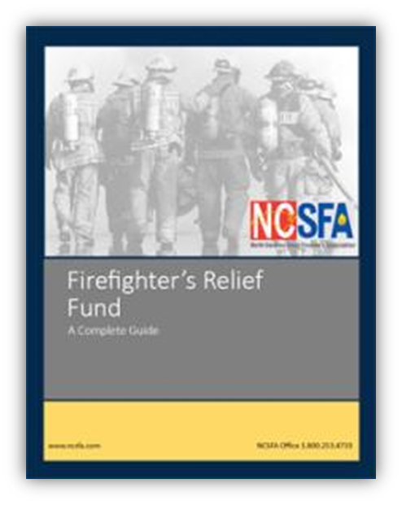
North Carolina Firefighters Relief Fund; Brochure
This brochure can be downloaded in either Word or PDF format by going to NCSFA.com, under “The Relief Fund Tab”

Slide 133
Gross Premium Assessment Collections
(Total Funds Generated)
 | General Fund Proceeds | Volunteer FD Fund (Grants) | DOI Proceeds (Relief Funds) | Worker's Compensation Fund
FYE 2014 | $11,669,480 | $8,335,343 | $6,668,274 | $6,668,274
FYE 2015 | $13,048,028 | $6,511,402 | $6,519,810 | $6,519,810
FYE 2016 | $13,886,360 | $6,943,180 | $6,943,180 | $6,943,180
FYE 2017 | $14,930,125 | $7,465,051 | $7,465,051 | $7,465,051
FYE 2018 | $15,167,614 | $7,583,807 | $7,583,807 | $7,583,807
FYE 2019 | $15,944,093 | $7,972,047 | $7,972,047 | $7,972,047
FYE 2020 | $16,935,251 | $8,467,625 | $8,467,625 | $8,467,625
FYE 2021 | $18,331,067 | $9,165,533 | $9,165,533 | $9,165,533
FYE 2022 | $20,305,464 | $10,152,732 | $10,152,732 | $10,152,732
FYE 2023 | $22,812,053 | $11,406,022 | $11,406,022 | *0
Pursuant to SL2022-6 sec. 1.4; no funds were to be transferred to VSWCF during FY2022-2023

Slide 134
FAQs
  Who has control of the relief fund money?
    The Local Relief Fund Board of Trustees.
  My department is owned and operated by municipal government. Do they control the relief fund?
    No. The Local Relief Fund Board of Trustees controls the funds.
  Can equipment or other purchases be made with relief fund money?
    No. N.C.G.S. 58-84-35 defines how the fund can be used.

Slide 135
FAQs
Who appoints the Relief Fund Board of Trustees?
  The fire department elects two representatives, the City and/or County appoints two representatives, and the N.C. Insurance Commissioner selects one representative. One of the five board members will be elected to serve as the Relief Fund treasurer.
Do the Relief Fund Board Members have to be residents of the fire district?
  The two fire department appointees & one N.C. Insurance Commissioner appointee shall be residents of the fire district, active members, or retired members of the fire department. The two City/County Commissioner appointees shall be residents of the fire district.

Slide 136
Questions?

Slide 137
Workers Compensation

Slide 138
Workers Compensation Benefits
Workers Compensation Benefits are normally purchased through three
different methods:
For Municipal Fire Departments they are normally secured through the NC League of Municipalities
Any department may purchase through private carriers called assigned risk
Non-Municipal Departments can purchase through the NC Volunteer Safety Workers Compensation Program.

Slide 139
North Carolina Volunteer Safety Workers Compensation Fund
The fund was established by NCGS 58-87-10
Definitions –
  Eligible unit. – A fire department or rescue/EMS unit that (i) is not part of a unit of local government and (ii) is exempt from State income tax under G.S. 105-130.11.
Creation –
  The Workers' Compensation Fund is created in the Office of State Fire Marshal as an expendable trust fund. Accordingly, interest and other investment income earned by the Fund accrues to it, and revenue in the Fund at the end of a fiscal year remains in the Fund and does not revert.

Slide 140
North Carolina Volunteer Safety Workers Compensation Fund
The fund was established by NCGS 58-87-10
Use
  Revenue in the Workers' Compensation Fund shall be used to provide workers' compensation benefits to (i) members of eligible units and (ii) the employees and volunteers of eligible entities. Workers Compensation law defined in Chapter 97 of the General Statutes governs the payment of benefits from the Fund. Benefits are payable for compensable injuries or deaths that occur on or after July 1, 1996.
Rates
  Rates are set by the NC Fire and Rescue Commission annually, and are significantly lower, particularly for career and part-time employees, than the private or assigned risk market.

Slide 141
Worker’s Compensation - Benefits
Workers Compensation $460,000 – $690,000 This benefit is calculated at a specific rate equaling 2/3 of his/her weekly wages for 500 weeks.
Presently the maximum rate is $1,380 for career emergency personnel and a minimum rate of $920 (2/3 of the maximum) for volunteer emergency personnel.
Benefits for minor age beneficiaries are also figured for 500 weeks or until age of 18, whichever is longer.
Part-time emergency personnel rate would be based on the salary paid for those part-time hours worked for the previous 12 months.

Slide 142
Gross Premium Assessment Collections
(Total Funds Generated)
 | General Fund Proceeds | Volunteer FD Fund (Grants) | DOI Proceeds (Relief Funds) | Worker's Compensation Fund
FYE 2014 | $11,669,480 | $8,335,343 | $6,668,274 | $6,668,274
FYE 2015 | $13,048,028 | $6,511,402 | $6,519,810 | $6,519,810
FYE 2016 | $13,886,360 | $6,943,180 | $6,943,180 | $6,943,180
FYE 2017 | $14,930,125 | $7,465,051 | $7,465,051 | $7,465,051
FYE 2018 | $15,167,614 | $7,583,807 | $7,583,807 | $7,583,807
FYE 2019 | $15,944,093 | $7,972,047 | $7,972,047 | $7,972,047
FYE 2020 | $16,935,251 | $8,467,625 | $8,467,625 | $8,467,625
FYE 2021 | $18,331,067 | $9,165,533 | $9,165,533 | $9,165,533
FYE 2022 | $20,305,464 | $10,152,732 | $10,152,732 | $10,152,732
FYE 2023 | $22,812,053 | $11,406,022 | $11,406,022 | *0
Pursuant to SL2022-6 sec. 1.4; no funds were to be transferred to VSWCF during FY2022-2023

Slide 143
Questions?

Slide 144
Fire and Rescue Grants

Slide 145
NC OSFM Fire and Rescue Grants
Fire Grants
The size of a grant may not exceed forty thousand dollars ($40,000).
  Departments who receive less than or equal to fifty thousand dollars ($50,000) per year from municipal and/or county funding are not required to match the grant funding.
  Departments receiving more than fifty thousand dollars ($50,000) but less than or equal to seventy-five thousand dollars ($75,000) per year from municipal and/or county funding shall match one dollar ($1.00) for each three dollars ($3.00) of grant funds (3:1 match).
  Departments that receive more than seventy-five thousand ($75,000) per year from municipal and/or county funding shall match the grant on a dollar-for-dollar basis (50/50 match).

Slide 146
NC OSFM Fire and Rescue Grants
Fire Grants
Eligibility
  Fire departments must be rated/certified by the NC OSFM Fire Ratings & Inspections section.
  Fire Department must enter the Total number of hours for paid/part-time employees in the Last fiscal year. (Total hours worked divided by 2080 equal full-time positions)
  Fire Department must report to the recognized incident reporting system.
  Be primarily volunteer with no more than 8 paid positions

Slide 147
NC OSFM Fire and Rescue Grants
Fire Grants
Application Timeline
  January 2: All rated Fire Departments are notified that the application is available.
  March 1: Deadline to submit application.
  May 15: Grant recipients announced.
  September 30: Invoices and forms must be submitted to NC OSFM to receive payment.

Slide 148
NC OSFM Fire and Rescue Grants
Fire Grants
Recipient Selection
  Applications are computer scored by point system.
  Funding from N.C. Department of Revenue is entered into database.
  Computer selects applications with the lowest score (greatest need) until the available funding is exhausted.

Slide 149
NC OSFM Fire and Rescue Grants
Fire Grants
Fraudulent Activity
  Entering falsified budget information.
  All income must be reported on the grant application. This includes the total agency budget to include salary for all paid staffing including benefits. Including fund raiser, donations, and EMS Billing.
  Applying for items and then purchasing other items without getting approval from OSFM.
  Providing falsified information for payment (e.g., using software to change the word quote to invoice and never receiving equipment).
  Returning grant funded equipment and requesting a refund or trading out equipment for different items. All equipment must be accounted for up to five years after the grant.

Slide 150
Fire Grant – Fraudulent Activity
Entering falsified budget information. All income must be reported on the grant application. This includes the total agency budget to include salary for all paid staffing including benefits
Applying for items and then purchasing other items without getting approval from DOI

Slide 151
Fire Grant – Fraudulent Activity
Providing falsified information for payment
  EX. using software to change the word quote to invoice and never receiving equipment.
Returning grant funded equipment and requesting a refund or trading out equipment for different items. All equipment must be accounted for for up to five years after the grant

Slide 152
Fraudulent Activity - Case Studies
Case excerpt #1 –
A complaint was filed with OSFM that a county had set up a way to help fund the 50/50 grants if they were received by adding the 50% to the Department budget after they had received the grant. This was to keep the reported amount of each departments budget lower to get better scoring on the grant application. This is not how it was intended to work, so after an investigation the departments had to forfeit the grant funds since this changed the scoring process for budgets. To alleviate this issue the county finance directors are responsible now to enter the actual amounts the county give each department for the previous year on an annual basis within the program.

Slide 153
Fraudulent Activity - Case Studies
Case excerpt #2 –
A concern was filed that a department had falsified the grant application on the number of paid personnel that were being employed. The department was taken off the eligibility list. The program requires not only to give the total full time paid personnel but also the hours paid per year for all part time employees. The program is now set to calculate this based on the total hours provided by the applicant. This is a major concern to make sure all the information is correct so that all eligible departments can receive the grant funding.

Slide 154
Fraudulent Activity - Case Studies
Case excerpt #3 –
A complaint was filed that a department was using grant funds to purchase items other than what they had applied for and were getting vendors to give false invoices. The department had to repay all the funds received. To alleviate this issue the inspectors are doing a full review of the equipment within the last 5 years at each inspection they perform.
Point out - these funds are Insurance monies and any misuse or false information could result in criminal charge of Insurance fraud.

Slide 155
Gross Premium Assessment Collections
(Total Funds Generated)
 | General Fund Proceeds | Volunteer FD Fund (Grants) | DOI Proceeds (Relief Funds) | Worker's Compensation Fund
FYE 2014 | $11,669,480 | $8,335,343 | $6,668,274 | $6,668,274
FYE 2015 | $13,048,028 | $6,511,402 | $6,519,810 | $6,519,810
FYE 2016 | $13,886,360 | $6,943,180 | $6,943,180 | $6,943,180
FYE 2017 | $14,930,125 | $7,465,051 | $7,465,051 | $7,465,051
FYE 2018 | $15,167,614 | $7,583,807 | $7,583,807 | $7,583,807
FYE 2019 | $15,944,093 | $7,972,047 | $7,972,047 | $7,972,047
FYE 2020 | $16,935,251 | $8,467,625 | $8,467,625 | $8,467,625
FYE 2021 | $18,331,067 | $9,165,533 | $9,165,533 | $9,165,533
FYE 2022 | $20,305,464 | $10,152,732 | $10,152,732 | $10,152,732
FYE 2023 | $22,812,053 | $11,406,022 | $11,406,022 | *0
Pursuant to SL2022-6 sec. 1.4; no funds were to be transferred to VSWCF during FY2022-2023

Slide 156
NC OSFM Fire and Rescue Grants
Fire Grants
Grants and Relief Fund Contact Information –
  For any questions, please the OSFM at 919.647.0000 or by email at FireRescueGrants@ncdoi.gov.

Slide 157
NC OSFM Fire and Rescue Grants
Rescue Grants
Rescue organizations will match the grant on a dollar-for-dollar basis, up to $25,000.
Organizations having cash assets over $1,000 may apply for the matching fund, up to $25,000.
Organizations having cash assets less than $1,000 may apply for a non-matching grant, up to $3,000.

Slide 158
NC OSFM Fire and Rescue Grants
Rescue Grants
Rescue Grant Funds can be used to:
  Assist fire departments and rescue squads in the most need.
  Purchase equipment.
  Make capital improvements.
  Help departments and squads improve rescue and EMS services.
  Rescue Grant Requests vs. Awards

Slide 159
NC OSFM Fire and Rescue Grants
Rescue Grants
Rescue Grant – Funding Per Year
  The Volunteer Rescue/EMS fund is funded by 18 cents of each vehicle inspection sticker.

Slide 160
NC OSFM Fire and Rescue Grants
Rescue Grants
Grants are subject to the following priority order:
  Rescue units
  Rescue/EMS units
  EMS units that are licensed as EMS providers under G.S. 131E-155.1
  EMS units that are volunteer fire departments that are a part of a county’s EMS system plan.

Slide 161
NC OSFM Fire and Rescue Grants
Rescue Grants
For the grant, “EMS unit” means either:
  an EMS provider licensed under G.S 131E-155.1 or
  a volunteer fire or fire/rescue department that is part of its county's EMS system plan. The unit or squad must comply with existing State statutes and with eligibility criteria established by the North Carolina Association of Rescue and Emergency Medical Services, Inc.

Slide 162
NC OSFM Fire and Rescue Grants
Rescue Grants
Eligibility
  Rescue/EMS organizations must:
    Meet the criteria of N.C. Association of Rescue & EMS. You do not have to be a member of the NCAREMS to be eligible to apply.
    Be primarily volunteer with no more than 10 full time equivalent paid positions.

Slide 163
NC OSFM Fire and Rescue Grants
Rescue Grants
Application Timeline
  Aug. 1: Fire/Rescue/EMS chiefs are notified that the application is available.
  Oct. 1: Deadline to submit application.
  Dec. 15: Grant recipients announced.
  April 30: Invoices and forms must be submitted to N.C. Department of Insurance to receive payment.

Slide 164
NC OSFM Fire and Rescue Grants
Rescue Grants
Recipient Selection
  Applications are computer scored on a points system.
  Funding from DMV entered into database.
  Computer selects applications with the lowest score (greatest need) until the available funding is exhausted.

Slide 165
NC OSFM Fire and Rescue Grants
Rescue Grants
Grants and Relief Fund Contact Information –
  For any questions, please the OSFM at 919.647.0000 or by email at FireRescueGrants@ncdoi.gov.

Slide 166
NC OSFM Fire and Rescue Grants
Additional Grant Information
Purchased Equipment with Grant Funds
  If equipment purchased with grant funds is disposed of within five years of the date of the grant award funding its purchase, then the grant recipient shall reimburse the appropriate fund the amount of matching funds used for the purchase of the equipment, less depreciation.

Slide 167
NC OSFM Fire and Rescue Grants
Additional Grant Information
Transfer of Purchased Equipment
  If a grant recipient shall cease to exist within five years of the date of award of the grant, it shall transfer, subject to the approval of the N.C. Office of State Fire Marshal, any and all equipment purchased with such grant funds to whichever department shall assume responsibility for providing service to the grant recipient's area of service or to another appropriate department that may effectively use the equipment.

Slide 168
FAQs
  What type of equipment can we apply for?
  Personal Protective equipment, vehicles (no SUVs), buildings, computers, or other miscellaneous equipment used to help department lower rating.
  What items are not typically approved through the Fire Grant?
  Training aids, physicals, physical fitness equipment, furniture, uniforms. If in doubt, call NCDOI.
    Rescue equipment through fire grant
  Is backordered equipment allowed?
  No. Backordered equipment received/invoiced after April 30th will not be paid.

Slide 169
FAQs
  Does the rescue/EMS provider have to wait until September 30 to submit the invoices?
  No. Upon delivery of all of the approved equipment, you may submit the invoices. Check requests are made to the controller’s office each Friday.
Are extensions allowed?
No. The Rescue Grant application must be submitted no later than October 1, and invoices must be submitted no later than April 30. Exceptions on invoices include 30 days for delivery of turnout gear, and 5 months for vehicles or buildings.

Slide 170
FAQ’s
  My fire department/rescue squad is owned and operated by a municipality. Can we apply?
  Yes. The department must serve a population of 12,000 or less.
    My department provides fire protection and rescue services. Do we provide only information regarding the fire service?
    No. Information for the entire entity must be provided.
  Does the fire department/rescue squad have to request the full amount?
  No. We will match dollar-for-dollar up to the maximum amount.

Slide 171
FAQ’s
      Can the fire department/rescue squad order the equipment prior to the grant’s announcement date?
      No. Equipment ordered prior to the first day the grant opens will not be honored.
  Can the fire department/rescue squad purchase used/refurbished/reconditioned equipment?
  No. Equipment purchases must be new. Exception: Used vehicles with one year service/maintenance records.
  Do I have to be at the light rescue level to be eligible for the grant?
  No. The administrative code does not specify being at the light level, only that you meet the criteria set forth by the Association of Rescue and EMS.

Slide 172
Questions?

Slide 173
Resources & Associations

Slide 174
OSFM State Emergency Response Team
In the event of a large-scale emergency in North Carolina, the N.C. Fire Service Emergency Response Plan is available to provide for the systematic mobilization, deployment, organization and management of fire-based resources.
The initial/primary source for determination of available resources will be the State Emergency Response Team (SERT) inventory database.

Slide 175
OSFM State Emergency Response Team
There are two methods to enter resources into the SERT inventory database.
  (1) periodic department NCRRS rating surveys conducted by NCDOI / OSFM.
  (2) individual fire department to update their information via the NCDOI / OSFM website.
The chief of the department makes the final decision as to what resources are available for deployment to any request for the department.

Slide 176
OSFM State Emergency Response Team
Changes are to be made by the fire department chief.
You will need to have your department’s username and password. This information is emailed/mailed to the fire chief and should be retained by the fire chief and not shared with other members.

Slide 177
OSFM State Emergency Response Team
It is important that if there are any changes in the chief, the new address, email, or phone number be sent to us as soon as possible.
Should you have any questions regarding the SERT equipment updates, please contact Mike Williams via email: mike.williams@ncdoi.gov.

Slide 178
OSFM State Emergency Response Team
Data entry required:
  A copy of the NIMS Typing Guide For Apparatus
  Equipment specifications: make, model, pump size, tank size, etc
  Other helpful information: NCAFC Emergency Response Plan
  NCAFC Field Guide for the Emergency Response Plan

Slide 179
Questions?

Slide 180
Background Checks

Slide 181
NC Firefighters Background Checks
All individuals 18 years of age or older applying to serve as a firefighter in NC, career or volunteer must have a criminal background check before being accepted.
Based on statute, certain felonies automatically deny the ability of the FD to accept the applicant. These are usually associated with Arson or unlawful burning laws.
Other convictions allow the department to refuse the applicant based on their criminal history.

Slide 182
NC Firefighters Background Checks
Any new applicant as a North Carolina Firefighter on any department, career or volunteer, must have a criminal background check performed prior to serving as a firefighter. These requirements are covered under NC General Statute GS 143B-943.
These background checks may be performed through the NC Department of Public Safety, or the NC State Bureau of Investigations by providing fingerprints.

Slide 183
NC Firefighters Background Checks
An applicant is prohibited from serving in a paid or volunteer position with a fire department if the applicant's criminal history record check reveals a conviction of arson or another felony conviction involving burning or setting fire under Article 15, Article 22, or any other Article of Chapter 14 of the General Statutes.

Slide 184
NC Firefighters Background Checks
A requesting entity shall request, and an applicant shall disclose, any pending felony charges involving burning or setting fire under Article 15, Article 22, or any other Article of Chapter 14 of the General Statutes.
  Upon becoming aware of pending felony charges, through the required disclosure or by other means, a requesting entity shall not offer the applicant a paid or volunteer position.
These requirements are covered under NC General Statute GS 143B-943. Refer to NCGS for the legal requirements.

Slide 185
State Resident Exception for Background Checks
State Resident Exception: Any individual applicant who attest to the fact of no previous charges or convictions, and third-party has resided in NC for the prior 5 years may use one of the following methods:
  A Criminal History Check through the Department of Public Safety or SBI utilizing fingerprints
  A statewide criminal history check utilizing a third-party vendor
  A statewide criminal history check conducted and certified by the Clerk of Court, at the Clerks discretion. Most Clerks will likely ONLY run criminal history checks for their own county and wont report out for other counties.
  Applicants under the age 18 are exempt from criminal history checks.

Slide 186
Questions?

Slide 187
OSFM Training Programs

Slide 188
Fire Service-Related Training Resources
Available Training Programs
  NC Office of State Fire Marshals
  NC Community College System (Local College)
  NC State Firefighters’ Association
  National Volunteer Fire Council
  International Association of Fire Chiefs
  NC Association of Fire Chiefs
  National Association of State Fire Marshalls
  National Fire Academy
  NC Society of Fire and Rescue Instructors

Slide 189

OSFM Training Programs

Slide 190
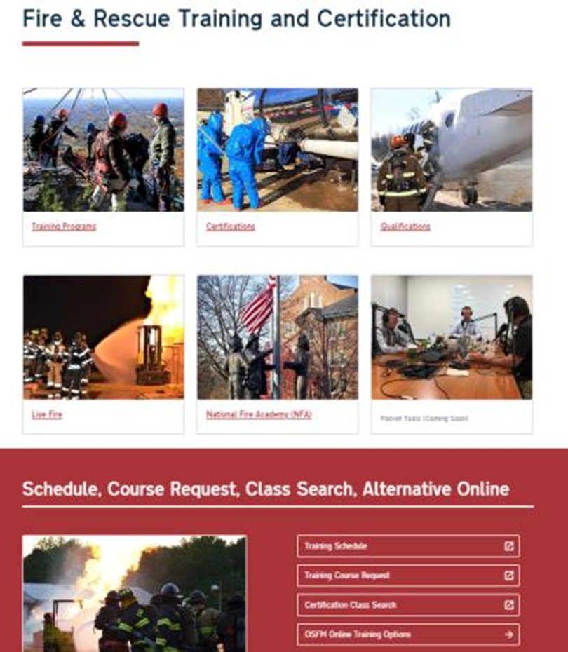
Training Requests
In order to facilitate Fire Rescue training requests, OSFM has developed an easy-to-use request system.
If on OSFM Training website: https://www.ncosfm.gov/fire-rescue/fire-rescue-training-and-certification choose “Training Course Request”

Slide 191
Fire and Rescue Certification
Fire and Rescue Certification Classes are under the NC Fire and Rescue Commission, which is given guidance by a Certification Board they appoint to oversee the development of classes, instructors, etc.
Most certification classes such as Firefighter, Driver Operator, Rescue Technician, etc., are delivered through local Community Colleges, or in the case of larger departments, direct delivery agency status.

Slide 192
Classification of Training Courses
  Direct Delivery
      All National Fire Academy courses.
      Specialized training developed by OSFM, such as Live Fire Instructor Program, Rapid Intervention Training, NC OSFM Instructor III, Fire Investigation Technician, Hazmat Tech, and Fire Officer III & IV certifications.

Slide 193
Classification of Training Courses
  Qualification
      Qualification School
      Field delivered qualifications, such as: Chief 101, Technical Rescuer Specialties, Live Fire Instructor, Rapid Intervention Crew, NFA, and many others.

Slide 194
Classification of Training Courses
  Ratings and Inspections
    Preparing for a Ratings Inspection

Slide 195
NC Firefighter Training
  NFPA 1403 (Standard on Live Fire Evolutions) –
    The NC Fire & Rescue Commission, or State Fire Marshal, does not certify to or have a certificate for a NFPA 1403. The pre-requisite classes listed in the 1403 standard are only for live fire training participation. They have nothing to do with the State of NC Certification system and should not be considered a minimum level of training to engage in interior structural fire ground operations.

Slide 196
NC Firefighter Training
  LIVE FIRE TRAINING EVOLUTIONS (FRC Policy 200.14)
  Scope - This policy shall establish guidelines, for the live fire training evolutions, as approved by the North Carolina Fire and Rescue Commission (Commission). This policy will address the various aspects of the program and applies to any live fire training evolutions conducted in acquired structure, and ONLY applies to live fire training structures/props when used for Commission sanctioned courses/programs. (a) Live fire training evolutions conducted as part of any Commission certification program must comply with the requirements of this rule.

Slide 197
NC Firefighter Training
  LIVE FIRE TRAINING EVOLUTIONS (FRC Policy 200.14)
    General Definitions
    1. Live Fire – Any unconfined open flame or device that can propagate fire to the building, structure, or other combustible materials.
    2. Training Structure –
    a. Acquired Structure – A building or structure acquired by the authority having jurisdiction (AHJ) from a property owner for the purpose of conducting live fire training evolutions.
    b. Live Fire Training Structure – A structure specifically designed for conducting live fire training evolutions on a repetitive basis.

Slide 198
NC Firefighter Training
  LIVE FIRE TRAINING EVOLUTIONS (FRC Policy 200.14)
    General Definitions
    3. Prop - a. Any prop shall produce live fire as defined by NFPA 1402. NFPA 1402 - 3.3.22 Live Fire. Any open flame capable of emitting thermal load or toxic by-products of combustion that would necessitate the use of personal protective equipment (PPE).

Slide 199
NC Firefighter Training
  LIVE FIRE TRAINING EVOLUTIONS (FRC Policy 200.14)
    Student Prerequisites and Age
    1. The 2018 edition of NFPA Standard 1403 requires that: “Students participating in live fire training evolution who have received the required minimum training and prerequisites from other than the authority having jurisdiction shall not be permitted to participate in any live fire training evolution without presenting prior written evidence of having successfully completed the prescribed minimum training to the levels specified in 4.3.1 (required minimum training) and 4.3.2.1 through 4.3.2.5 (prerequisites).”

Slide 200
NC Firefighter Training
  LIVE FIRE TRAINING EVOLUTIONS (FRC Policy 200.14)
    Student Prerequisites and Age
    2. Student, or participant, shall be at least 18 years of age to participate in live fire delivered by any Commission approved Delivery Agency and/or led by any qualified live fire (or LP Gas instructor). ID’s will be checked by qualified instructors before allowing students to participate in the live fire training. Signatures on Form 200.14A validates that the student is at least 18 years old and have successfully completed the above required minimum training and prerequisites.

Slide 201
NC Firefighter Training
  LIVE FIRE TRAINING EVOLUTIONS (FRC Policy 200.14)
    Student Prerequisites and Age
    2. Student, or participant, shall be at least 18 years of age to participate in live fire delivered by any Commission approved Delivery Agency and/or led by any qualified live fire (or LP Gas instructor). ID’s will be checked by qualified instructors before allowing students to participate in the live fire training. Signatures on Form 200.14A validates that the student is at least 18 years old and have successfully completed the above required minimum training and prerequisites.

Slide 202
NC Firefighter Training
  TRD0070 - Volunteer Fire Officer ISO580C Training Credit
    It was approved in the March 2020, NC Fire and Rescue Certification Board meeting that any person who successfully completes the Fire Officer level 1 certification course should receive NC Office of State Fire Marshal TRD0070 - Volunteer Fire Officer ISO 580C training credit. Meeting the prerequisites for Fire Officer Level 1 Certification are not required. Only successful completion of a FIP 3718 - Fire Officer Level 1 course will grant this credit.

Slide 203
NC Firefighter Training
  TRD0070 - Volunteer Fire Officer ISO580C Training Credit
    This credit gives Fire Departments the availability to train their volunteer fire officers to a NFPA 1021 based program, while gaining credit toward ISO credit. A person may continue to pursue the NC Fire Officer Level 1 Certification if they successfully complete the prerequisites, which can be found here: Fire Officer Certification Page (OSFM Website).
    Fire Officer | OSFM

Slide 204
NC Firefighter Training
  580G program has been implemented.
    FF Recruit training option.
  C- School sessions will be offered, in conjunction with already scheduled Q Schools.
  Program guidance has been drafted, and information will be released if/when request are received.
  Please assist with statewide distribution by details on the additional route to certification.

Slide 205
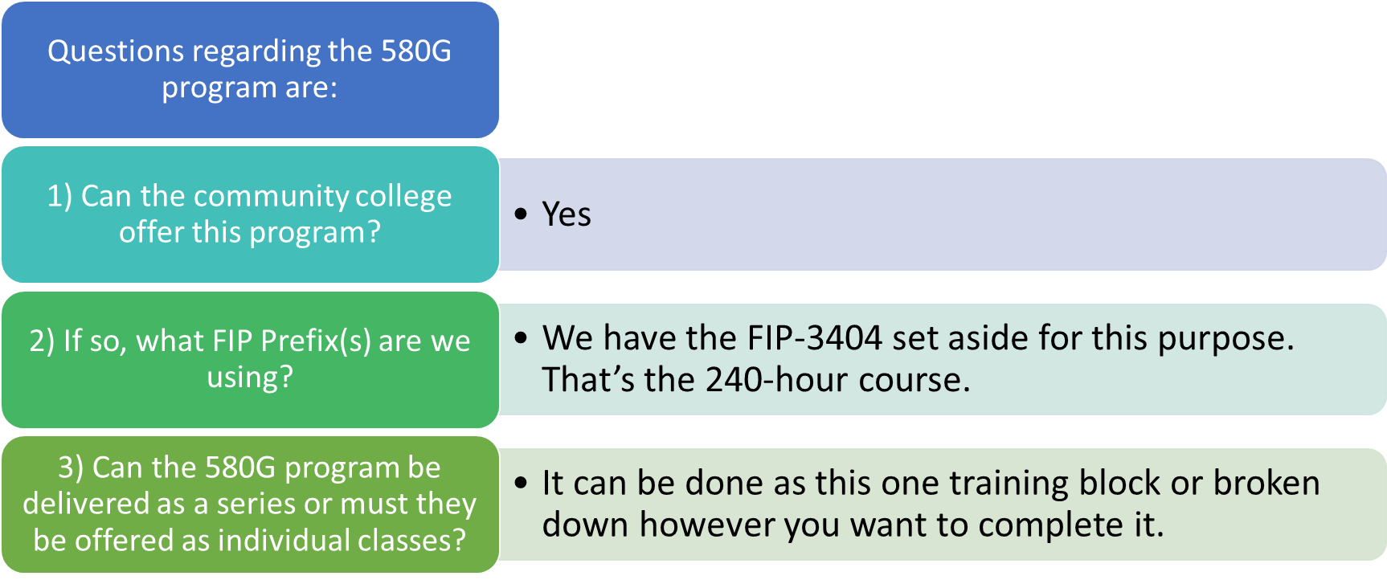
NC Firefighter Training

Slide 206
Questions?

Slide 207
NC Associations

Slide 208





State Associations

Slide 209
Regional Associations
N.C. Eastern Carolina Firefighters Association
www.encfa.org
N.C. Piedmont Firefighters Association:
www.pncfa.org
Western N.C. Association of Firefighters:
www.wncaff.com

Slide 210
Questions?

Slide 211
Safety, OSHA & NFPA

Slide 212
OSHA and NFPA
  Identify the requirements set forth by OSHA that pertain to volunteer, career and combination fire departments.
  Identify the requirements set forth by NFPA that pertain to volunteer, career and combination fire departments.

Slide 213
OSHA
The N.C. OSHA program is administered by the N.C. Department of Labor, not the N.C. Department of Insurance or the N.C. Office of State Fire Marshal.
Contained in N.C. General Statutes G. S. 95-131
N.C. OSHA Regulations must meet or exceed Federal OSHA Regulations.

Slide 214
OSHA Duty Clause
SEC. 5 (a) Each employer:
  shall furnish to each of his employees employment and a place of employment which are free from recognized hazards that are causing or are likely to cause, death or serious physical harm to his employee;
  2) shall comply with occupational safety and health standards promulgated under this Act.
SEC. 5 (b) Each employee shall comply with occupational safety and health standards and all rules, regulations, and orders issued pursuant to this Act which are applicable to his own actions and conduct.

Slide 215
National Fire Protection Association
Non-Profit Corporation
Develops consensus standards through an intricate committee process
Standards are not laws, but can carry the weight of laws if adopted by enforcement agencies such as OSHA.

Slide 216
Parallel Standards
OSHA
General Industry
Standard
NFPA
Fire and Rescue
Specific
Standard

Slide 217
Standard of Care
  Defined as the level of competency anticipated or mandated during the performance of a service or duty
The last 50 years have taught us:
  Potential impacts are limitless
  There are options in operational approaches
  Initial responders need competency
  Development of a Standard of Care has occurred

Slide 218
Standard of Care
Influenced by:
  Laws
  Regulations
  Standards
  Guidance
  Knowledge
  Experience

Slide 219
Negligence
Defined as “performance outside of the accepted Standard of Care.”
  If elements of the Standard of Care are not followed, it could be considered negligence.
  Negligence can be by the individual, an officer, the organization, or the employer.

Slide 220
Gross Negligence
Defined as “willful failure to meet the Standard of Care.”
  Can be applied to individuals or organizations.
  Remember that ignorance of the law (Standard of Care) is no excuse.
  Example: Personnel not required to wear appropriate PPE.
  Example: Failure to train.

Slide 221
Standard of Care & Liability
Remember that by operating within the Standard of Care we, as responders, will not need to worry about legal implications.

Slide 222
Questions?

Slide 223
North Carolina Response Rating System

Slide 224
Definitions
Fire Insurance District (G.S. 153A-233) - An area outside corporate limits with boundaries approved by the County Board of Commissioners for fire insurance purposes. It is NOT supported by either a referendum type fire tax (G.S. 69.25) or a special service district tax (G.S. 153A-300).

Slide 225
Definitions
Rural Fire Protection District (G.S. 69-25) - An area outside corporate limits with boundaries designated by petition of 35% of the resident free-holders, in which a fire tax not to exceed $ 0.15 per $ 100.00 valuation, has been authorized by the resident qualified voters within the district.

Slide 226
Definitions
Fire Service District (G.S. 153A-300) - An area outside corporate limits, with boundaries approved by the County Board of Commissioners, in which a fire tax is levied without referendum for fire protection services. Such district or districts may include territory within corporate limits if approved by resolution of the municipal governing body.

Slide 227
NC Fire Districts By Type (2025)

Slide 228
Fire Department Status in NC (2025)

Slide 229
Fire Department Ratings (2025)

Slide 230
Impact of being Non-Certified
Insurance Premiums Will Increase
Loss of Potential Residential Development
Loss of Potential Commercial Development
Loss of Local Funding Tied To Property Development
Not Eligible for the Pension Fund
Not Eligible for the Fireman’s Relief Fund
Not Eligible for the Fireman’s Death Benefit - N.C.
Not Eligible for the Grants

Slide 231
Certification of Fire Districts
The Administrative Rules are contained in the following chapter for 9S requirements:
  SECTION .0900 – Public Protection Classifications FOR FIRE DISTRICTS
  To Meet the 9S / 9E Requirements for Fire Departments in North Carolina the following slides will cover the requirements for 9S ratings.

Slide 232
Charter and Amendments
The inspector will need to scan the Charter and any Amendments
The Inspector will need to scan a copy of the departments FEIN.

Slide 233
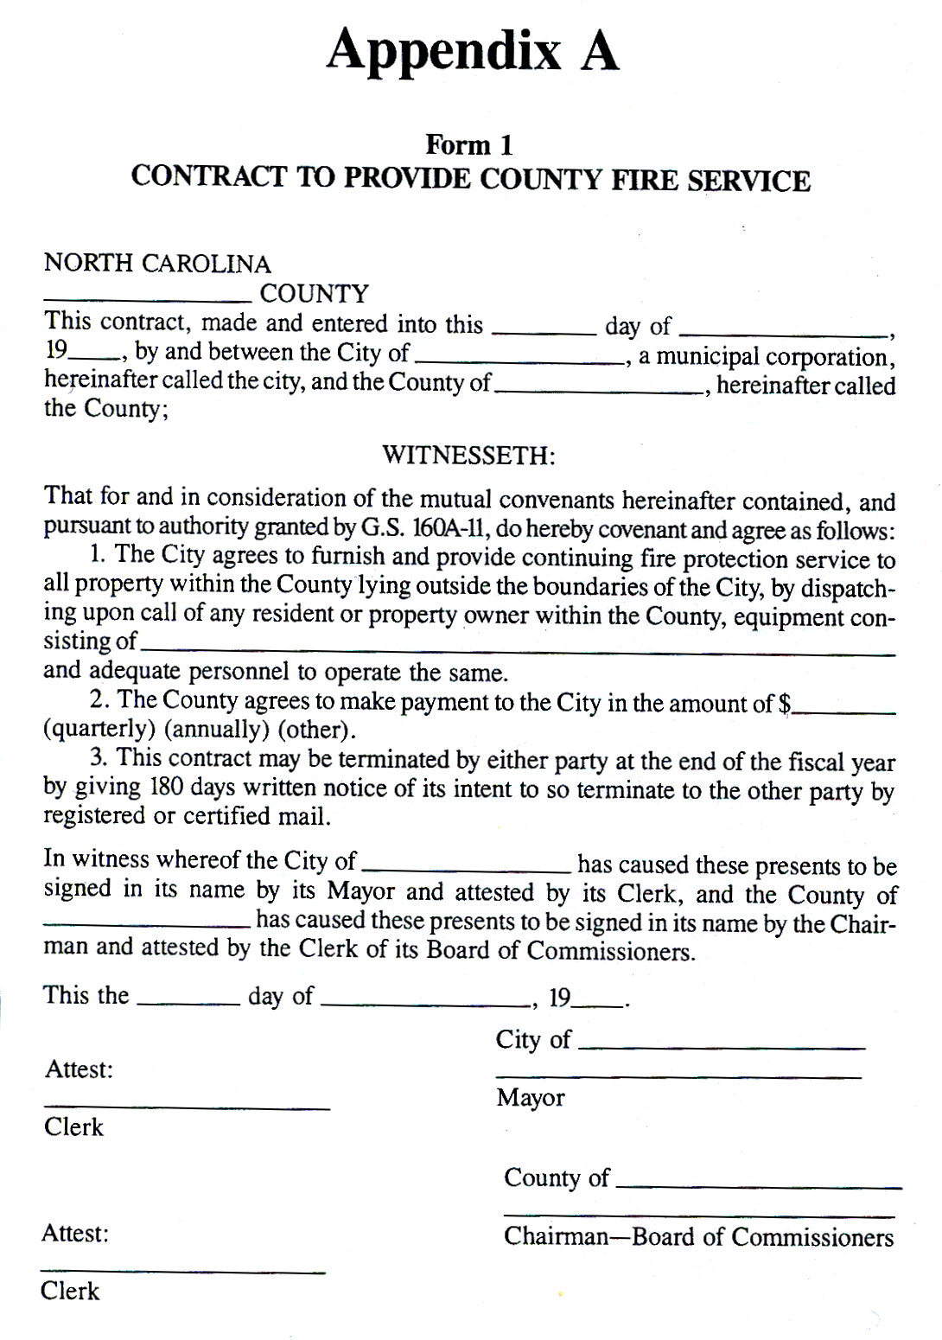
Current Contracts
The inspector will need to scan all current county and/or municipality Contracts (must be properly signed and dated).
Taken from the minutes of the _________ County
Board of Commissioners on _________,
The _______ presented a written description and map of the _______ Fire District which are set out in full in the minutes. He
indicated that the Commissioners needed to approve the description and map
prior to certification and map had been approved by the NC Department of
Insurance. Commissioner ___________ made the motion to approve
the map and description of the ____________ Fire District which was
seconded by Commissioner _________ and passed by unanimous vote.
_______ _____________________________
County Clerk to the Board
(Affix County Seal Here)
The inspector will need to scan the most current County Commissioner approval of Insurance District Map

Slide 234
Verification
WHEREAS, The Volunteer Fire Department of the Town of _________ is a
part of the town’s municipal government and serves as an agency of the town; and
WHEREAS, The Volunteer Fire Department of the Town of ________ has
requested confirmation of this Agency relationship; and
WHEREAS, This Agency’s relationship is longstanding and generally
acknowledged.
NOW THEREFORE, Be it resolved, that the Town of __________ does hereby
confirm this Agency’s relationship and does verify by this Resolution that relationship.
Adopted this ________ day of ________, 19___.
ATTEST:
________________________________
Clerk Mayor
Verification by City/Town, that the department is part of the municipality can be verified by
  Resolution
  Letter from the city or town Mayor, Town Administrator or City or Town Manger
  Established City or Town Charter
GIS Map of your district to include all station locations with proper road base.

Slide 235
Boundary Extensions
A rural fire district may extend it’s boundaries to more than 5 road miles but no more than 6 road miles from the primary fire department’s Insurance District Lines (An established automatic aid agreement for at least one piece of apparatus carrying a minimum of 1000 gallons of water is required to extend the district).

Slide 236
Department Rosters
The inspector will verify the Current Fire Department Roster of Members to include the Names and Date of Birth for all “Eligible Firefighters” as defined in G. S. 58-86-2 (5).
The roster submitted to the NCSFA pursuant to G.S. 58-86-25 may be used for this section.
Each fire department shall provide workers compensation insurance for all eligible firefighters.

Slide 237
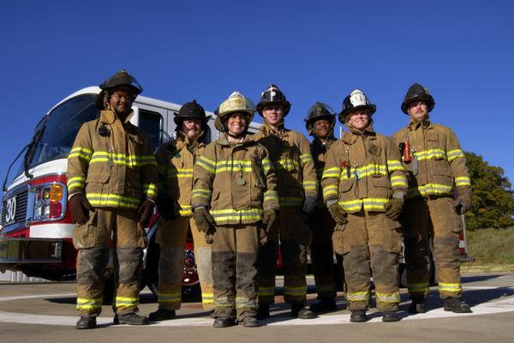
Personnel Requirements
All creditable personnel must be 18 years of age
15 “Eligible Firefighters” needed for a single station department
For each additional station, 4 more “Eligible Firefighters” are required
The department shall provide each “Eligible Firefighter” the following equipment:
  Pants
  Coat
  Helmet
  Boots
  Hood
  Gloves

Slide 238
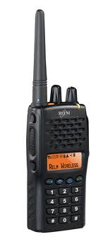
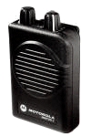
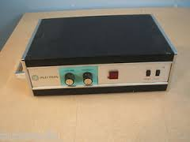
Personnel Communications Requirements
If the department does not use a siren, then each firefighter shall be equipped with a pager, or some type of radio that has paging capabilities, to notify the firefighters of a call.

Slide 239
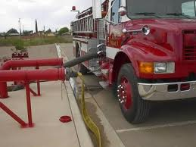
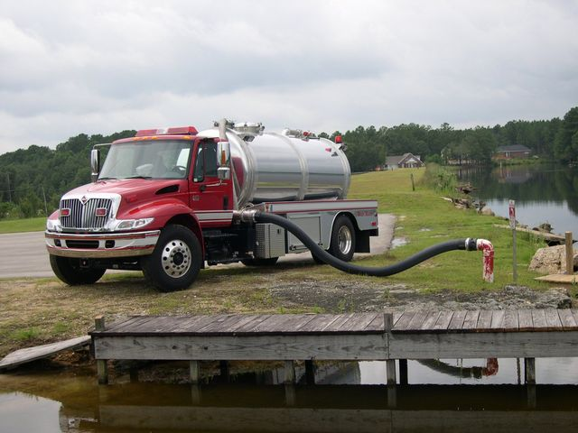
Engine Requirements
Engine Requirements
  A signed and dated pump test conducted in the last 12 months
  750 GPM UL approved fire pump
  300 gallon water tank (minimum)
  Monthly maintenance check-off sheets
  Monthly inventory of equipment check-off lists
Tanker Requirements
  Minimum 1,000 Gallon Water Capacity
  Adequate Hose for Filling & Dumping
  Properly Baffled per NFPA 1901
  1 – Traffic Vest for each riding position
  Monthly Inventory & Maintenance Check off sheets

Slide 240
Engine Equipment Requirements
    (1) Pick Head Axe
    (1) Flat Head Axe
    (1) Forcible Entry Tool
    (1) 6’ Pike Pole or Plaster Hook
    (2) Hand Light (rechargeable)
    (2) Class BC Portable Extinguishers @ 20 lb. minimum
    (1) 2.5 Gallon Water Extinguisher
    (1) First Aid Kit
    (1) Bolt Cutter (min 14” handles)
    (1) Portable Radio
    (1) Traffic Vest for each riding position
    (1) 100’ Utility Rope at least ½” in diameter
    (2) 200’ 1 1/2” or 1 3/4” pre-connected attack line with nozzle attached
    (2) 10’ sections of ‘suction’ hose or 15’ of soft suction hose at least 4”in diameter
    (4) SCBAs & (4) spare cylinders
    (1) Roof Ladder at least 12’
    (1) Extension Ladder at least 24’
    (1) Folding Ladder

Slide 241
Fire Station Requirements
The Fire Station building shall provide suitable heating, as well as all weather protection, of the department’s response equipment.
Before the inspection of a new fire station can be conducted, the fire department must provide the following:
  Proof of Certificate of Occupancy
  New maps with insurance district lines and county resolution.
A fire department that has multiple fire stations, each fire station cannot be more than 10 road miles from another fire station within the fire district.

Slide 242
Training
Fire departments shall provide at least 4 hours of training per month, for a total of 48 hours per year.
All “Eligible Firefighter” of fire departments shall comply with the training requirements of G.S. 58-86-2 as a minimum.(effective 12/01/2013).
The fire departments shall provide training records to verify that the “Eligible Firefighters” obtained the required 36 hours of training. No more than 12 hours of Medical training may be counted toward the 36 hours.
The Fire Chief shall have attended the Chief 101 class within 12 months of becoming chief.

Slide 243
Recognized – National Reporting System
When a fire department responds to a fire, a chief of that fire department shall complete or cause to be completed a fire incident report on the current electronic version of the NFIRS/NERIS in accordance with G.S 58-79-45
A fire department shall keep records on dates, times, and locations of all fires.
All reports shall be submitted to OSFM within 120 days of the occurrence.
When a fire department responds to a fire involving fatalities, an initial report shall be filed by the district fire chief or fire marshal within 48 hours of the incident to the N.C. Office of State Fire Marshal.
The Report Civilian Fire Causality Form is located on OSFM 24.

Slide 244
Response to Structure Fires
The primary fire department shall ensure the response of four “Eligible Firefighters” and one engine to all structure fires and fire alarms in structures with fire damage. Firefighters responding from an automatic department cannot be counted as one of the four.
The fire department responding to a structure fire shall have a plan to provide a minimum flow of 200 GPM for 20 minutes within 5 minutes of the first arriving engine.

Slide 245
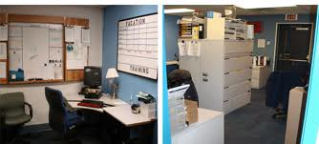
Electronic Records
The department must have a policy in place ensuring documentation cannot be tampered with or edited by unauthorized personnel
The department must have a policy describing the method in which they back up the documentation

Slide 246
Non-Compliance Procedure
The department must submit a corrective action plan within 30 days of the day of the inspection
Upon receipt of the corrective action plan the department will have 6 months to become compliant
If, after 6 months and the department is still in non-compliance OSFM will consult with the governing body of the fire department and place the fire department on probation for a period not to exceed 6 months

Slide 247
Non-Compliance Procedure
Upon completion of the probation period OSFM will re-inspect the fire department for compliance
If a fire department remains non-compliant, OSFM shall designate the department a PPC 10 (non-certified)

Slide 248
Certification of Fire Districts
Helpful Documents for departments
  9S Rating Requirements
  https://www.ncosfm.gov/nc-administrative-code/open
  Fire Suppression Rating Schedule
  Contact your inspector on how to obtain a copy
  Pre-Survey Worksheets
  https://www.ncosfm.gov/ratings-pre-survey-workbook

Slide 249
Office of State Fire Marshal
Fire Rating Staff
Tony Bailey(Inspections Supervisor) tony.bailey@ncdoi.gov
Vernon Ward (Senior Field Inspector) vernon.ward@ncdoi.gov
Deral Raynor deral.raynor@ncdoi.gov
Terry Young terry.young@ncdoi.gov
Jeremy Hunt jeremy.hunt@ncdoi.gov
Brian Cox brian.cox@ncdoi.gov
Lee Kennedy lee.kennedy@ncdoi.gov
John Whitfield john.whitfield@ncdoi.gov

