Slide 1

North Carolina
Code Officials Qualification Board
Education & Research Committee
March 12, 2025, MEETING AGENDA
Introduction
Roll Call/Conflict of Interest Reminder
Board Course Development Update (legacy/new)
Standard Certificates
Post 1/1/2025 applications and certificates
Public Comment
6. Adjournment
Chair, Danny Couch
Andy Matthews
Montrena Hadley
Kenny Weatherington
Joshua Robbins

Slide 2
Ethics & Conflict of Interest
ETHICS AWARENESS & CONFLICT OF INTEREST REMINDER
In accordance with the State Government Ethics Act, it is the duty of every NC Code Officials Qualification Board member to avoid both conflicts of interest and appearances of conflict.
Do any NC Code Officials Qualification Board members have any known conflict of interest or potential of conflict with respect to any matters coming before the NC Code Officials Qualification Board, Education and Research Committee today?
If so, please identify the conflict or potential of conflict and refrain from any undue participation in the particular matter involved.
Let the minutes show that members of the Board who are certified code enforcement officials are reminded that the State Ethics Commission has cited the potential for a conflict of interest because they serve on the Board that certifies them. Board members should exercise appropriate caution in the performance of their public duties should issues involving their certifications or that of any of their employees come before the Board. This would include recusing themselves to the extent that their interests would influence or could reasonably appear to influence their actions.

Slide 3
3. Board Course Development Update
  2024 Code updates “LEGACY” courses
  2025 Rule changes New “Residential/Commercial” courses Level I & II
  Board course Descriptions and Hours to NCCCS – recommended/maximum
RECOMMENDATIONS GOING FORWARD

Slide 4
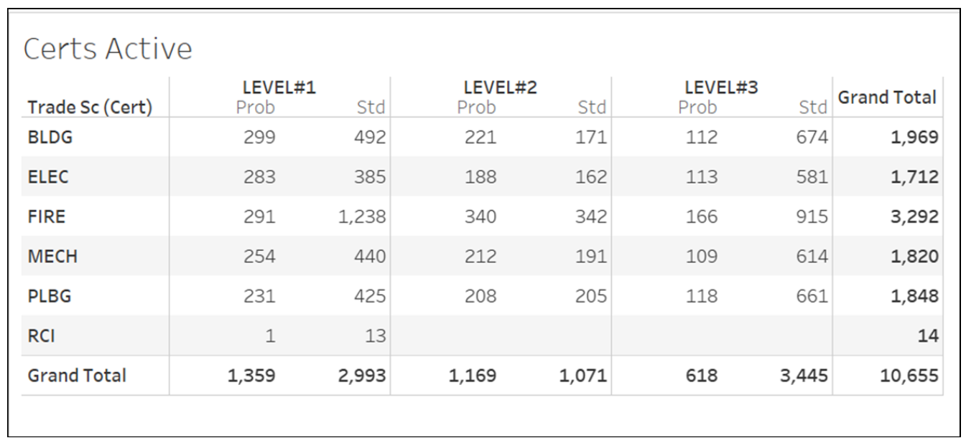
How many “legacy” probationary inspectors?
RESIDENTIAL

Slide 5
RECOMMENDATIONS FOR 2025 - staggered
(assumes new 2024 code books avail in March)
Courses
  Continue teaching “legacy” courses 2018 vs 2024 through December 31, 2025*
  *Deploy new Law and Admin July 1, 2025
  *Deploy new Fire Level I, II, III July 1, 2025
  *Deploy new Building Level I (Residential) July 1, 2025
  Deploy other new 2024 courses as they become available – Level II & III minor changes?
State Exams
  Continue PSI admin of “legacy” exams 2018 vs 2024 through December 31, 2025*
  *Pilot new Law and Admin July 1, 2025, 80 test item, 2 hr via Supplemental LMS Moodle
  *Pilot new Fire Level I, II, III July 1, 2025, 120 test item, 3 hr, 1.5 min/item
  Deploy other new 2024 exams as they become available – Level II & III minor changes?

Slide 6
3. Board Course Development Update
Law & Admin – UNC SOG Code Officials Handbook DRAFT; Online 40-question practice and 80-question EOC/State Exam
Fire – L1 36, L2 32, L3 24 (N/C)
Building – L1 48, L2 48, L3 40
Mechanical – L1 32, L2 32, L3 24
Plumbing – L1 32, L2 32, L3 24
Electrical – L1 48, L2 40, L3 32
RCI – Residential Changeout Inspector – 40 (N/C)
Permit Tech – Board course development – 28

Slide 9
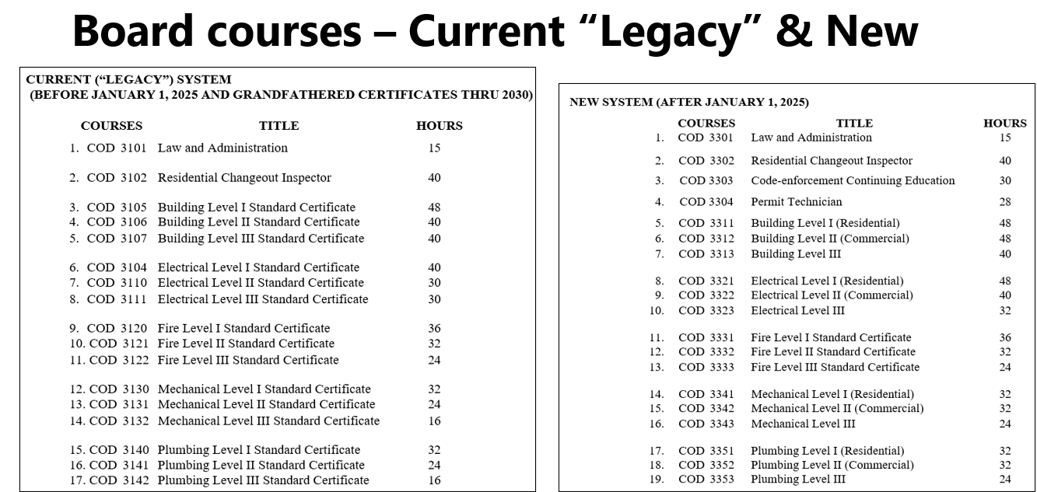

Slide 10
What’s it take to make a Board course?
Syllabus – schedule, references, assignments
Slide presentations
Student worksheets
End-of-Course (EOC) tests, proctored, timed
State exams, proctored, timed

Slide 11
Law & Administration – legacy course update
2024 NC Administrative Code & Policies
Chap 3. insert 2024 NC Gen. Statutes Pertaining to Administration of the NC State Building Code.
UNC SOG Code Officials Handbook DRAFT
Articulate course LMS Moodle
40-question practice
80-question EOC/State Exam remotely proctored

Slide 12
BL1 (RESIDENTIAL)
2024 NC RESIDENTIAL CODE
80-question EOC
120-question State Exam

Slide 13
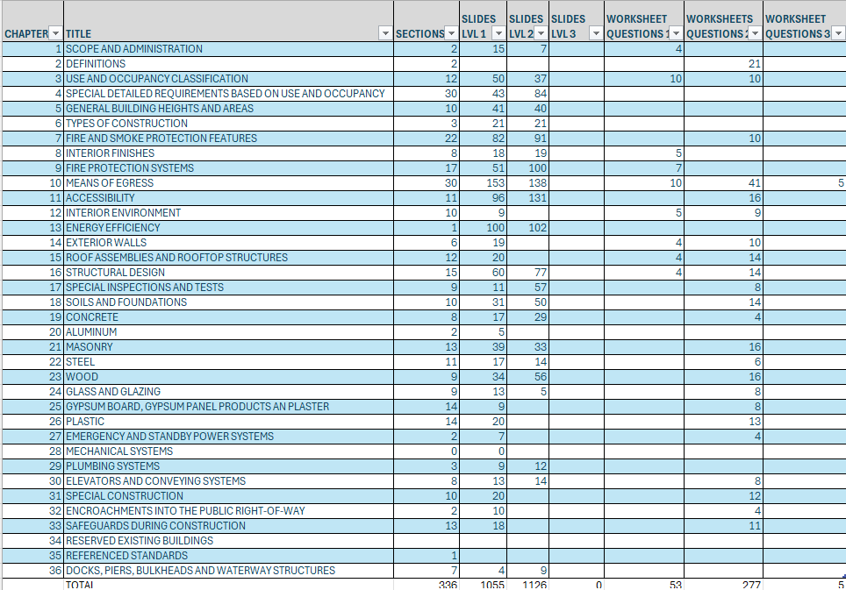
BL1 (COMMERCIAL)
2024 NC BUILDING CODE
80-question EOC
120-question State Exam

Slide 14
4. Standard Certificates
  CE Percentage Completion Update
  Education Coordinators Update
  Roster Submissions Board Courses since 7/1/24

Slide 15
5. Post January 1, 2025, applications and certificates
  CE Percentage Completion Update
  Education Coordinators Update
  Roster Submissions Board Courses since 7/1/24

Slide 16
6. Public Comment

Slide 17
7. Adjournment

